Slide 1
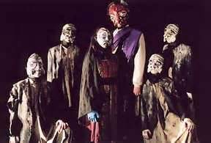
SOPHOCLES’ ANTIGONE
BACKGROUND OF THE FOUNDING OF THEBES
W. D. GRIFFIN, JR

Slide 2
The Olympian Gods
The first-born of Cronus and Rhea was Hestia, followed by Hades, Poseidon, Demeter, Hera and Zeus, who was the last-born. They were the first six Olympian gods. Zeus was the king of the gods, Poseidon ruled the seas and earthquakes, and Hades, the Underworld. They were joined by the Children of Zeus: Ares and Hephaestus (Hera), Athena (Metis), Apollo and Artemis (Leto), Hermes (Maia), Aphrodite (Dione) and Dionysius (Semele). After receiving the Underworld as his realm, Hades was no longer considered an Olympian. Dionysus replaced Hestia as an Olympian after his birth.

Slide 3
The Lesser Olympians
The lesser Olympians were Hestia, the goddess of the hearth who was replaced by Dionysius; Asclepius, the god of medicine and the son of Apollo and Coronis; Hebe, the daughter of Zeus and Hera who was the cupbearer of the gods until replaced by Ganymede; Persephone, the daughter of Demeter and wife of Hades; and, Heracles who married Hebe upon attaining immortality.

Slide 4
Recurring Themes in Greek Mythology
The gods appeared as archetypal images of human traits, i.e. passion (Aphrodite), familial relationships (Hera), nature (Demeter)
What happens to man is the result of the will of the gods and appropriate sacrifices and rituals must be made to the gods
The gods punish ordinary men and heroes alike for excessive pride or hubris (theme of all Greek tragedies and epic poetry)
Heroes, such as Heracles, Odysseus or Theseus, possess
extraordinary elements linked to his birth and childhood
In order to reach the Underworld, one must receive some form of burial rites
Zeus is often referred to as God
The role of the female in Greek society was to raise the children: females into adulthood and the males until they were old enough for the father to educate them in the rules of society (generally around the age of 7)

Slide 5
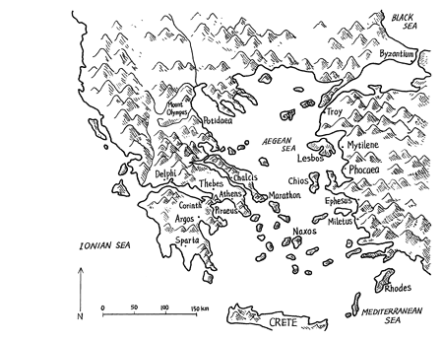
Map of Ancient Greece

Slide 6
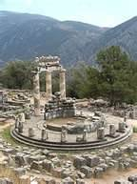
The Founding of Thebes
Thebes was first named Cadmeia after its founder, Cadmus, son of Agenor and Telephassa, and sister of Europa
Zeus abducted Europa in the form a bull and carried her to Crete
Cadmus was sent with his mother by Agenor to find Europa
Telephassa died during the search, prompting Cadmus to seek advice from the oracle of Apollo at Delphi
The oracle told Cadmus to follow a certain cow until she laid down from weariness; and there to sacrifice her to the gods and found a new city on that spot near the river Ismenos

Slide 7
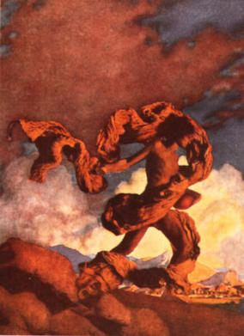
The Founding of Thebes (cont’d)
The land and the river were guarded by a large serpent or dragon, a son of Ares, which killed many of Cadmus’ men
Cadmus killed the serpent; and, while sacrificing it to Athena, she told him to take the teeth of the dragon and sow them.
Armed men sprang from the ground and attacked Cadmus
Cadmus threw stones into the midst of the men causing them to turn on each other until only five were left
These five men composed the noble families of Cadmeia and were called Spartoi (sown men)

Slide 8
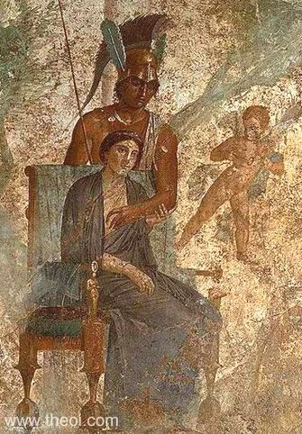
The Founding of Thebes (cont’d)
For slaying his dragon, Cadmus had to serve Ares for one year (eight of our years)
At the end of the servitude, Ares and Aphrodite gave Cadmus their daughter, Harmonia, in marriage
Hephaestus gave Harmonia a necklace which he had forged as a wedding gift
This necklace would be a source of future trouble for Thebes
The daughters of Cadmus and Harmonia all met with misfortune

Slide 9
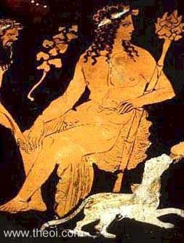
Dionysus
Dionysus was the Greek god of wine and vegetation
He was the son of Zeus and Semele, daughter of Cadmus
She was destroyed by the glory of Zeus when she asked him to prove his divinity
Zeus placed her unborn child in his thigh until his birth
His epitaph dithyrambos means double birth
The name Dionysus also refers to being born of Zeus (Dios) and raised by the nymphs of Mt. Nysa

Slide 10
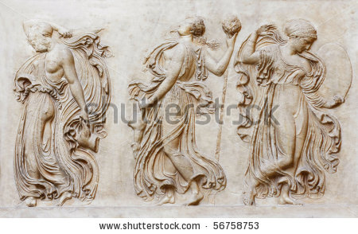
Dionysus (cont’d)
He is described as wearing a fox skin and carrying a staff (thyrsus) covered in ivy and honey with a pine cone at its top
His followers are called the Maenads, or raving ones, and their cry is evoё (euhoe, which is a Greek interjection like Oh)
Dionysus and the Maenads play an important role in the history of Thebes

Slide 11
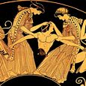
PENTHEUS
Pentheus was the son of Agave, a daughter of Cadmus, and Echion, one of the Spartoi.
As the king of Thebes, he refused to recognize Dionysus as a god and his rituals; and, had Dionysus bound and thrown into prison, from which he easily escaped
Dionysus led Pentheus to a clearing on Mt. Cithaeron and had him climb up a tree in order to view his rites as performed by the Maenads

Slide 12
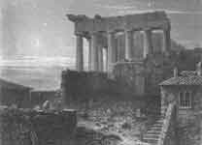
PENTHEUS (cont’d)
The Maenads, led by Agave, saw Pentheus in the form a lion and in their frenzy ripped him apart. Agave tore off his head and carried it back to Thebes unaware of her deed until the frenzied state had subsided
Having slain her son, she could not receive the same proper burial as did Pentheus
Menoeceus I was the son of Pentheus and the father of Creon and Jocasta

Slide 13
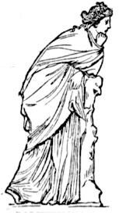
THE HOUSE OF LABDACUS
Polydorus, the son of Cadmus, married Nycteis, the sister of Antiope and daughter of Nycteus
Labdacus was the son of Polydorus and Nycteis; and, the father of Laius
Labdacus also met an untimely death because he also refused to recognize the rituals and divinity of Dionysus
Lycus, who was married to Dirce, and Nycteus were the sons of the Spartoi, Chthonius

Slide 14
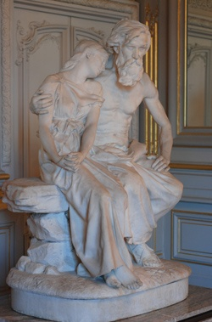
THE HOUSE OF LABDACUS (cont’d)
Since Laius was an infant, Lycus assumed the regency of Cadmeia and declared himself king
His niece, Antiope, was loved by Zeus and became pregnant by him
Fearing her father’s anger, she fled to Sicyon in the Peloponnese
In despair, Nycteus killed himself
Lycus then attacked Sicyon and retrieved Antiope

Slide 15
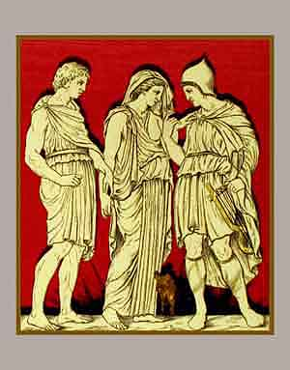
THE HOUSE OF LABDACUS (cont’d)
Antiope was imprisoned by Lycus and Dirce after giving birth to twin sons, Zethus and Amphion
Both were exposed by Lycus and found by a shepherd who raised them
Zethus became a skilled herdsman, while Amphion became a skilled musician, playing a lyre given him by Hermes

Slide 16
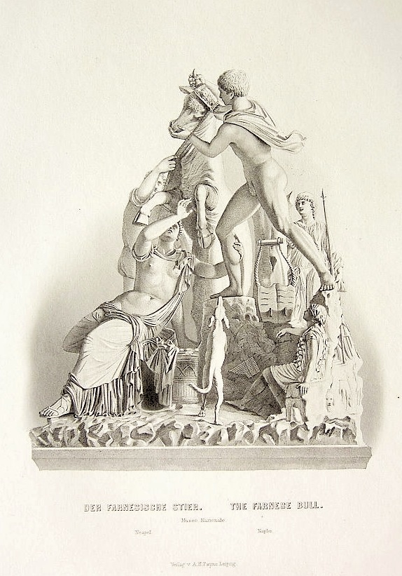
THE HOUSE OF LABDACUS (cont’d)
Returning to Cadmeia they met their mother who had escaped and related to them what had happened
Amphion and Zethus killed Lycus and tied Dirce to a bull to be dragged to her death
A fountain sprang from her blood that carries her name
Amphion and Zethus now become the rulers of Cadmeia

Slide 17
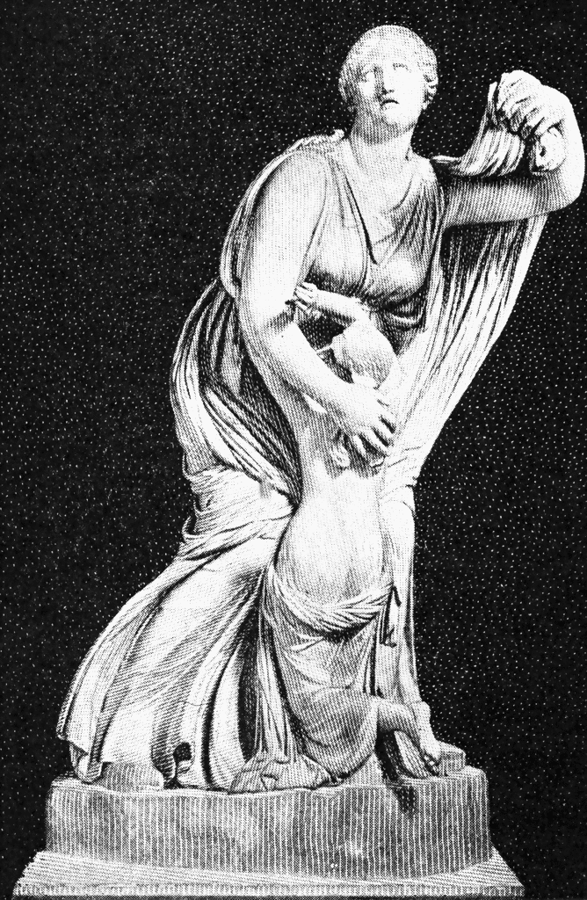
THE HOUSE OF LABDACUS (cont’d)
The brothers banished Laius from Cadmeia
They built walls for the city, whose stones were moved into place by Amphion’s lyre
Amphion married Niobe, who bore him seven sons and seven daughters
Niobe’s boast that she had more children than Leto, mother of Apollo and Artemis, angered these two gods
Apollo slew the sons with his arrows, while Artemis slew the daughters with hers
Niobe was turned to stone and her tears for her slain children became a spring
Zethus married the nymph Thebe in whose honor the newly walled city was renamed Thebes

Slide 18
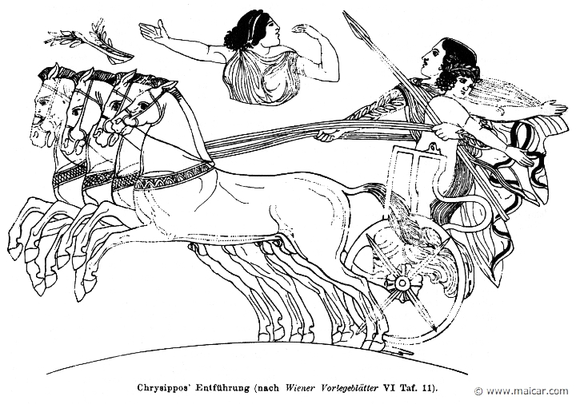
THE HOUSE OF LABDACUS (cont’d)
In exile Laius received the hospitality of King Pelops
Ties of guests and hosts were considered the most sacred of human trusts
Laius abducted Chrysippsus the son of Pelops with whom he was in love
Pelops cursed Laius and his descendants for his betrayal

Slide 19
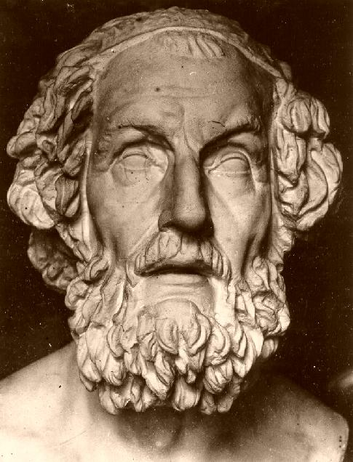
THE HOUSE OF LABDACUS (cont’d)
Laius returned to Thebes to reclaim his rightful place as king and married Jocasta
When he consulted the oracle of Apollo at Delphi regarding the children to be born to them, the oracle stated that he would be given a son; and that he would die at his hands and the son would marry his mother, as this was the decision of Zeus in response to the curse called down upon him by Pelops

Slide 20
OEDIPUS
Laius attempted to cheat the oracle by exposing his infant son on Mt. Cithaeron with a spike driven through his ankles
The servant given the task pitied the infant and gave him to a Corinthian shepherd of King Polybus and his wife Merope who named him Oedipus (Swellfoot or Swollen Ankles)
When told by a companion that he was not the couple’s natural son, Oedipus consulted the oracle at Delphi where the curse was repeated
Fearing that it referred to those who had raised him, he unknowlingly departed on the road to Thebes in an attempt to cheat the oracle

Slide 21
OEDIPUS (cont’d)
Arriving at an intersection of three roads, he met a chariot driven by an old man with his herald
The chariot blocked the intersection. As the herald attempted to push Oedipus off the road, Oedipus struck him
The old man struck Oedipus with his staff and Oedipus struck him twofold, eventually killing both men
The old man was Laius, his father, and he unknowingly had fulfilled the first part of the curse of Pelops
Oedipus continues his journey to Thebes only to find that it is plagued by a creature called the Sphinx (Strangler) that was sent by Hera

Slide 22
OEDIPUS (cont’d)
The Riddle of the Sphinx
The Muses, daughters of Zeus and Memnosyne, gave the Sphinx the riddle
Any Theban who passed by the creature and could not answer correctly, was killed and eaten
The Sphinx had the head of a woman, body of a lion and the wings of an eagle
To end the plague Creon, the brother of Jocasta, had named himself king after the death of Laius and offered the throne and his sister as a wife to anyone who would solve the riddle and end the plague

Slide 23
OEDIPUS (cont’d)
The Riddle of the Sphinx
Oedipus readily agreed and approached the Sphinx
The Sphinx asked her riddle:
“What is it that has four feet, two feet and three feet?”
“Man. As an infant he walks on hands and knees, as he matures he walks on two and in old age he walks on three, using a walking stick.”
Upon hearing the reply, the Sphinx threw herself off the Theban acropolis

Slide 24
OEDIPUS (cont’d)
Oedipus marries his mother Jocasta fulfilling the prophecy of Apollo
They have four children, Eteocles, Polynices, Ismene and Antigone
Many years pass and a pestilence visits Thebes; and, again, the oracle of Apollo is consulted
The oracle reveals that a pollution exists in Thebes:
the murderer of King Laius walks among them and must be removed
At the same time Polybus dies in Corinth and a messenger is sent to Thebes to offer Oedipus the throne of Corinth
Fearing that he would marry Merope, Oedipus refused
The messenger reassured him that this would not be the case, since Polybus and Merope were not his real parents, but that he had found him exposed on Mt. Cithaeron

Slide 25
OEDIPUS (cont’d)
Oedipus sends for the servant who had exposed him on Mt. Cithaeron and the truth is revealed
Upon hearing this Jocasta retires to her chamber and hangs herself out of despair
Seeing his dead wife and mother, Oedipus takes the brooches from her robe and blinds himself
Creon becomes king again and banishes Oedipus as part of the curse that he had made against Laius’ unknown killer and in obedience to the oracle of Apollo

Slide 26
OEDIPUS (cont’d)
Oedipus wandered for many years accompanied by his daughter Antigone
He finally arrived in Athens where he was received by King Theseus
Theseus refused to allow him to be returned to Thebes since a prophecy stated that the land in which Oedipus was buried would prosper
The legend of Oedipus is one of the best known thanks largely to Sigmund Freud’s naming a psychological condition called the “Oedipus complex” after the fateful king in 1910

Slide 27
THE SEVEN AGAINST THEBES
Now at age to rule, neither Polynices or Eteocles could decide which should be king
They agreed to rule in alternate years while the other would go into exile
Eteocles ruled the first year while Polynices went to Argos, taking the necklace of Harmonia with him
While in Argos, Polynices and Tydeus, another exile, were given the daughters of King Adrastus, who promised to restore them to their rightful places
Since seemed that Eteocles had no intention of giving up the throne as agreed, Thebes would be attacked first

Slide 28
THE SEVEN AGAINST THEBES
The remaining Argive leaders were Capaneus, Hippomedon, Parthenopaeus and Amphiarius
Amphiarius had the gift of prophecy and knew that only Adrastus would survive and opposed the expedition
Polynices bribed Eriphyle with the necklace of Harmonia to convince Amphiarius to change his mind
As he set out, Amphiarius ordered his sons to avenge his death on their mother and to make a second expedition against Thebes when that of the Seven had failed
The Argive army reached Thebes and each leader attacked one of the city’s seven gates

Slide 29
THE SEVEN AGAINST THEBES
The defenders were assured victory, since the blind prophet Tiresias had foretold that:
…if a Spartoi sacrificed himself, then Thebes would be rid of the blood guilt for the slaying of Ares’ dragon and the city would be saved from any attackers.
Menoeceus (Megareus), son of Creon and a Spartoi descendant, stabbed himself and fell into the serpent’s den ensuring victory for Thebes
Only Capaneus was successful in scaling the walls of Thebes, bragging that not even Zeus could keep him out of the city
Zeus struck him with a thunderbolt instantly killing him

Slide 30
THE SEVEN AGAINST THEBES
Tydeus would have received immortality, but Athena took it from him when she saw him eating the brains of the enemy who had mortally wounded him
Tydeus was mortally wounded by Melanippus who was slain by Amphiarius. It was Amphiarius who gave Tydeus the head of Melanippus whose brains he was eating
Amphiarius escaped and was swallowed up by the earth near the River Ismenos
Adrastus escaped to Argos only by the speed of his divine horse Arion

Slide 31
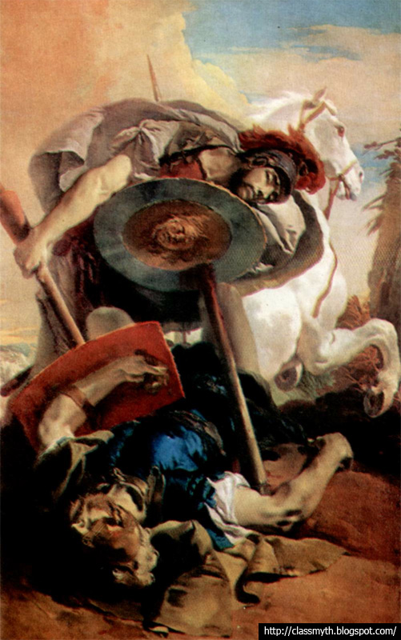
THE SEVEN AGAINST THEBES
Polynices and Eteocles killed each other in the battle
Once again, Creon becomes the king of Thebes
And here, Antigone begins……

Slide 32
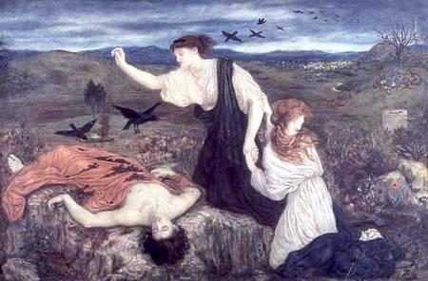
ANTIGONE
Upon the death of Eteocles and Polynices, Creon becomes king for a third time
Creon decrees that Eteocles will receive proper burial rites as the sitting ruler; being considered a traitor, Polynices will not (an action which goes against the will of the gods)
Antigone performs a symbolic burial by casting three handfuls of dirt over the body and sprinkling it with either wine or olive oil.

Slide 33
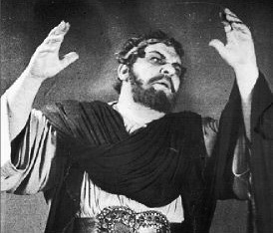
ANTIGONE (cont’d)
Creon orders that Antigone be buried alive in a tomb (again defying the gods)
Haemon, the son of Creon, was engaged to Antigone and tried to rescue her from the tomb.
By the time he arrived Antigone had hung herself; and, upon seeing Antigone dead, killed himself with his own sword
Eurydice killed herself upon hearing of the death of her other son
Creon was left to rule with no heirs to the throne

Slide 34
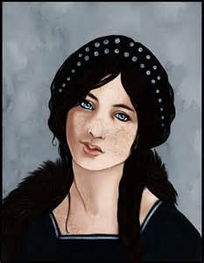
ISMENE
Sophocles writes Ismene out of the Greek myth of Thebes
Other sources indicate that she had a lover whom she would meet outside the city walls
Eventually, they were discovered by the Argive, Tydeus.
Both were eventually killed by him.

Slide 35
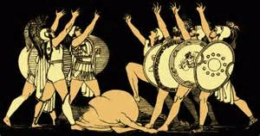
EPIGONI
According to Euripides, Adrastus went to Eleusis as a suppliant and persuaded Theseus to attack Thebes in order to properly bury the Argive dead.
As the corpse of Capaneus burned on his pyre, his wife, Evadne, threw herself on the pyre with him.
Amphiarius had ordered his sons to attack Thebes and to punish their mother Eriphyle for her betrayal.

Slide 36
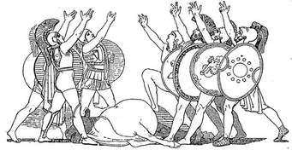
EPIGONI
Alcmaeon carried out his father’s command 10 years later with the sons of the six other chieftains; and are called the Epigoni ( the offspring, later generation, the ones who come after).
They attacked Thebes and were successful.
Upon the advice of Tiresias, the Thebans abandoned their city before the attack and it was destroyed.
The Thebans migrated to found the city of Hestiaea

Slide 37
EPIGONI
Alcmaeon next carried out his father’s other command and killed his mother for which he was pursued by the Furies, finding temporary shelter in Arcadia.
Here he married the daughter of Phegeus, giving her the necklace of Harmonia.
Soon the land was afflicted with famine because it was harboring a murderer and he was forced to leave.
He was told by an oracle to seek a land on which the sun had not shone at the time of the murder.

Slide 38
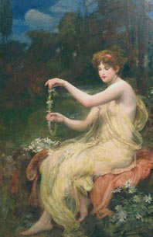
EPIGONI
He found such a land at the mouth of the river Achelous recently formed by the river’s silt.
He settled here and was purified by the river god and married his daughter Callirhoe, but he did not live long (he had gotten the necklace of Harmonia from Phegeus by deceit to give to his new bride and was killed by the sons of Phegeus ).
The necklace was dedicated by the sons of Callirhoe and Alcmaeon at Delphi where was stolen in the 4th Century bringing bad luck to the thieves.
The sons of Alcmaeon founded Acarnania in Western Greece.

Slide 39
EPIGONI
According to the Bibliotheca (Apollodorus), they were:
Aegialeus, son of Adrastus *
Alcmaeon, son of Amphiaraus *
Amphilochus, son of Amphiaraus
Diomedes, son of Tydeus *
Euryalus, son of Mecisteus
Promachus, son of Parthenopaeus *
Sthenelus son of Capaneus *
Thersander son of Polynices *
To this list, Pausanias also adds:
Polydorus son of Hippomedon *
* These were the Seven against Thebes mentioned in Morford

Slide 40
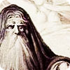
TIRESIAS
The most famous of all the seers in Greek mythology
The prophet of Thebes for seven generations
He continued his prophecies in the Underworld, retaining his full mental faculties while other souls were insubstantial
Odysseus consults him in the Underworld while trying to return to Ithaca

Slide 41
TIRESIAS
He was a descendant of the Spartoi and the son of the nymph Charlico, a follower of Athena; and blind
He never reached the new city of Hestiaea
On the journey to the new city he drank from a spring called Tilphussa and died on the spot
Two myths surround the blindness of Tiresias

Slide 42
TIRESIAS
Myth 1:
He accidentally saw Athena naked and was blinded by her. Unable to stop the punishment of Athena, his mother gave him the power to understand the speech of birds
Myth 2:
While walking on Mt. Cyllene, he saw two snakes mating and killed the female and was changed into a woman. He remained a woman for seven years until he saw another pair of snakes mating and killed the male. He was changed back to a man. Zeus and Hera were arguing over which gender enjoyed the act of love more and called upon Tiresias to judge since he had lived as both. He stated that man enjoyed one part while the female enjoyed nine. Hera blinded him but Zeus gave him the gift of prophecy (Hesiod)
As woman, he became a priestess of Hera, married, and had children including a daughter, Manto, who was the mother of the famous seer Mopsus

Slide 43
Other Mythological References
Rivers of the Underworld
Acheron: River crossed to enter the Underworld
Styx: River by which oaths were sworn (unbreakable)
Phlegethon: River of Fire
Cocytus: River of Lamentation
Lethe: River of Forgetfulness (souls drank from it when granted a second life)
Tiresias
Prophet of Thebes for seven generations. He was blinded by Athena when he accidentally saw her bathing. She gave him the ability to prophesy by understanding the language of birds.

Slide 44
Other Mythological References
Procne and Philomela
Procne married Tereus and wished for her sister, Philomela to visit her. Tereus wanted her for himself and imprisoned her, cutting out her tongue to prevent her from calling for help. Procne discovered what had happened to her sister and released her. Together they killed Procne’s children and served them to Tereus for dinner and fled. Philomela was turned into a swallow and Procne into a nightingale.
Tereus was changed into a sea hawk.
The Furies
Initially called the Erinyes (Avenging Ones) but later, the Eumenides (Kindly Ones) after the trial of Orestes, they were three sisters who avenged wrongs done by humans against the gods and humans alike. Their names were Alecto (unceasing anger), Tisiphone (vengeance) and Megaera (jealousy).

Slide 45
REFERENCES
Morford, Mark P.O. and Robert J. Lenardon, Classical Mythology, Second Edition. New York: Longman Inc., 1977
ancientgreecelife.com
appleiosdownload.com
coursesite.uhcl.edu
drawings.blogspot.com
etc.usf.edu

Slide 46
REFERENCES
http://www.hfac.uh.edu/mcl/Classics/Oedipus.JPG
johndenugent.org
library.thinkquest.org
miguelzorita.com
shows.vtheatre.net
twelveolympians.wordpress.com
www.alvagallery.com
www.argonauts-book.com
www.aworldofmyths.com
www.maicar.com
www.mlahanas.de

Slide 47
REFERENCES
www.news.cornell.edu
www.pantheon.org
www.probertencyclopaedia.com
www.shutterstock.com
www.superteachertools.com
www.theoi.com
www.trentu.ca
www.tuttoblog.com

