Slide 1
Some of that stuff I told you we would learn
Heracles

Slide 2
Heracles
Amphitryon marries Alcmena.
Zeus comes to Alcmena in the form of Amphitryon, her own husband.
Zeus and Alcmena have Heracles while Amphitryon and Alcmena have Iphicles.

Slide 3
Hera
Hera tries to prevent the birth of Heracles.
Eileithyia, goddess of childbirth, keeps him in there by clasping her hands and crossing her legs.
Alcmena’s nurse, Galanthis, distracts Eileithyia by telling her that Heracles was born. Eileithyia turns her into a weasel.
Hera continues to persecute Heracles.

Slide 4
Heracles
Hera sent two snakes to kill him while he slept when he was a wee little baby. Heracles strangled the snakes and played with them like playthings.
He then grew to be a healthy, young demigod and was sent off to be trained as a hero.
Where did he go you may ask?

Slide 5
Training
Heracles received training from many people
He learned wrestling from Autolycus.
He learned chariot-driving from Amphitryon.
Sometimes Heracles learns from Chiron.
He learned music from Linus. He then killed him during a lesson by smacking him with a lyre. For killing him he was exiled to Mt. Cithaereon.

Slide 6
Exile
He killed the Cithaereon lion for King Thespius. Thespius allowed Heracles to sleep with his 50 daughters.
Later he helped King Creon and received Creon’s daughter, Megara, as a wife.

Slide 7
THIS IS MADNESS!
Hera drives Heracles insane and he kills Megara and his three children by her.
He then snaps back to reality and goes to the Oracle to seek advice.
Hera, through the Oracle, commands Heracles to serve King Eurystheus for 10 years.

Slide 8
The 10 (12) Labors of Heracles
Eurystheus asks Heracles to do 10 tasks for him and he would be free.
Most of these tasks either involve killing or capturing except for one.

Slide 9
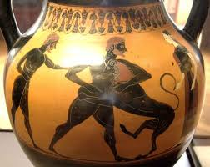
Task # 1: Kill the Nemean Lion
The Nemean Lion was a lion in Nemea.
It’s pelt, skin, fur, idk was invulnerable to edged weapons, so Heracles beat it to death with his club.
He then skinned it with its own claws and wore it.

Slide 10
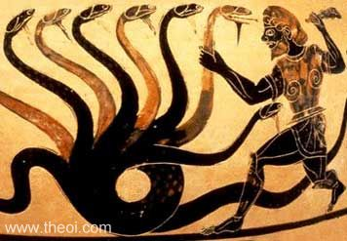
Task # 2: Kill the Lernean Hydra
The 9-headed Hydra lived in the Lernean swamp.
Heracles chops off a head and two grow back.
Heracles finally has an idea. He chops off a head and has his nephew Iolaus burn the wound.
All heads are disposed of except for the immortal one which he buries under a rock.

Slide 11
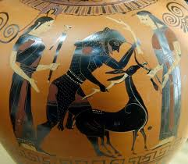
Task # 3: Capture the Cerynean Hind
The Cerynean Hind is a deer sacred to Artemis.
Its golden horns are marked with the word Taygete.
Heracles catches it at the Ladon river.

Slide 12
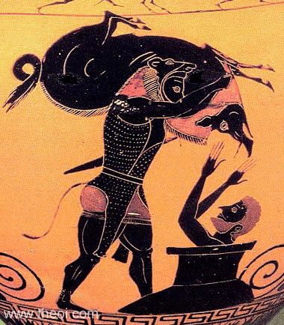
Task # 4: Capture the Erymanthian Boar
A boar on Mt. Erymanthus.
Heracles captured it by driving it into deep snow.
During this task, he stopped by the house of the centaur Pholus.
When he brought it back, he scared Eurystheus so much that he jumped and hid in a jar.

Slide 13
Task # 5: Clean the Augean Stables
King Augeas had a very large, and dirty stable. Heracles had to clean them in one day. Augeas promised Heracles 1/10 of his herds.
Heracles rerouted the Alpheus and Peneus rivers to clean the stables.
Augeas refused his pay and exiled him.
After this task, Heracles supposedly founded the Olympic games.

Slide 14
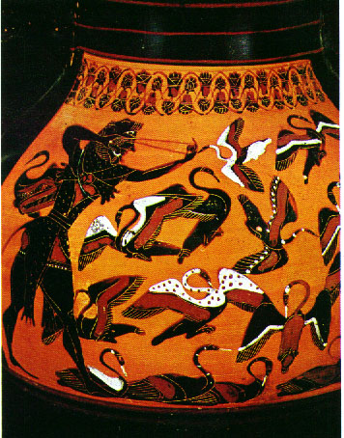
Task # 6- Kill the Stymphalian Birds
These birds were made of bronze, launched their feathers at passerbys, and had toxic dung that lived at Lake Stymphalus.
Heracles startled them using bronze catanets. Then he played duck hunt.

Slide 15
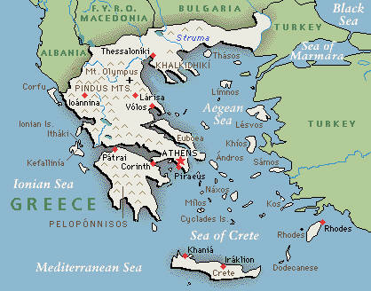
The Peloponnesian Labors
These first six labors occur on the Peloponese.

Slide 16
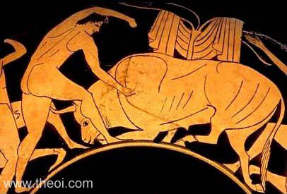
Task # 7: Capture the Cretan bull.
He went to Crete and captured it and released it in Marathon near Athens.

Slide 17
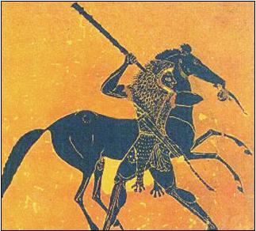
Task # 8: Capture the Mares of Diomedes
The mares ate human flesh. :O
Heracles captured them and tamed them by feeding their master, Diomedes, son of Ares, to them.
On the way back, Heracles stops at the house of Admetus and Alcestis.

Slide 18
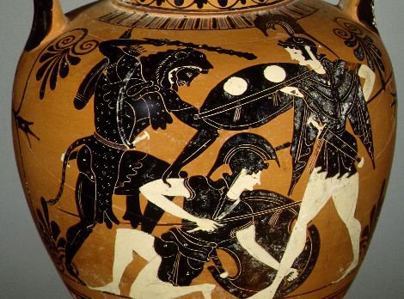
Task # 9: Capture the girdle of Hippolyta
Hippolyta was the queen of the Amazons. Heracles asked her for the girdle and she said yes. Then Hera spread suspicion of the stranger among the Amazons, who then attacked him. Heracles killed Hippolyta and left.
On the way back he saved Hesione at Troy from a sea monster.

Slide 19
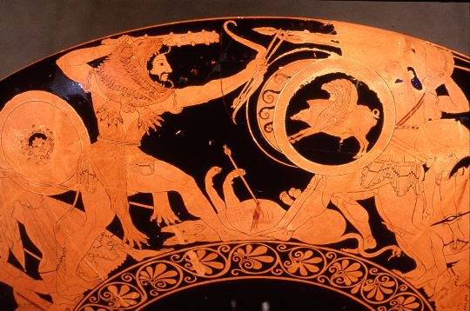
Task # 10: Capture the Cattle of Geryon
Geryon is a guy with three bodies.
Heracles goes and fights the giant guard, Eurytion, and the two-headed dog, Orthus.
He kills them and Geryon, takes the cattle and returns.
On the way, he encounters Cacus, the Ligurians, and made the pillars of Heracles.

Slide 20
Eusrystheus demands two more labors.
He claims that since Heracles had help defeating the Hydra and wanted pay for cleaning the Augean stables, he would have to do new ones.

Slide 21
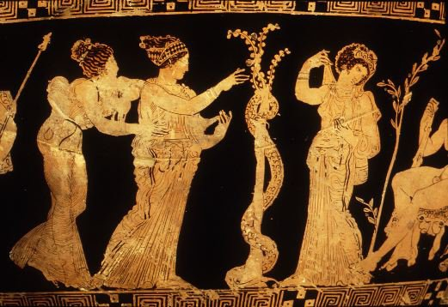
Task # 11: Fetch the Apples of the Hesperides.
There was a tree with golden apples in the far north. It was guarded by the Hesperides and the dragon Ladon.
Story 1- Heracles went there, beat up the dragon, and took the apples.
Story 2- Heracles went to Atlas and carried the world for him until he returned with the apples. Heracles tricks him into carrying it again.
During this he kills Busiris and frees Prometheus.

Slide 22
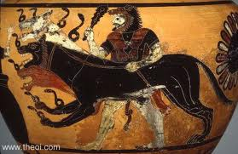
Task # 12: Capturing Cerberus
Heracles goes down to the underworld. He asks Hades if he can borrow Cercerus. He wrestles Cerberus and brings him up and back.
While down there Heracles freed Theseus from the Chair of Forgetfulness.

Slide 23
After being freed
Heracles served under Omphale
Sieged Troy
Went on the Quest for the Golden Fleece
Competed with Achelous and won Deianira

Slide 24
Iole
Heracles went to an archery contest held by Eurytus for the hand of his daughter Iole.
Heracles won and demanded his prize. Eurytus refuses.
Heracles lays seige and wins.
Deianira is not pleased with another woman.

Slide 25
The end of Heracles
Deianira has the robe with Nessus’ blood delivered by Lichas to Heracles.
Heracles is in agonizing pain and punts Lichas out to sea. He makes a funeral pyre and lies on it.
Everyone except Poeas is too scared to light the pyre. Poeas gets the bow and arrows of Heracles.

Slide 26
Happy Ending
Heracles is given immortality by Zeus and is given Hebe as his wife.
On Mt. Olympus Heracles acts as a glorified doorman.

