Slide 1
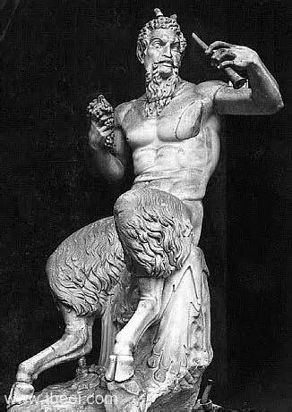
LESSER DIVINITIES & MYTHS
W. D. GRIFFIN,JR
AUGUST 30, 2014

Slide 2
TABLE OF CONTENTS
Myth | Slide | Myth | Slide
Ino | 3 | Arion | 97
Actaeon | 7 | Biton & Cleobis | 101
Orion | 9 | Dryope | 104
The Pleiades | 16 | The Hyades | 107
Pan | 18 | Linus | 109
Orpheus | 23 | Marpessa | 114
Aristaeus | 36 | Marsyas | 117
Nisus & Scylla | 41 | Melampus | 121
Pterelaus | 44 | Merope (Messenia) | 130
Glaucus & Scylla | 47 | The Muses | 133
Glaucus (son of Sisyphus) | 53 | Myrrha | 135
Bellerophon | 57 | Nymphs | 142
Otus & Ephialtes | 66 | Pomona | 145
Midas | 70 | Rhoecus | 152
Epimenides | 76 | Salmoneus | 156
Aeacus | 78 | Sisyphus | 159
Amymone | 88 | Tyro | 172
Arachne | 89

Slide 3
INO

Slide 4
daughter of Cadmus and Harmonia
second wife of Athamas, father of Phrixus and Helle (see Jason)
had two sons by Athamas, Melicertes and Learchus
hated Phrixus and Helle and attempted to have Athamas sacrifice him after parching the grain herself, causing a famine and bribing the envoy to say that the oracle at Delphi demanded Phrixus’ death to end the famine
Ino fled to Mt. Parnassus and lived with the Maenads
thinking Ino to be dead, Athamas married Themisto, whose name means “belonging to the law”

Slide 5
thinking Ino to be dead, Athamas married Themisto, whose name means “belonging to the law”
Athamas secretly returns Ino when he discovers that she is still alive
Themisto then plots to kill Melicertes and Learchus dressing her children in white and Ino’s in black, then slaying those dressed in black
Ino disguised as a servant dressed Themisto’s children in black and Themisto slew her own children
Themisto killed herself once she realized the mistake
Hera upon discovering that Ino had nursed Dionysus drove her and Athamas insane

Slide 6
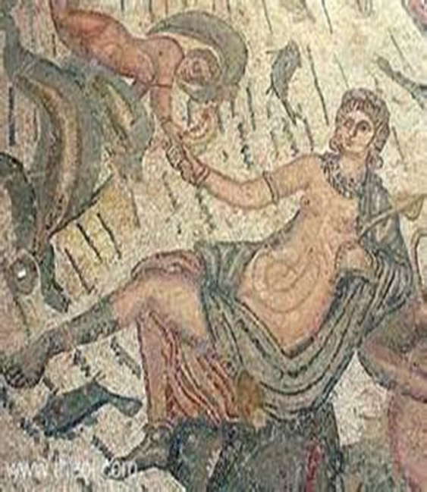
Athamas slew Learchus and then attempted to slay Ino and Melicertes
with Melicertes in her arms she sprang into the sea
the gods transformed both into sea deities
Ino is transformed into Leucothea (white goddess) who aided Odysseus
Melicertes is transformed into Palaemon (called Portumnus by the Romans as the god of ports and shores) in whose honor the Isthmian Games were held
both held the power to save from shipwreck and were patrons of sailors
Note: the Isthmian Games were started by Sisyphus of Corinth after burying the mortal remains of Melicertes

Slide 7
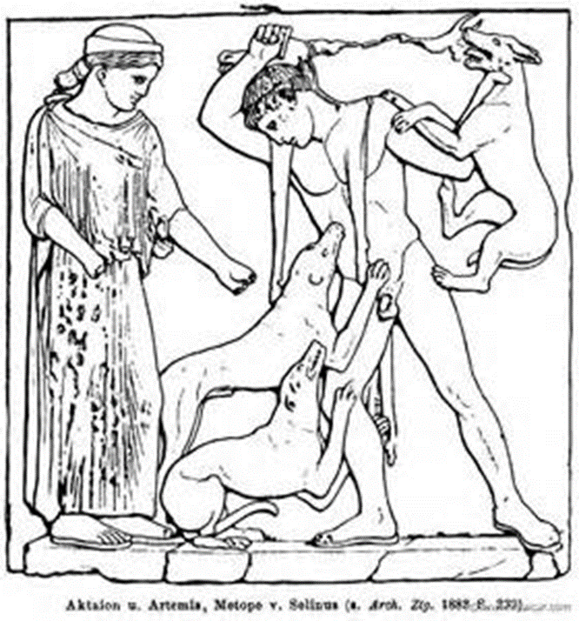
ACTAEON

Slide 8
the son of Aristaeus and Autonoë, daughter of Cadmus; grandson of Apollo and Cyrene an oak nymph with a passion for hunting
while hunting, he accidentally saw Artemis bathing and stared too long
Artemis commanded that he not speak at the risk of being changed into a stag
hearing his hunting party he called out and was immediately transformed into a stag and killed by his hounds (Ovid says 50)

Slide 9
ORION

Slide 10
referred to as “The Hunter”
several myths surround Orion and his origin
according to Hesiod (Astronomia) he is the son of Poseidon and Euryale, daughter of Minos
being the son of Poseidon he is given the ability to walk on water
other sources depict him as earth-born and a giant
scholia in the margins of a copy of Homer’s Iliad belonging to Eudocia, the wife of Theodosius II, attribute one earth-born version to Euphorion of Chalcis and also supported by Hyginus

Slide 11
according to this version Zeus, Poseidon and Hermes visited Hyrieus of Tangara
Hyrieus roasted one of his finest bulls and served it to the gods
during the feast Hyrieus told of his wishes for a son
the gods urinated into the bull’s hide and told Hyrieus to bury the hide and dig it up in 10 months (this refers to the time the Greeks used for measuring gestation called lunations)
Hyrieus did as instructed and Orion was born from the earth
Orion traveled to Chios, famous for its wine, and cleared the island of wild beasts for its king Oenopion whose name means wine face in return for the hand of his daughter Merope
Oenopion stalls the marriage and Orion attempts to rape her

Slide 12
Oenopion puts Orion into a deep sleep with the aid of Dionysus and blinds him
an oracle tells him that his sight can be restored by traveling east and letting the rays of the sun god Helios fall on his eyes
Orion traveled east following the sound of the clanging hammer of Hephaestus until he reached the island of Lemnos
Hephaestus takes pity on him and lends him one of his workers Cedalion to assist him in his quest
placing Cedalion on his shoulder they reached the sun god and his sight was restored
Orion returned to Chios seeking revenge but Oenopion had fled and could not be found

Slide 13
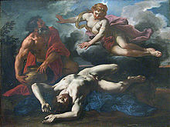
in another version, while clearing the island, he attempted to rape Artemis who brought a scorpion out of the earth which stung him to death
unable to find Oenopion, Orion goes to Crete and hunts with Artemis and Latona
while hunting with them, Orion brags that he will hunt and kill every living thing on earth
Mother Earth (Gaea, Ge) send a giant scorpion that stings him to death

Slide 14
in another version Eos was said to have loved him and Artemis slew him out of jealousy
yet another version states that Apollo objected to her love for Orion and tricked her into killing him by challenging her to hit a bobbing object in the sea which was the head of Orion who was swimming
Pherecydes of Leros describes Orion as being married to Side before his attempt to marry Merope
Side was thrown into Hades by Hera for rivaling her in beauty
he also has Artemis slaying Orion out of jealousy after Eos carried him to Delos

Slide 15
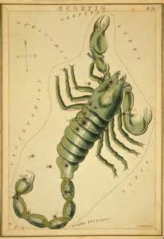
in still another version Orion chased Opis who was a follower of Artemis and attempted to rape her
he was slain by the arrows of Opis
he was also said to have chased the Pleiades who were also followers of Artemis (some versions say it was Pleione, their mother)
in distress they called upon Zeus for help who raised them to the heavens where they form a constellation
Orion himself was raised as constellation with his dog, Sirius and chases the Pleiades
the scorpion that stung Orion was also placed in the heavens as well, i.e. Scorpio

Slide 16
THE PLEIADES

Slide 17
the Pleiades were the daughters of Atlas and Pleione
their names were Electra (the mother of Dardanus the founder of Troy), Maia (mother of Hermes), Taygete (mother of Lacedaemon the founder of Sparta), Alcyone, Merope, Celaeno and Sterope
they were pursued by Orion until they were placed in the heavens by Zeus
it is said that Electra left her place to keep herself from witnessing the fall of Troy
others say Merope left to marry the mortal Sisyphus of Corinth

Slide 18
PAN

Slide 19
god of fields, groves and wooded glens; the personification of nature
part human with the horns, ears and legs of a goat
sometimes referred to as Aegipan who was nurtured by Almathea on Crete with Zeus as an infant
some sources say that Aegipan is the father of Pan or his son
Aegipan, Hermes and Cadmus recovered the sinews of Zeus when they had been stolen by the giant Typhoeus (Typhon)
during Zeus’ battle with the Titans Pan was said to have let out such a terrible scream that it frightened and scattered them
Hermes or Dionysus are usually referenced as his father and the nymph Dryope or Penelope of Mantineia (Dionysiaca of Nonnus)

Slide 20
he had no formal temples as his altars were found in caves and grottoes
if disturbed during his afternoon nap, he would make a frightening sound (hence we have the derivative panic)
his attribute was the pan pipe or syrinx (see Io and Argus)
he was also said to have loved Echo who spurned his advances to which he asked his followers to kill her and scatter her body parts over the earth
Gaea gathered the parts except for her voice which could only repeat the last words that she had heard
he also loved a nymph named Pitys who was transformed into a pine tree to escape his advance

Slide 21
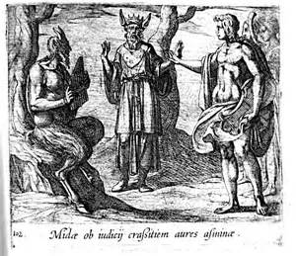
he challenged Apollo to a music contest
Apollo played the lyre and Pan his pan pipes
the judges were Tmolus and Midas
Tmolus voted for Apollo and Midas, Pan
Apollo changed Midas’ ears into those of a donkey

Slide 22
The Death of Pan
other than Asclepius, Pan is the only other immortal to die
one version states that, when the angels announced the birth of Christ, a loud groan was heard as Pan died
according to Plutarch Pan died during the reign of Tiberius
as he sailed to Italy, Thamus heard a voice that asked him to proclaim the death of the god Pan when he reached Palodes
Thamus did as instructed and a loud groan was heard on the shore

Slide 23
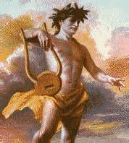
ORPHEUS

Slide 24
referred to as “the father of songs” by Pindar
son of the Muse Calliope and either Apollo or the river-god Oeagrus of Thrace (some sources refer to Oeagrus as a king)
lived near Pimpleia near Olympus
while living with his mother and the other Muses, Apollo gave him a golden lyre and taught him to play it when he was courting Thalia
Calliope taught him to write verses and songs
Hermes invented the lyre; Orpheus perfected it!

Slide 25
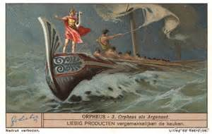
he joined Jason on his quest for the golden fleece using his talents to inspire the Argonauts when they wearied of the journey
as they neared the Sirens on the return from Colchis, he began to play and sing more beautifully than they, saving Jason and his crew from their danger

Slide 26
the story of Orpheus and Eurydice is related mostly by Ovid and Virgil
he wooed and won the heart of Eurydice, a Dryad, with his music
when Hymen the god of marriage performed the wedding, he could not foresee happiness in the marriage (the torches smoldered)
soon after the wedding, while walking in the fields with her attendants, Eurydice was seen by Aristaeus who was smitten by her beauty
while trying to escape his advances, she stepped on a viper which bit her foot causing her death
Orpheus was inconsolable and neither gods nor men would hear his complaint

Slide 27
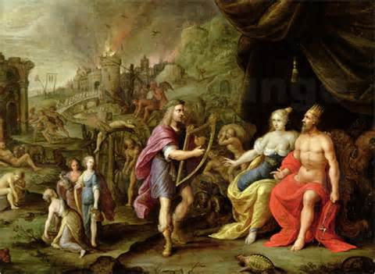
he resolved to go Hades to plead his case, entering at Taenarus
he passed through the throngs of ghosts and pleaded his case before Hades and Persephone, singing his petition to them
ghosts shed tears; Tantalus lost his thirst; Ixion’s wheel stood still; the Danaids rested from their task; Sisyphus sat on his rock; the Furies wept; even Cerberus was lulled to sleep
Neither Hades nor Persephone could resist and summoned Eurydice

Slide 28
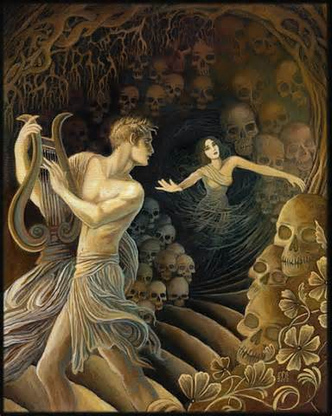
Eurydice was allowed to return on the condition that Orpheus not look back at her until both had reached the Upper Air
slowly they made their way through the shades and ghosts, Orpheus becoming more anxious as they neared the exit
as Orpheus reached the Upper Air, he became even more anxious and turned to verify that Eurydice was behind him
Eurydice had not yet reached the entrance and was pulled back to the Underworld
Orpheus was denied a second attempt to retrieve his beloved

Slide 29
in his grief Orpheus returned to Thrace
the Thracian maidens tried in vain to win his heart but he refused their advances
at last a band of Maenads approached him declaring him their despiser hurling a javelin at him which fell harmlessly to the ground enchanted by his music
the Maenads raised their voices louder than the music and set upon him, tearing him limb from limb
his head and lyre were tossed into the Hebrus River
they floated past the mouth of the river to the shores of Lesbos

Slide 30
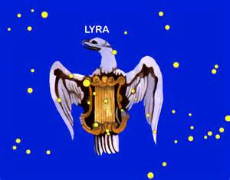
his head was placed in the sanctuary of the island and Zeus placed his lyre among the stars
the Muses gathered his limbs and buried them at Libethra near Mt. Olympus
it is said that the nightingales sing more sweetly here than any other place
his shade passed again to the Underworld and was reunited with Eurydice
Musaeus is attributed to being either his son or a devout follower who assumed his characteristics
Note: only Orpheus, Heracles, Theseus, Odysseus and Aeneas were the only mortals to visit the Underworld and return

Slide 31
Orphism
he is said to have been struck down by a thunderbolt from Zeus for teaching mysteries previously unknown
by the 5th Century he was accepted as a human religious teacher
Dionysus was the dominant god in the pantheon of Orphism, often under the name of Zagreus
shedding of blood and the eating of flesh were among the primary prohibitions of the cult
the fundamental belief was the transmigration of the soul and the sanctity of life

Slide 32
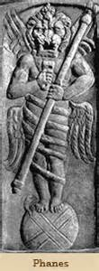
the first principle of Orphism was that Chronus (Time), described as having the head of a bull and a lion with the head of a god in between, was accompanied by Adrasteia (Necessity)
from Chronus came Aether, Chaos and Erebus
in Aether he fashioned an egg that split in two and from this sprang the first-born of all the gods, Phanes who was the creator of all things and called by many names including Eros
Phanes was a bisexual deity with golden wings and four eyes, described as possessing the appearance of various animals

Slide 33
Phanes bore a daughter Night who was his partner in creation and his successor in power
Night bore Gaea (Earth) and Uranus (Heaven) and they produced the Titans
Cronus succeeded the rule of Night and Zeus then succeeded Cronus
Zeus then swallowed Phanes and all previous creations, including a special race of men of the Golden Age
Zeus now created all things new with the help of Night and, as second creator, became the beginning, middle and end of all things
Zeus then mated with Kore (Persephone) and Dionysus was born

Slide 34
the essence of the dogma of Orphism is that the Titans kill and devour Dionysus
the Titans were struck down by the thunderbolt of Zeus and from the ashes arose mankind, making man part evil and mortal but part pure as the Titans did not destroy the heart of Dionysus
thus Dionysus was “born again”
the rebirth of Dionysus provides the Orphic Bible with the divine authority for belief in the immortality of man’s soul
thus it was necessary to keep the soul pure as opposed to the contamination and degradation of the body

Slide 35
it also offered a kind of original sin, transmigration of the soul, an afterlife of reward and punishment, and finally, after various stages of purification, a union with the divine spirit in the realms of the upper aether
basically the seeds of everything came from Phanes or Zeus: out of the One comes everything and into the One all things are once again resolved

Slide 36
ARISTAEUS

Slide 37
the son of Apollo and the water nymph Cyrene who was an avid huntress
in Boeotia he was referred to as the “pastoral Apollo”
guardian of flocks and herds, protector of vine and olives and the keeper of bees (most well-known for this role)
according to a prophecy that he put into the mouth of Chiron, Apollo would take Cyrene to Libya and make her the founder of Cyrene, a city on a fertile coastal plain
when he was born, Hermes took him to be raised on nectar and ambrosia and to be made immortal by Gaea
the Myrtle nymphs taught him how to curdle milk, to keep the bees in their hives and other arts of husbandry

Slide 38
he was also taught more mysteries by Chiron
associated with the founding of Thebes being married to Autonoë and the father of Actaeon and Macris, who nursed Dionysus
also became enamored of Eurydice and in chasing her caused her death (see Orpheus)
when his bees died, he sought the aid of his mother who told him to find Proteus who pastured the sea calves of Poseidon
Proteus would be able to tell him of the mortality of his bees and how to remedy it
Proteus could change shapes and had to be restrained before he would divulge any secrets

Slide 39
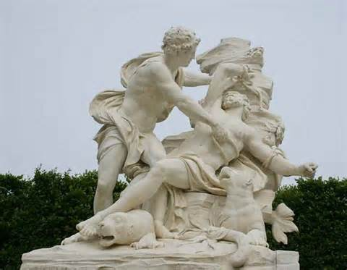
Cyrene led him to the cave of Proteus on the island of Pharos (some sources say Carpathos)
reaching his cave, he found Proteus sleeping and he immediately bound him in chains
Proteus, awakened by a shout from Aristaeus, changed himself into fire, flood, a wild beast and other various shapes to no avail
returning to his natural state, he told Aristaeus that the nymphs had punished him for the death of Eurydice by killing his bees

Slide 40
Aristaeus must build four altars to the nymphs in a leafy grove and sacrifice four perfect bulls and four cows of equal beauty
he must also pay such funeral honors to Orpheus and Eurydice as may allay their resentment
he must wait nine days and see what had befallen
Aristaeus did as instructed and when he returned after nine days he found a swarm of bees taking possession of one of the carcasses and pursuing their normal activities as in a hive

Slide 41
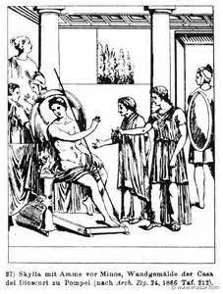
NISUS & SCYLLA

Slide 42
after the death of his son, Androgeous, whether by ambush or being sent to capture the Marathonian Bull by Aegeus, Minos sought revenge
Minos attacked Megara first where Nisus was king (Aegeus was the king of Athens)
Nisus had a lock of purple hair which, as long as it was on his head, prevented the capture of Megara
Scylla, the daughter of Nisus, saw Minos on the field of battle and fell madly in love with him
while Nisus slept, Scylla crept into his room, cut the lock of purple hair and carried it to Minos expressing her love for him
when Megara fell, Minos was repulsed by her lack of filial loyalty

Slide 43
there are two versions of Scylla’s fate
in the first Minos sailed back to Crete with Scylla swimming frantically to catch up to him
in the second Minos tied her to the rudder of his ship and pulled her through the sea back to Crete
in either case Scylla was transformed into a seabird (ciris); Nisus, into a sea eagle (hiliaeetus) which chases her (Ovid, Hyginus)

Slide 44
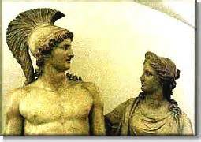
PTERELAUS

Slide 45
Son of Lelex
ruled the land by the River Achelous
had numerous sons who settled on the islands of the Ionian Sea
three of the sons, Ithacus, Neritus, and Polyctor, settled on the island of Ithaca (named after Ithacus)
Neritum and Polyctorium were cities on the island founded by the other two sons
two of his other sons, Taphius and Teleboas, founded the Taphian and Teleboan tribes

Slide 46
Son of Taphius
grandson of the first Pterelaus although some accounts make him Taphius the son of Poseidon and Hippothoë
Poseidon gave Pterelaus a lock of golden hair which made him immortal as long as the lock grew on his head
raided the cattle of Amphitryon, king of Mycenae and step-father of Heracles
Amphitryon retaliated and attacked Pterelaus
Comaetho, the daughter of Pterelaus, fell in love with Amphitryon and betrayed her father by cutting the lock of hair
Amphitryon defeated Pterelaus and divided the Taphian kingdom among his allies including Cephalus who was the ancestor of Odysseus
Comaetho was put to death by Amphitryon in retribution for her act of betrayal

Slide 47
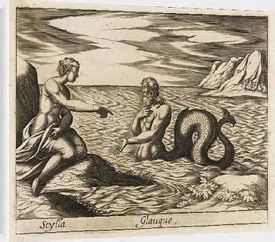
GLAUCUS & SCYLLA

Slide 48
Glaucus was a fisherman who became a sea god
according to Ovid he rubbed an herb on a dead fish which brought the fish back to life
he ate some of the herb (some sources say that he rubbed the herb on his body)
the herb caused him to rush into the sea where his lower body was transformed into the tail of a fish
Oceanus and Tethys accepted him and took away his mortal parts by pouring the waters of a hundred rivers over him and taught him how to prophesy
while accepted by those who dwelt near the sea or in it, he was repulsed by those who land dwellers
so it was when he discovered Scylla bathing in her favorite cove

Slide 49
upon seeing Glaucus Scylla ran to a high promontory where she could watch him
when he expressed his love for her, Scylla ran further inland to escape his advances
Glaucus turned to Circe for help in winning the heart of Scylla
Circe wanted Glaucus for herself , although he rejected her wooing and advances, and gave him a “love” potion to pour into the waters where she bathed
Glaucus did as instructed and, when Circe entered the water, the potion caused her to grow six serpents with the heads of dog from her waist
from this point in Sicily on the strait of Messina she would harass any seafarers passing her, i.e. Odysseus
she remained there until she became a reef and still a danger to ships and sailors

Slide 50
Glaucus himself became a guardian of fish and divers and those who go down to the sea in their ships
Vergil indicates in the Aeneid that Deiphobe, the Cumaean Sybil, was the daughter of Glaucus
as a guardian of seafarers, when the Argonauts were caught in a storm, Orpheus invoked the Cabeiori who caused the winds to cease and Glaucus to appear
the Cabeiori were Samothracian gods who were invoked in times of great stress and danger
Glaucus stayed with the Argonauts for two days and prophesied the future adventures of the crew and the eventual immortality of the Dioscouri and Heracles

Slide 51
Other Origins
in The Banquet of the Learned Athenaeus states that Glaucus was chasing a hare on Mt. Oreia until the animal fell almost dead
he picked up the hare and carried to a nearby spring and rubbed it with some grasses that were growing near it
the grasses restored the rabbit to life
Glaucus ate some of the grasses and was filled with “divine madness”
in this state Zeus caused him to throw himself off a cliff and made him a sea god
in yet another version from Possis of Magnesia cited by Athenaeus Glaucus was the builder and pilot of the Argo and not Argus

Slide 52
during a naval battle between the Argonauts and the Etruscans, Glaucus fell off the ship and was turned into a sea god by the will of Zeus
the herb itself was said to have grown on Thrinacia (island of the sun god Helios) and was used as a remedy for the horses of the Sun’s chariot to fight fatigue
per Aeschrion of Samos the name of the herb was “dog’s tooth” and was sown by Cronus

Slide 53
GLAUCUS (son of Sisyphus)

Slide 54
this Glaucus was the son of Sisyphus, the king of Corinth (originally called Ephyra), and the Pleiad Merope
Merope became mortal to marry Sisyphus and bore him Glaucus, Oryntion, Almus and Thersander
Glaucus became king of Corinth and was also known for feeding his horses human flesh to make them more fierce in battle
Glaucus attempted to marry the shape-shifting daughter of Erysichthon, Mestra
in spite of large wedding gifts paid, she eluded the marriage and was taken to an unknown island by Poseidon

Slide 55
he married a daughter of Nisus, Eurymede (Apollodorus) or Eurynome (Hyginus)
Zeus vowed that he could father no children, even with his own wife, because of violations against Aphrodite
Homer indicates in The Iliad that he and Eurynome were the parents of Bellerophon, although Poseidon is generally accepted as his father
after Pelias was slain by his sisters, Acastus buried his body and held funeral games in his honor
many great heroes including many of the Argonauts participated in the games
Glaucus entered the chariot race and was defeated by Iolaus, the nephew and charioteer of Heracles

Slide 56
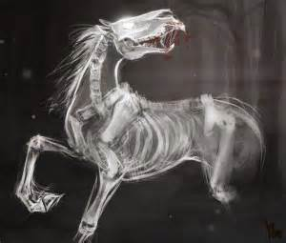
there are two versions of his death which was result of participating in the race
the first indicates that Glaucus had no food for his horses so they ate him instead
the other states that he had an accident as he traveled back to Corinth caused by Aphrodite using his horses as retribution for his violations against her
as a result of his death by his horses, Glaucus haunted the Isthmian Games in the form of a Taraxippus (horse disturber) which is ghost that stands in a passage of bank on the long side of the course

Slide 57
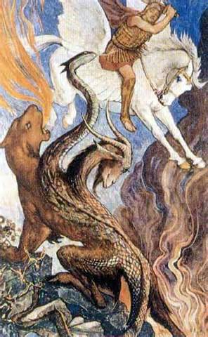
BELLEROPHON

Slide 58
son of Glaucus, king of Corinth, and Eurynome; some sources indicate that his father was Poseidon as Glaucus was ordained to have no children by the gods
traveled to Tyrins to be purged for the slaying of his brother, Deliades
some sources indicate that he may have slain a shadowy enemy named Belleros, hence the name Bellerophon (slayer of Belleros)
he was propitiated of his crime by Proteus (uncle of Perseus)
while staying with Proteus, Stheneboea, the wife of Proteus became enamored of Bellerophon (Homer calls her Anteia in the Iliad)
in anger she accuses Bellerophon of attempting to seduce her to Proteus and demands that Bellerophon must die

Slide 59
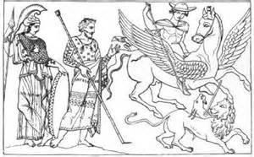
fearing the wrath of Zeus for violating the bonds of host and guest, Proteus sends him to Lycia on the plains of the Xanthus River to carry a message to Iobates, the father of Stheneboea
the message instructed Iobates to kill Bellerophon for attempting to violate his wife, Iobates’ daughter
Bellerophon was treated hospitably for nine days before Iobates read the message
Iobates also feared the wrath of Zeus and the Furies for killing a guest

Slide 60
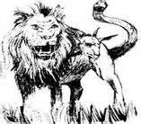
rather than kill Bellerophon, Iobates requests that he rid neighboring Caria of the Chimera
the Chimera had the head of a lion, the body of a goat and the tail of a serpent (or dragon) and breathed fire
the Lycian seer Polyidus told Bellerophon that he would need the winged horse Pegasus in order to defeat the Chimera

Slide 61
Polyidus told Bellerophon to sleep in the temple of Athena in order to learn how to capture Pegasus
Athena appeared to him in a dream and told him to use the golden bridle to tame the winged horse
when he awoke, the golden bridle lay beside him and Athena directed him to the Pirene, a favorite spring of Pegasus
Pindar says that Poseidon gave Pegasus to him as a gift
when Bellerophon approached the horse with the golden bridle, Pegasus came to him and submitted to the bridle
Bellerophon mounted Pegasus and flew to Caria

Slide 62
mounted on Pegasus, Bellerophon slew the Chimera with his spear (some red clay pottery shows him wielding the trident of Poseidon)
another version indicates that he attached a block of lead to his spear
when the Chimera’s hot breath melted the lead, it filled her throat choking it to death
Bellerophon returned victorious to Iobates, but he refused to acknowledge his defeat of the Chimera
he then sent him to conquer the Solymi and the Amazons, whom he defeated by dropping boulders on them

Slide 63
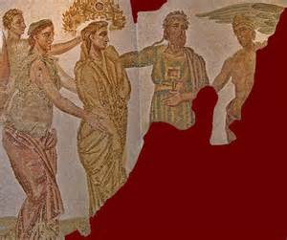
when these attempts failed, Iobates sent him to slay the Carian pirate Cheirmarrhus
Bellerophon slew all of the assassins sent to ambush him
when the palace guards were sent to kill him, Bellerophon prayed to Poseidon to flood the plains (he did)
the floods and Bellerophon retreated when the women of the palace lifted their robes offering themselves to him (he retreated out of modesty) (Plutarch, On the Virtues of Women)
Iobates finally gave up and gave Bellerophon his daughter Philonoe in marriage and half his kingdom

Slide 64
Philonoe bore him Isander who was killed by Ares in a battle with the Solymi (Homer, Iliad), Hippolochus, and Laodamia who bore Zeus Sarpedon who was slain by Patroclus during the Trojan War
Laodamia was slain by Artemis while weaving (Homer, Iliad)
Bellerophon felt that he deserved a place on Olympus and attempted to reach the palace of the gods on Pegasus
Zeus sent a gadfly to sting Pegasus throwing Bellerophon back to earth where he landed in a thorn bush
Bellerophon roamed the Plains of Aleion (Wandering) as hermit shunning men until his death (Pindar, Homer, Ovid)

Slide 65
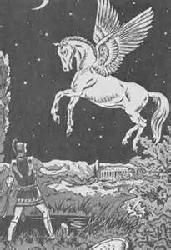
Pegasus
offspring of Poseidon and Medusa
captured and tamed by Athena and given to the Muses
the spring where his hoof first touched Mt. Helicon is the Hippocrene (horse spring)
after throwing Bellerophon, resided in the stables of Olympus and carried the thunderbolts for Zeus
when he was place among the stars, it is said that a single feather fell near Tarsus

Slide 66
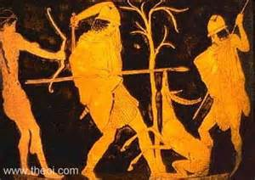
OTUS
&
EPHIALTES

Slide 67
the Aloadae were the twin sons of Poseidon and Iphimedia (some sources list Canace as their mother) the first wife of Aloeus
they were giants who grew three cubits in height and one in breadth each year
after nine years they attempted to take their place among the gods by piling Mt Ossa on top of Olympus and Mt Pelion on top of Ossa
Zeus called for his thunderbolt to subdue the twins, but Poseidon interceded on behalf of his sons, promising to keep them in line, which he did
they managed to capture Ares and hold him in a bronze jar for 13 months (lunar year)

Slide 68
Ares would have remained in the jar had not their stepmother Eriboea told Hermes who freed him
for her betrayal Aloeus had her flayed alive
next the twins decided that they would take a goddess for a wife: Otus, Hera and Ephialtes, Artemis (some sources have this reversed)
they drew lots to see whose lady would be taken first and Ephialtes won
they sought her in all of her favorite hunting places and haunts until they saw her on the shore heading for the sea
knowing their purpose she ran across the sea with the twins giving chase (being sons of Poseidon their feet never touched the water)

Slide 69
Artemis led them to the wooded island of Naxos (Dia) where she disappeared once they had caught up to her
instead of the goddess there stood a beautiful white hind which sprang into the woods
forgetting Artemis they gave chase to the hind, splitting up to better trap the beautiful animal
they spotted the hind in a clearing as they stood opposite of each other, the hind directly between them
as they hurled their javelins the hind disappeared and they were slain by each other’s weapon
they atoned for their actions in Hades by being bound by serpents to stone pillars tormented by the perpetual hooting of a screech owl

Slide 70
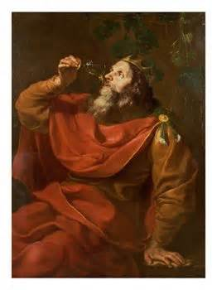
MIDAS

Slide 71
son of Gordias and king of Phrygia, the land of roses
Gordias was a poor farmer on whose cart pole an eagle landed and did not move as he drove to the temple of Zeus in Telmissus
Gordias took this as sign that he would become a king
as he approached the gates of the city a seeress told him to sacrifice to Zeus and to allow her to accompany him to select his offerings
Gordias agreed if she would marry him to which she agreed after the sacrifice was completed
meanwhile the Phrygians consulted the oracle about their lack of a king

Slide 72
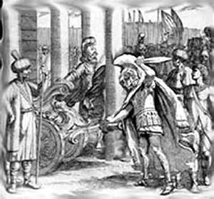
the oracle advised them that a man driving an ox-cart would be their next king
Gordias was made king and the ox-cart was preserved on the acropolis of the city of Gordium which he founded
the yoke of the cart was tied to the cart with an intricate knot designed by Gordias known as the Gordian Knot, often associated with a difficult problem
legend stated that he who could untie the knot would rule Asia
Alexander the Great solved the problem by cutting it down the middle

Slide 73
Midas became king after the death of his father
the satyr Silenus, mentor and teacher of Dionysus, became drunk and wandered into Phrygia (some say that he passed out in the rose garden of Midas)
the Phrygians carried him to Midas who recognized him and carried him back to Dionysus after 11 days
Dionysus offered Midas any gift of his choosing
Midas chose the “golden touch” not thinking of the consequences
he picked up a twig which turned to gold as well as any other object that he touched
when his food turned to gold he realized his folly

Slide 74
Midas returned to Dionysus and asked for the wish to be reversed
Dionysus told Midas to bathe in the river Pactolus to remove the “touch”
the power was removed by the river and the shores of the river now have a golden hue
cured of the curse Midas was asked to be a judge in a music contest between Pan and Apollo
the other judge was Tmolus
Tmolus chose Apollo and Midas chose Pan
for his lack of taste in music Apollo gave Midas the ears of a donkey

Slide 75
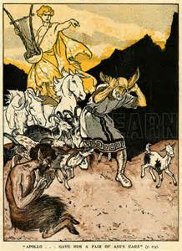
Midas was forced to wear a turban or headdress
only his barber knew of his humiliation but was sworn to secrecy
unable to hold the secret the barber dug a hole in the meadow and revealed the secret
soon a group of reed grew up and whispered “Midas has ass’s ears”

Slide 76
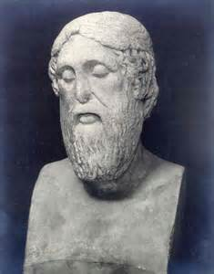
EPIMENIDES

Slide 77
the Rip van Winkle of Greek mythology
while tending his father’s sheep, he fell asleep while tending his sheep in a Cretan cave sacred to Zeus and slept for 57 years
when he awoke, he had been given the power of prophecy
he was sent by the oracle of Delphi to purify Athens of a pollution caused by the Alcmaeonidae
Megacles had killed followers of Cylon while a suppliant in the temple of Athena
Epimenides purified the city and, rather than accept the large payment from the citizens of Athens, he only asked for peace and friendship between Athens and Knossus his home

Slide 78
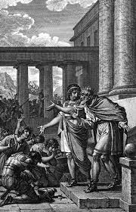
AEACUS

Slide 79
Aeacus was the son of Zeus and Aegina, the daughter of the river-god Asopus
To protect her from the anger of Asopus Zeus carried her to the island of Oenopia
Aeacus renamed the island Aegina after his mother and became its king
He was known for his piety and respect for justice
When Nisus and Sceiron were disputing the throne of Megara, they asked Aeacus to judge
Aeacus ruled that Nisus should be king and Sceiron minister of defense
Sceiron felt that Aeacus had judged fairly and gave him his daughter, Endeïs, for his wife

Slide 80
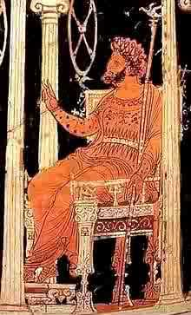
Aeacus gained further respect and admiration when all Greek lands were struck by a drought for either the murder of Stymphalus by Pelops or the treatment of Androgeus by Aegeus
The oracle at Delphi told the Greek leaders that the drought could only be lifted by the prayers of Aeacus
Envoys were sent to Aeacus to beseech him to pray to which he responded that he would do what he could to help
Aeacus prayed to Zeus and fertility was restored to the lands except Attica where the capitulation of Aegeus to Minos lifted the drought
Endeïs bore him two sons, Peleus (father of Achilles) and Telamon (father of Ajax and Teucer)
Aeacus was also the father of Phocus by the nereid Psamathe

Slide 81
Phocus excelled in athletic prowess more so than Teucer and Peleus and was favored more by Aeacus
Teucer and Peleus slew Phocus and were exiled by Aeacus from Aegina
Peleus
After leaving Aegina, Peleus came to Phthia where he was purified by its king Eurytion who gave him part of his kingdom
Peleus accompanied Eurytion on the Calydonian boar hunt where he accidentally killed Eurytion with a javelin intended for the boar
Once again Peleus was sent into exile and was purified by Acastus, the son of Pelias and king of Iolcus

Slide 82
Astydamia, the wife of Acastus, fell in love with Peleus and, when he refused her advances, she accused him of trying to seduce her
Rather than kill his guest, Acastus took Peleus hunting on Mt. Pelion where he left him asleep after the hunt
Acastus hid his invincible sword, a gift from Hephaestus, in a pile of dung which is a folk tale element describing how Peleus would cut out the tongues of the animals he killed to prove his skill as a hunter (Apollodorus) (also footnote fodder)
Peleus awoke to find himself surrounded by wild animals and centaurs who would have killed him had he not been protected by Chiron who returned his sword to him
He avenged himself by sacking Iolcus and marching his army between the severed body parts of Astydamia

Slide 83
Peleus later married Thetis on Mt. Pelion who bore him Achilles
The Myrmidons
In a fit of jealous rage against Aegina, Hera sent a plague of intense heat on the island
Ovid (Metamorphoses) describes the heat as so intense that animals and humans alike fell dead; and those seeking the coolness of the ground only felt more heat
Ovid also relates that those who placed the dead on funeral pyres also threw themselves onto the pyres to escape the plague
Priests could not sacrifice bulls as they would die before reaching the altar

Slide 84
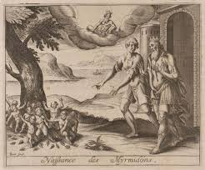
Aeacus climbed the stairs to the temple of Jupiter and prayed for an end to the plague
As he prayed, an oak spread its branches over him and he saw a trail of ants each with piece of grain in its mouth
Aeacus prayed that Jupiter would fill his cities with people as great as this army of ants and kissed the oak down to its roots
That night Aeacus dreamed that he saw the oak tree again and its branches were filled with ants
A mighty tremor shook the tree and the ants fell to the grasses below and began to grow and stand upright, taking on human form with strong arms and legs

Slide 85
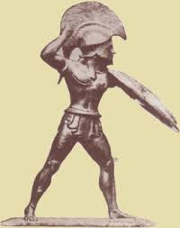
The next morning Aeacus was awakened by unfamiliar voices and his son Telamon telling him that the dream had been fulfilled
Aeacus called his new populace Myrmidons after the Greek name for the ant, myrmex.
The Myrmidons were strong, hardworking, thrifty and honest creatures
These were the forces that Achilles took to Troy

Slide 86
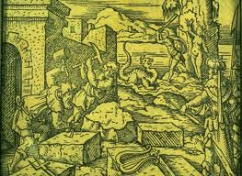
The Walls of Troy
When Poseidon and Apollo built the walls of Troy, they took Aeacus as their assistant (Pindar, Olympian Odes)
Upon completion of the work three serpents (or dragons) approached the walls
The two that attacked the walls built by the gods fell dead, while the one that attacked those build by Aeacus found a way through
This prompted Apollo to prophesy that Troy would fall at the hands of the Aeacidae (descendants of Aeacus)

Slide 87
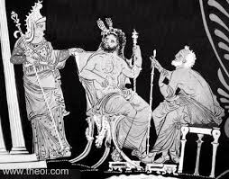
The death of Aeacus
After the his death, the sons of Phocus also left Aegina
Aeacus was left to rule alone in his last days
Upon his death he was made the third judge in the Underworld with the Cretan brothers Minos and Rhadamanthys
In works of art he is represented as carrying a scepter and the keys to the gates of Hades

Slide 88
AMYMONE
Amymone was the daughter of Dana$üs$ and was sent to search for water after her family moved to the Argolid
Bored with her chore, she spotted a deer and hunted it
Her javelin missed its mark and struck a sleeping satyr who immediately pursued her
Her cries for help were heard by Poseidon who came to her aid and dispatched the satyr
She lay with Poseidon and, suddenly remembering her task, Poseidon struck the ground with his trident and created a triple stream which was named after her (the name was later changed to Lerna)
She bore Poseidon a son, Nauplius, who was a famous navigator and for whom the port of Argos was named
She is represented with a water pitcher as a reminder of the sacred spring of Lerna and the copious springs that made Argos well-watered
Note: Her name means “blameless one” and is sometimes identified as Hypermnestra, the Danaid who did not slay her husband

Slide 89
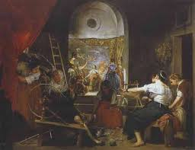
ARACHNE

Slide 90
The myth of Arachne comes from Ovid’s Metamorphoses, Book 6, 1-145.
Arachne was the daughter of Idmon of Colophon who was skilled at the art of weaving
Living in the Lydian village of Hypaepa even the nymphs of the fountains and forests would leave their haunts to watch her spin her beautiful tapestries
Those who watched insisted that Minerva herself had been her teacher
Arachne denied that Minerva was her teacher and took offense when her work was called divine
Arachne even dared Minerva to compete with her and offered to give up weaving if Minerva won

Slide 91
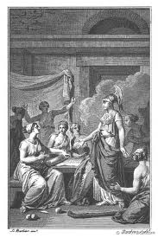
Disguised as an old woman, Minerva approached Arachne and advised her to accept her earthly talent and to seek the forgiveness of the goddess
This advice only infuriated Arachne more and with fists clenched as if to strike the old woman asked where her goddess was and why she refused to compete with her
It was then that Minerva dropped her disguise and the nymphs and Thracian women fell to their knees except for Arachne

Slide 92
Pallas (Minerva) spun the contest of the naming of Athens restoring Cecrops on the hill of Mars
Beneath the hill stood the twelve Olympians, six on each side with Jupiter in the center in regal garments
Neptune was depicted striking the rock from which sprang the horse, his gift to the city
Opposite was Minerva in helmet and aegis striking the earth with her spear from which sprang the olive tree
In the corners she spun the fates of mortals who dared to claim equality or superiority to the gods
In the first corner were Queen Rhodope of Thrace and her husband Haemus who were changed into Mount Rhodope and the Balkan Mountains for comparing themselves to Zeus and Hera

Slide 93
In the second corner she spun the fate of the Pygmy queen Gerana who boasted equal beauty to Hera and was turned into a crane (thereafter the Pygmies and cranes were constantly at war with each other)
The third corner depicted Antigone of Troy, the sister of Priam who was turned into a stork for also boasting of superior beauty to Hera (Note: One source states that Hera turned her hair into snakes and another god took pity on her and transformed her into a stork, which thereafter preyed on snakes)
The fourth portrayed Cinyras who was clasping the steps of the temple which had been the knees of his daughters (Note: Ovid does not state if this offense was the result of his musical contest with Apollo which he lost and was killed by Apollo, his daughters flinging themselves into the sea and were changed into sea birds)
Minerva framed her tapestry with olive branches, the sign of peace

Slide 94
The center of Arachne’s tapestry was Europa and the bull with waves so realistic that they seemed to move as she wove
Around this she wove the various indiscretions of the gods beginning with Jupiter
She wove Asteria pursued by Jupiter in the form of an eagle who flung herself into the Aegean Sea in the form of a quail to escape his advances and became Ortygia (“Quail Island” the birthplace of Diana)
This was followed by Leda and the swan; as the satyr who slept with Antiope; the deception to Alcmena; the golden shower of Danaë; the tickling flame to Aegina; the happy shepherd to Mnemosyne; and the spotted snake to Proserpina

Slide 95
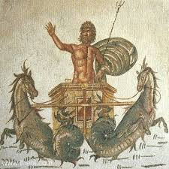
Next she turned her attention to Neptune portraying him as the bull with Canace; then as Epineus he conceived two giants; as a ram he took Theophane; the mild Ceres as a horse; Medusa as a bird; and Melantho as a dolphin
Apollo followed depicted with hawk feathers or a lion’s mane
How as a shepherd he played with Issa, Macareus’ daughter

Slide 96
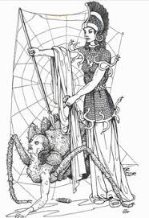
She wove Bacchus hidden in a bowl of grapes to trick Erigone
Finally she wove how Saturn, changed into a horse, conceived the centaur Chiron
She framed her scene with flowers and ivy
None could condemn her work which threw Minerva into a rage and she tore her work to shreds
Then Minerva took her shuttle and beat her about the face four times
Unable to take any further punishment, Arachne hung herself
As she swung, Minerva took pity and sprinkled her with Hecate’s potion changing her into a spider to be the tenuous weaver of an ancient craft

Slide 97
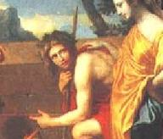
ARCAS

Slide 98
Arcas was the son of Zeus and Callisto, who was changed into a bear by Hera in a rage of jealousy
Arcas was either rescued from his mother’s womb by Hermes and raised by Maia in Arcadia or sent to live in the court of Lycaon his maternal grandfather
While Zeus to wandering earth disguised as a peasant, he came to the house of Lycaon
Lycaon killed Arcas, cut him into pieces, cooked him and served him to Zeus thinking that he could fool him
Zeus immediately overturned the table and struck the house with his thunderbolt killing all the sons of Lycaon except Nyctimus
Zeus then restored Arcas to life

Slide 99
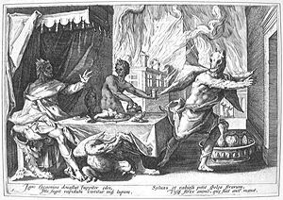
Zeus then turned his attention to the fleeing Lycaon and transformed him into a werewolf
Arcas succeeded Nyctimus as king and introduced weaving, bread-making and crop cultivation to the Arcadians which he learned from Triptolemus
He had three sons Azan, Apheidus and Elatus who upon his death drew lots for and received respectively Azania, Tegea and Mt Cyllene
He also had an illegitimate son Autolaüs

Slide 100
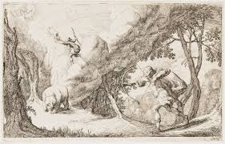
At the demand of the Delphic oracle the Mantineians brought the bones of Arcas to their city from the ruins of Maenalus
The most accepted version is that, while hunting, he spotted a bear which was Callisto
Before he could raise and toss his javelin, Zeus raised both to the heavens as constellations: Callisto as the Great Bear (Arctus, Ursa Major, or the Big Dipper); Arcas as Arctophylax, guardian of the Great Bear (Arcturus, Böotes, Ursa Minor, or the Little Dipper)
Note: Ursa Major was also known as Haxama (the Wain)

Slide 101
In Book I of the Metamorphoses Ovid describes the victim of Lycaon’s attempt to deceive Zeus as a Northern Prisoner and not Arcas
In Book II he describes the myth of Jupiter and Callisto whom he calls the Arcadian nymph
He also relates how Juno visits the realm of Tethys and Oceanus and requested that they “forbid these bearlike beings in the stars to wade your waters”
Some sources say that she made the request of Poseidon
Arcadia
Arcadia derives its name from Arcas

Slide 102
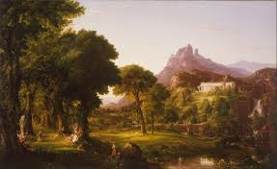
It is a mountainous region of the interior of the Peloponnesus
The first ruler of Arcadia was Pelasgus who was either earth born or an immigrant from Argos
Pelasgus taught the naked, root-eating inhabitants the rudiments of shelter, clothing and diet
Lycaon was his son by either the nymph Cyllene or the Oceanid Meliboea

Slide 103
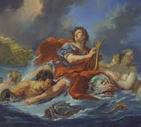
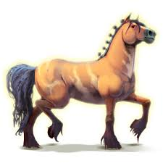
ARION

Slide 104
The poet
He was a poet who lived ca. 700 B.C.
He was credited with inventing the dithyramb, a choral ode to Dionysus
Not only was he skilled in poetry and music, but he also had a beautiful voice when he sang
He traveled from Corinth to Sicily for a contest which he won
On the return trip the crew of the ship decided to take the prize and kill Arion
He asked that he be allowed to sing one more song which was granted
As he sang, his beautiful voice attracted dolphins who carried him to safety

Slide 105
He proceeded to Corinth where he related the details of his journey to the king Periander
Periander did not believe him until the ship arrived in the port and the sailors told him that Arion had remained in Sicily
At that moment Arion appeared wearing the same robes as he had on the day of his rescue
They confessed their crime and were crucified by the king
Periander then ordered a bronze statue of a man on a dolphin be erected at Taenarum
Apollo then placed both Arion and the dolphin (Delphinus) among the stars

Slide 106
The divine horse
While searching for Persephone, Demeter disguised herself as a mare to escape the pursuit of Poseidon
Poseidon changed himself into a stallion and mounted her
Two offspring were born as a result: a daughter, Desponia, whose name was known only to the initiates of the Eleusinian mysteries and the swift horse Arion
Arion ran with the herds of Oncius until Heracles begged for him
Heracles later gave Arion to Adrastus
It was Arion who saved the life of Adrastus in the battle of the Seven against Thebes

Slide 107
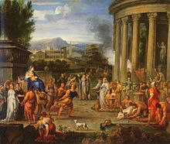
BITON
&
CLEOBIS

Slide 108
Biton and Cleobis are two brothers whose legend is related by Solon to Croesus (Herodotus, Histories)
Their mother Cydippe was a priestess of Hera who desired to travel to Argos for a festival of Hera; and to see the ivory and gold statue of the goddess sculpted by Polyclitus whose talent rivaled that of Phidias
The oxen that would pull her cart had not returned from the fields
As it was growing late, Biton and Cleobis harnessed themselves to the cart and pulled her to the temple in Argos, a distance of 5.1 miles
Cydippe was so impressed by their devotion to her and her goddess that she prayed to Hera that she would give them the best gift that a god could give a mortal

Slide 109
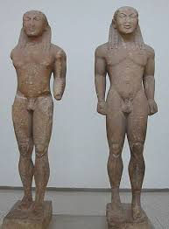
Hera heard the prayer and ordained that the brothers would die in their sleep at the festival where they, her mother and Hera were all being praised; and be worshiped as heroes
That night the brothers lay down to sleep in the temple and never awoke
The Argives erected statues of the brothers to the sanctuary of Apollo at Delphi

Slide 110
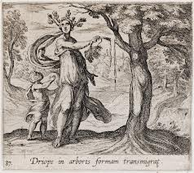
DRYOPE

Slide 111
This myth is mentioned in Book IX of Ovid’s Metamorphoses
Dryope was the daughter of Euryton, king of Oechalia, by his first wife
Dryope was seduced by Apollo
After marrying Andaemon, she bore a son to Apollo whom her father named Amphissus
One afternoon she and her sister, Iole, were myrtle and daisies to make garlands to honor the nymphs
They sat beside a small lake and, wishing to amuse her son, plucked a lotus blossom
Iole notice blood dripping from the stem
The tree was the nymph Lotis who had been transformed into the tree which bore her name while trying to escape from Priapus

Slide 112
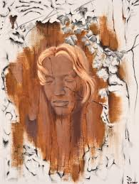
Before she could offer a prayer of forgiveness, she felt herself rooted to the ground
Soon her body began to grow bark
Iole brought Andaemon to the spot where Dryope asked that he bring her son there to play in the shade and to warn him to be careful of picking any flowers or plants as one does not always know if a nymph is living in it
With that her face was covered in bark and she too became a lotus tree
Note: This is not the same Dryope who lured Hylas away from the quest for the golden fleece at Hera’s request

Slide 113
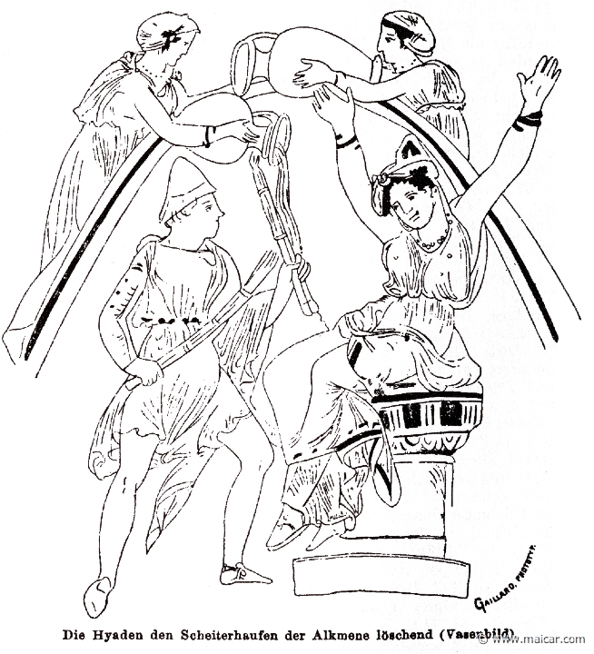
THE HYADES

Slide 114
The Hyades were the daughters of Atlas and, either Pleïone or the Oceanid Aethra
They derive their name from their brother Hyas whose name means “to rain” and who was killed by a boar or lion
The sisters wept until Zeus placed them in the stars at the head of the constellation Taurus
They are called the “rainy stars” because of their setting in the evening and morning bringing rain in May and November
They were said to have cared for Dionysus on Mt. Nysa at the request of Zeus
Their sisters are the Pleiades and the Hesperides
The Roman name for the Hyades is Suculae

Slide 115
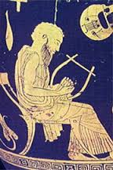
LINUS

Slide 116
Linus was a poet-musician whose death was widely mourned
Since there were so many traditions about Linus, Pausanias tried to distinguish three separate persons named Linus
Son of Psamathe and Apollo
Psamathe was the daughter of King Crotopus of Argos
She exposed the infant fearing the anger of her father if the child was discovered
He was discovered and raised by shepherds until the dogs of Crotopus found and ate him
Upon discovering the death of his child, Apollo sent Poine (Vengeance) to punish the Argives by snatching children from their mothers

Slide 117
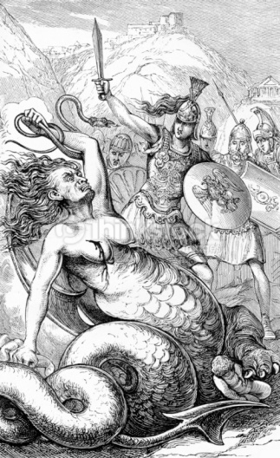
Poine was slain by Coroebus, causing Apollo to send a second punishment against Argos
Coroebus went to Delphi to be punished individually so that Argos did not have to suffer further
The Pythia told him to carry a tripod until he dropped it and to settle there
The tripod dropped in the Geraneian Mountains
To appease Apollo, the Argives erected a temple midway between Argos and Delphi where Linus and his mother were bewailed by the mothers and children of Argos

Slide 118
Son of Urania and Amphimarus
This son of the Muse Urania and Amphimarus, a son of Poseidon, was slain by Apollo because of his skill in music
Son of Apollo and Calliope
This son of Apollo is considered the inventor of melody and rhythm
He taught his brother, Orpheus, to play the lyre and then moved to Thebes
He also taught music to Heracles but was slain by his student when he reprimanded him for making errors

Slide 119
ailinon
The general belief is that the personification of Linus the musician grew up as an explanation of ancient songs that were sung to the word ailinon as a lament for harvested crops or dying vegetation
The name Linus is taken from this lament
Ailinon means “woe is me”
Our English word alas is derived from ailinon

Slide 120
MARPESSA

Slide 121
Marpessa, whose name means “the robbed one”, was the daughter of Alcippe and Evenus, the son of Ares and Demonice and king of Aetolia
Idas, an Argonaut and a hero of the Calydonian Boar Hunt, loved Marpessa and she returned his love
Apollo also loved Marpessa
When Evenus refused to allow them to marry, Idas sought the aid of Poseidon
Poseidon gave him a winged chariot to aid him in his quest
When Idas and Marpessa fled Aetolia, Evenus gave chase but was no match for the chariot of Poseidon

Slide 122
Evenus pursued them as far as the Aetolian river Lycormas
There he killed his horses and either out rage or grief drowned himself in the river which was thereafter named for him
Although Evenus gave up the chase, Apollo did not
Apollo and Idas squared off to fight for Marpessa’s affection, but Zeus stepped in between them ordering Marpessa to choose
Marpessa chose Idas fearing that Apollo would lose interest in her when she had grown older
Marpessa bore a daughter, Cleopatra, who married Meleager
Pausanias states that, when Idas died, Marpessa killed herself

Slide 123
MARSYAS

Slide 124
The aulos, the double-piped flute, was invented by Athena but discarded and cursed when her face became distorted as she played it and the other gods ridiculed her
The flute was found by the satyr, Marsyas, who picked it up and taught himself to play the instrument beautifully
He challenged Apollo to a music contest to be judged by the Muses which Apollo accepted with the provision that winner might do whatever he wished to the loser
Marsyas played so eloquently that he would have won had not Apollo played the lyre upside down, a feat that he could not perform

Slide 125
Apollo hung Marsyas from a pine tree in Celaenae in Phrygia and flayed him alive
Book VI of Ovid’s Metamorphoses states that all the nymphs, forest gods, his brother satyrs, and shepherds rained so many tears for Marsyas that the clearest stream in ancient Phrygia was formed which bore his name and flowed into the Maeander River
His body was given to either his father or his student, Olympus
The flute itself floated down this river to the Maeander and reappeared near Asopus where a shepherd found it and dedicated it to Apollo

Slide 126
Apollo hated flute music for a long time after the contest until he was reconciled to it by an Argive musician named Sacadas
Apollo permitted the Pythian flute tune to be played at Delphi
In spite of his ignoble end Marsyas remained a hero in Phrygia

Slide 127
MELAMPUS

Slide 128
Melampus is another of the seers of Greek mythology, and is perhaps the first, although not as well known as Tiresias or Calchas
An Aeolid from Thessaly he moved to the Peloponnesus with his parents, Amythaon and Idomene, and his brother, Bias
He and Bias prospered in Pylos for a time but Melampus later moved to a rural area to live with Polyphantes
After Polyphantes killed two snakes that had bitten and killed his servants, Melampus rescued and reared the young snakes
During his sleep he awoke to find the snakes licking his ears only to discover that he could understand the language of birds and animals

Slide 129
With the aid of the birds’ and animals’ knowledge of the future and the personal interest of Apollo, whom he met at the Alpheius River, Melampus became a seer
Melampus was devoted to his brother who had fallen in love with Pero, the daughter of Neleus
When Neleus demanded the cattle of Phylacus, king of Phylace, as a dowry, Bias turned to Melampus for help

Slide 130
The cattle were guarded by a dangerous, unsleeping dog but Melampus agreed to help Bias knowing that it would take one year to complete the task
Melampus divined that he would be imprisoned for one year
He was captured in the cattle yard of Phylacus and locked in a small cell in Phylacus’ barn
At the end of a year Melampus heard two wood worms talking in the beams overhead
One boasted that he had nearly gnawed through the beam
Melampus called for his keeper who moved him to another cell just as the roof collapsed

Slide 131
When Phylacus heard of the powers of Melampus, he sent for him to consult with him on a problem of his own
Phylacus had son named Iphiclus by Clymene, the daughter of Minyas
Iphiclus was so fleet it was said that he could race the wind without crushing the heads of the wheat or asphodel
But this fame was of little consequence to him since he was impotent
When Melampus learned of the disability, he offered effect a cure in return for the cattle to which Phylacus agreed

Slide 132
Melampus sacrificed two bulls (some versions say oxen) and invited birds to the feast, the last of which was an old vulture
The vulture told Melampus that, as a young boy, Iphiclus had seen his father carrying a bloody knife after gelding some rams which frightened him immensely
To avoid further scaring his son, Phylacus drove the knife into an oak tree (or wild pear) which was the home of a hamadryad who cursed the prince into sickness
The vulture then offered the cure which was to locate the knife and boil it in water and make a potion of the rust on the blade
Iphiclus was to drink the water for ten consecutive days
Phylacus did as instructed and Iphiclus was cured later becoming the father of Podarces and Protesilaüs

Slide 133
Melampus returned driving the cattle and Neleus had no choice but to give Pero’s hand to Bias in marriage
Pero bore him a son, Talaüs
Melampus’ fame as a seer caused Proëtus (some claim that it was later during the reign of Anaxagoras) to ask him to come to Tiryns to cure his daughters of madness
Melampus agreed but requested a third or a half of his kingdom in return
Proëtus refused and the madness spread to the remaining Argive women

Slide 134
The women lost their hair, became leprous and, imagining themselves to be cattle, roamed wildly through the mountains and deserts
Proëtus and the Argive men were ready to accept his terms but, having the upper hand, Melampus now demanded a third for Bias
The terms were accepted and Melampus and Bias together with corps of Argive youths drove the women either to Lusi or Sicyon
During the ordeal Iphinoë died but her two sisters, Lysippe and Iphianassa were cured along with the other women with herbs and the rites of purification
Melampus threw the remaining herbs into the river whose waters Ovid claims were a cure for drunkenness

Slide 135
Melampus and Bias were duly paid and even married the remaining daughters of Proëtus
Melampus married Lysippe who bore him Abas, Mantius and Antiphantes whose grandson was Amphiariüs, one of the Seven against Thebes
Bias married Iphianassa and his grandchildren were also prominent in the Seven against Thebes
Pindar states that Melampus gave up divination when he became a king in Argos
Herodotus states that Melampus taught the rites of Dionysus to the Greeks having learned them from Cadmus

Slide 136
MEROPE (Messenia)

Slide 137
Merope was the daughter of Cypselus of Arcadia and descended from Arcas, the son of Zeus and Callisto
She was married to Cresphontes, a Heraclid, to whom she bore three sons
Two of the sons remained with their parents in Messenia while the third, Aepytus, was sent to be raised by his grandfather, Cypselus
Cresphontes and his two older sons were killed by another Heraclid, Polyphontes, who forced Merope to marry him
Aepytus returned to Messenia unknown to his mother to exact vengeance on the murders of his father and brothers
He claimed to have killed Aepytus and would have been killed by his mother had not an old man recognized him and warned her

Slide 138
Together they plotted to kill Polyphontes
Polyphontes offered a sacrifice of triumph and invited the supposed murderer to participate
As Aepytus raised the sacrificial ax, rather than strike the sacrifice, he brought it down on Polyphontes
His rule was just and shrewd and gained such honor that his descendants were no longer called Heraclidae but Aepytidae

Slide 139
THE MUSES

Slide 140
The Muses were nine in number and were the daughters of Zeus and the Titaness Mnemosyne (Memory) and were attributed to various arts and sciences They lived on Mt Helicon
Muse | Domain | Meaning of Name | Emblem
Calliope | Epic Poetry | The Fair-voice | Writing Tablet
Clio | History | The Proclaimer | Scrolls
Erato | Love Poetry | The Lovely | Cithara (an ancient Greek instrument in the lyre family)
Euterpe | Song and Elegiac Poetry | The Giver of Pleasure | Aulos (an ancient Greek flute)
Melpomene | Tragedy | The Songstress | Tragic mask
Polyhymnia | Hymns | She of Many Hymns | Veil
Terpsichore | Dance | The Whirler | Lyre
Thalia | Comedy | The Flourishing | Comic mask
Urania | Astronomy | The Heavenly | Globe and compass

Slide 141
MYRRHA

Slide 142
Myrrha was the daughter of Cinyras, king of Paphos in Cyprus, and Cenchreïs (she is also called Smyrna by Apollodorus, Panyasis, and Hyginus)
Either because Cenchreïs boasted that Myrrha was more beautiful than Aphrodite or Myrrha herself did not honor the goddess properly, Aphrodite punished her with an incestuous infatuation for her father
Aided by her nurse she arranged to sleep with him for twelve nights while her father was intoxicated thinking her to be a concubine with whom he was sleeping in the absence of his wife
Myrrha became pregnant and was pursued by her father with a sword when he discovered what has occurred

Slide 143
When she could run no more, she begged the gods to make her invisible
The gods transformed her into a myrrh tree, her tears becoming the fragrant drippings that exude from the tree itself
Cinyras killed himself out of shame for the incestuous union
After nine months, the tree split open and Adonis was born

Slide 144
Ovid’s version of the myth appears in Book X of his Metamorphoses
In his version Cupid denies that it his arrows that caused the infatuation of Myrrha for her father
Ovid claims that it was a Fury from Styx that lit these flames in Myrrha
Myrrha could have had the pick of any of the young men within hers and the surrounding kingdoms but none would do but her father
Unable to control the urges, Myrrha decided to hang herself but in the attempt attracted the curiosity of her nurse who was sleeping outside her door

Slide 145
The nurse agreed to assist her in sleeping with her father as long as she agreed not to attempt to hang herself again
It was time for the festival of Ceres when all married women went out in praise of the harvest
During the festival wives would not share their husband’s beds for nine days
Among them was Cenchreïs who was the purest of them all and never failed to keep the letter of the law

Slide 146
It was during this festival that the nurse approached Cinyras, who was intoxicated on wine, and told him that she could arrange for him a concubine about the age of his daughter
Cinyras agreed and the nurse hurriedly returned to Myrrha to tell her
Myrrha stumbled three times as she approached her father’s chamber
The arrangement lasted several nights in complete darkness until Cinyras raised a lamp “to see his treasure”
He went wild with horror and picked up his sword to kill her but she was able to flee
She walked for nine months from Cyprus past the palms of Arabia, the fields of Panchaia until she reached Sabaea

Slide 147
She begged for relief from the gods who transformed her into a myrrh and her weeping tears became the fragrant drippings of the same tree
With the help of Lucina the bark split open and Adonis was born

Slide 148
NYMPHS

Slide 149
A nymph was a daimon that resided in a particular place, object or natural phenomenon
Classifications
Dryads, Hamadryads: wood nymphs which originally belonged to oak trees but later Dryads were later ascribed to any tree
Meliae: wood nymphs of the ash tree
Naïads: fresh water nymphs of springs, lakes and streams
Nereids, Oceanids: sea nymphs although very few Oceanids are associated with the sea; Thetis and Dione may have been goddesses reduced to a lesser rank
Oreads: mountain nymphs

Slide 150
Most nymphs were confined to their own mountains, springs, groves, or even individual trees
Tales set in particular locations reflect the most typical view of nymphs, e.g. the aggressive love of a water nymph for Hylas
The term nymph means young woman

Slide 151
POMONA

Slide 152
Pomona was a Roman goddess of fruitful abundance whose name is derived from the Latin pomum meaning fruit, specifically orchard fruit
She has no Greek counterpart
In Book XIV of his Metamorphoses, Ovid describes her rejection of all suitors including Pan, Silenus and many satyrs
She kept her gardens and orchards locked away from mankind
Even Vertumnus, the Roman god of seasonal change, attempted to win her affections disguising himself as a harvester offering a basket of sweet barley; as a farmer with hayseed in his hair coming from the hay fields; as a cattle herd who had just turned his oxen to pasture; as a handyman with a ladder and pruning shears as if to pick apples; a fisherman; and, a soldier

Slide 153
He got her permission to view her from a respectable distance
One day he appeared as an old woman with gray hair, wearing a bright turban and leaning on a stick
He walked about the garden admiring the apples and peaches; and then with admiration for Pomona gave her a kiss
Then he sank to the ground and looked at an elm tree which supported vines of ripe, round grapes
Then he remarked that, if the tree stood alone, it would be viewed only for its pretty leaves

Slide 154
Then he turned his attention to the vine, stating that, if the vine did not have the tree, its fruit would fade away in the weeds and grasses
Vertumnus then told her that she could have more suitors than Helen of Troy, or the girl who caused the battle between the Lapiths and Centaurs, or the number of suitors vying for the attention of Penelope while Ulysses was away, if she were to change her mind about remaining single
Then he told her to forget ordinary men and to take the best—Vertumnus
He then reminded her that Venus took fearful toll of those who hold hard hearts and scorn love
He then proceeded to tell her the story of Iphis and Anaxarete

Slide 155
Anaxarete was beautiful maiden of Cyprus who was loved by a poor shepherd named Iphis
Iphis professed his love of Anaxarete to her nurse and then to her servants, which she scoffed
He hung flowers on her the lintel of her doorpost, “watered with tears”
Unable to bear the rejection any longer, Iphis hung himself on the lintel which he had adorned with flowers
As he hung his feet knocked on the door, the servants opened only find Iphis hanging before them
They cut him down and carried him to his mother

Slide 156
His mother did the only thing left to do: carry his body to the funeral pyre
The pyre was near the house of Anaxarete who ran to the balcony to view the funeral
Still unmoved by the sight, Venus turned her into a stone statue which still stands at Salamis in the temple of the Staring Venus (Venus Prospiciens)
Realizing that the speech of an elderly woman still had not moved Pomona, he dropped his disguise

Slide 157
Dazzled by his godlike figure, Pomona “melted in is arms”
Pomona and Vertumnus shared a festival on August 13 known as the Verumnalia
The pruning shear is the attribute of Pomona

Slide 158
RHOECUS

Slide 159
Rhoecus was a young man who enjoyed walking through the forests of Attica
One morning, as he was passing through a forest on his way to meet friends for a day of games, he passed an oak tree that was about to fall over
Knowing that Dryads and Hamadryads often inhabited trees, yet unsure if this particular oak was so, Rhoecus propped it up to prevent it from being toppled by a strong wind
As he turned his back to leave, he heard a voice come from the oak expressing her gratitude for saving her and asked what he would have for a reward
Rhoecus boldly asked for her love and the nymph yielded to his desire

Slide 160
The nymph agreed but on the condition that he be faithful to return to her each day one hour before sunset and to communicate with her messenger, a bee
Rhoecus agreed and proceeded to meet his friends for either a game of dice or some athletic contests which included foot races, javelin throwing and quoits
Being past noon, he was caught up in his game(s) and ignored the bee that was buzzing about his ear eventually brushing it aside and injuring it
Glancing at the bee, Rhoecus noticed that the sun had reached the peaks of the mountains and remembered his promise

Slide 161
Rhoecus ran quickly back to the Dryad, hoping to find her in a forgiving mood
The Dryad was angry that he had not kept his promise
He begged for her forgiveness and a second chance to prove himself but she refused and blinded him for failing to comply with her one request
This myth is recorded by Apollonius of Rhodes as a scholium in his Argonautica

Slide 162
SALMONEUS

Slide 163
Salmoneus was the son of Aeolus and Enarete and the brother of Athamas, Sisyphus, Cretheus, Perieres, Deioneus, Canace, Alcyone, and Perimede
He was the king of Salmonia, near Ellis on the Peloponnese
His first wife was Alcidice (Diodorus Siculus) , the daughter of Aleüs and Neaera, who bore him a daughter, Tyro
His second wife was Sidero who with Salmoneus mistreated Tyro when she claimed that Poseidon was the father of her two sons
Salmoneus was arrogant, and either called himself Zeus or boasted that he was greater than Zeus
To prove his claim he would drive his four-horse chariot through the streets pulling dried hides and bronze kettles (thunder) and hurling firebrands into the air (lightning)

Slide 164
Other sources such as Hyginus and Apollodorus state that he had built a bronze bridge and drove his chariot over it to create the sound of thunder
Zeus threw his thunderbolt and killed Salmoneus and destroyed his city
Vergil has Aeneas seeing Salmoneus in Tartarus suffering eternal torment in the Aeneid
Note: This myth can be traced to the custom of imitating rainstorms in order to bring rain. Salmoneus may have been a weather magician

Slide 165
SISYPHUS

Slide 166
Sisyphus was the son of Aeolus and Enarete and the brother of Athamas, Salmoneus, Cretheus, Perieres, Deioneus, Canace, Alcyone, and Perimede
He founded the city of Ephyra (original name of Corinth)
He was the father of Glaucus, Ornytion, Almus and Thersander by the Pleiad Merope and the grandfather of Bellerophon by Glaucus (Homer)
Sisyphus was noted for his cunning
When the thief Autolycus kept stealing his cattle undetected, Sisyphus recovered them by marking their hooves

Slide 167
He avenged himself by sleeping with Autolycus’ daughter, Anticleia
Odysseus was said by his enemies to have been born of this union rather than that of Anticleia’s husband Laërtes
According to Hyginus (Fabulae) Sisyphus hated his brother Salmoneus so much that he asked the Delphic oracle how to kill his brother without incurring with wrath of the gods
The oracle told him to have children by Salmoneus’ daughter Tyro and to have them kill Salmoneus
Tyro bore him two sons, but killed them upon learning of the oracle which caused Sisyphus to commit an unspecified impious act

Slide 168
Sisyphus promoted navigation and commerce but ruled Corinth with an iron fist killing all travelers and guests which violated Xenia, which fell under Zeus’ domain
He discovered the corpse of his nephew Melicertes that had been brought ashore by a dolphin after Ino had jumped into the sea to escape the madness of Athamas
Sisyphus buried the body where he discovered it and founded the Isthmian games in his honor
He told the river-god Asopus that he had seen Zeus abduct his daughter Aegina, the mother of Aeacus, in return for creating a spring on the Acrocorinth (acropolis of Corinth)

Slide 169
For revealing his abduction of Aegina, Zeus sent Thanatos (Death) to chain Sisyphus in Tartarus
Curious as to why Hermes was not escorting him to the Underworld, Sisyphus asked for a demonstration of how the chains worked
As Thanatos began to demonstrate, Sisyphus turned the tables and chained Thanatos in the Underworld, causing an uproar on earth since no mortals could die with Death chained in Hades
Annoyed that his battles had lost all enjoyment since no one could die, Ares intervened and freed Thanatos and turned Sisyphus over to him

Slide 170
Before returning with Ares to the Underworld Sisyphus told Merope not to make the customary sacrifices after his death
When Hades found that no sacrifices were being made, he sent Sisyphus back to earth to remonstrate with Merope
He stayed there until he died of old age and was buried on the Isthmus in a secret grave
As punishment for his deceit and trickery, Sisyphus was to push a boulder up a steep hill in Tartarus for his hubristic thought that he was more clever than Zeus

Slide 171
Zeus displayed his cleverness by causing the boulder to roll back down the hill just before he reached he top
In Book X of his Metamorphoses Ovid states that, when Orpheus played in the Underworld on his quest to regain Eurydice, Sisyphus sat on his stone until he finished
Any task that seems unending or fruitless is referred to as a Sisyphean task or Sisyphean

Slide 172
TYRO

Slide 173
Tyro was the daughter of Salmoneus and Alcidice who was raised by her uncle Cretheus, king of Iolcus, who later married her
She fell in love with the river Enipeus on whose banks she was often found for many hours
Poseidon took advantage of her infatuation with Enipeus and seduced disguised as the river
She secretly bore twin sons and exposed them in a field only to be found by horse herders who named them Pelias and Neleus
Some sources indicate that Salmoneus refused to believe her story of the twins’ paternity and, with Sidero whom Salmoneus had married after the death of Alcidice, mistreated her

Slide 174
Tyro eventually married Cretheus and bore him three sons, Aeson, Pheres and Amythaon
Pelias and Neleus sought out their mother when they had grown to manhood
When they had learned of the misery of Tyro at the hands of Sidero, they sought her out
Sidero, having learned of their arrival, sought refuge in the temple of Hera where she was found by Pelias
Pelias slew her in Hera’s temple invoking the goddess’s anger
She exacted her vengeance through his nephew Jason whom she aided in his quest for the Golden Fleece

Slide 175
REFERENCES
Gayley, Charles Mills. The Classical Myths in English Literature and in Art. New York: Blaisdell Publishing Company, 1963.
Hamilton, Edith. Mythology. New York: Grand Central Publishing, 2011.
Morford, Mark P. O. Classical Mythology. New York: Longman, Inc., 1977.
Ovid. Metamorphoses. New York: Signet Classics, 2009.
Tripp, Edward. The Meridian Handbook of Classical Mythology. New York: Penguin Books, 1974.
www.wikipedia.org/greek mythology. 2014.

