Slide 1
NOTED COUPLES OF MYTH
W D GRIFFIN, JR
SEPTEMBER 1, 2014

Slide 2
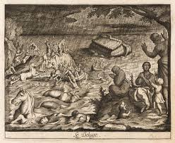
DEUCALION & PYRRHA

Slide 3
Deucalion, the son of Prometheus and Pronoea, was married to Pyrrha, the daughter of Epimetheus and Pandora and ruled over Phthia
Having traveled through Greece and finding man to be uncaring and disrespectful of the gods, Zeus made plans to end the Bronze Age with a flood
Prometheus foretold the plans to Deucalion and told him to build a chest large enough for Pyrrha and himself and to supply it with provisions
Deucalion and Pyrrha floated for nine days and nine nights until they landed on Mt Parnassus
Here they sacrificed to Zeus, the Corycian nymphs, the mountain nymphs and to Themis who had charge of the Delphic oracle

Slide 4
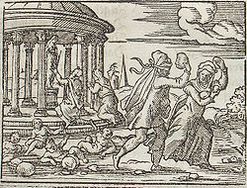
Viewing the desolation, Pyrrha and Deucalion were distraught with the aspect of being alone and prayed to Themis
Themis responded that should throw over their shoulders the bones of their mother
Pyrrha was afraid of the answer since digging up the bones of someone already buried would incur the wrath of the Furies
Deucalion reasoned that their was only one mother, Gaia (Ge), and that her bones were stones
Each began to cast stones over the shoulder
Those cast by Deucalion became men; by Pyrrha, women

Slide 5
The gods restored the plant and animal life destroyed by the flood
Deucalion and Pyrrha had five children: Hellen, Amphictyon, Protogeneia, Pandora and Thyia
Hellen was the father of the Hellenic race of Greece
In Book I of the Metamorphoses Ovid describes the Flood and how Jupiter with the aid of Neptune covered the earth in water, while Iris replenished the rain clouds from the earth’s streams
Jupiter looked down and saw Pyrrha and Deucalion on Mt Parnassus whose hearts were pure and dedicated to the gods
He took pity on them and sent the North Wind to part the clouds; Neptune struck his trident to calm the waters; and Triton was summoned to remove the waters with his conch

Slide 6
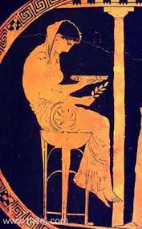
They walked to the stream Cephisus and there dipped their hands and scattered the waters on their heads and tunics
From there they went to the altar, fell to their knees, and kissed the altar
They asked Themis how to save mankind from “eternal nothingness”
Themis heard the prayer and responded that they “walk from the temple with covered head, with girdled tunic open at breast and shoulder, and, as the wind flows, scatter your mother’s bones”

Slide 7
Pyrrha could not obey not wanting to desecrate her mother’s spirit
As they left the altar, Deucalion turned to Pyrrha and told her that their Great Mother is the Earth; and that the stones are her bones
They left the temple with robes flowing and cast pebbles over their shoulders
Those that Deucalion cast became men; Pyrrha’s, women
Some sources indicate that the Deluge was inefficient
Megarus, a son of Zeus by a Sithnid nymph, swam in the darkness of the rains toward the cries of the cranes until he came to a mountain in Corinth which was thereafter called Mt Geranium (Crane Mountain)

Slide 8
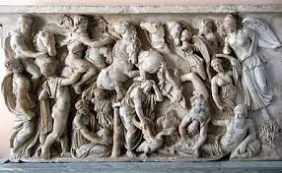
Cerambus was said to have been saved by nymphs who bore him up on wings
Some inhabitants of Delphi escaped by following the howling of wolves to one of the peaks of Parnassus where they founded Lycoreia (Place of the Mountain Wolves)
When the grandsons of Deucalion set out to occupy the lands allotted to them, they found them well populated

Slide 9
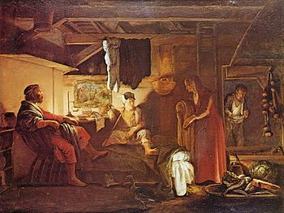
BAUCIS
&
PHILEMON

Slide 10
The myth of Baucis and Philemon is found in Book VIII of Ovid’s Metamorphoses and relates the importance of xenia (hospitality to strangers) or theoxenia (hospitality to gods disguised as strangers)
The myth is related by the old and wise Lelex who claimed to have visited the temple of Jupiter in Phrygia where an oak and a linden (Ovid calls it a lime) tree grow side by side and almost intertwined
In a certain valley of Phrygia Jupiter and Mercury disguised themselves as travelers and went door-to-door seeking shelter and hospitality
“A thousand gates were locked before them” until they reached at last a small humble cottage with its doors thrown open

Slide 11
The cottage was the home of Baucis and Philemon who had lived there since they had first married
When the gods entered, Philemon arose and dusted off a bench and covered it with a rug
As Philemon saw that the gods were made comfortable, Baucis rekindled the fire
She put in fresh cut cabbage and Philemon pulled down a side of bacon from the rafter and cut pieces of the fat to boil with the cabbage
Then they placed a woven willow bench and over it a grass-filled mattress covered with a “gaily covered cloth”
Next a wobbly, three-legged table was brought out which was propped up by a piece of slate

Slide 12
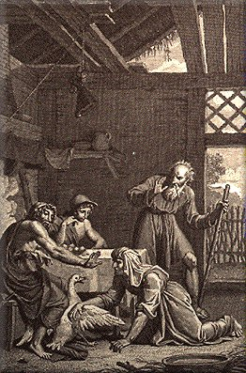
Next Baucis rubbed the table with mint and served the gods a meal of olives, cherries, cottage cheese, radishes and eggs cooked in the coals of the fire
Then came table wine with figs, dates, nuts, apples and a comb of honey set to the side
When the bowl of wine was emptied, it filled itself and they knew the gods were their visitors
They offered to make a better meal and tried to catch a goose which ran to Jupiter for protection

Slide 13
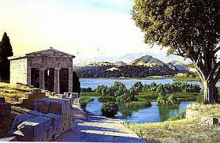
Jupiter asked that the goose be spared and told them that the “un-god-fearing country” would be condemned but they would be spared
He instructed them to leave their home and follow them up the mountain
When they were “an arrow’s flight from where the top of the mountain loomed high”, they turned and saw that the valley was now a lake and their house had become a temple with great marble pillars, a golden dome and a terrace where the barnyard once stood

Slide 14
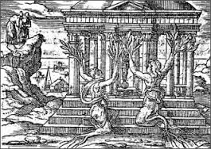
Then Jupiter turned to the couple and asked what gift they would have
Baucis replied that they wished to be the servants of the newly established temple; and that they share the moment of death so that one may not outlive the other
They served Jupiter faithfully for many years and at the time of their “death” Baucis was transformed into a linden; Philemon, an oak

Slide 15
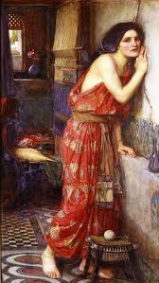
PYRAMUS & THISBE

Slide 16
The myth of Pyramus and Thisbe is found in Book IV of Ovid’s Metamorphoses
It is told by Alchithoe, the daughter of Minyas, to her sisters, Leuconoe andArsippe, as they went about their weaving in honor of Minerva rather than observe the festival of Bacchus
Pyramus and Thisbe grew up in house in Babylon joined by a common wall that had a hole in it by which they were able to communicate
They eventually fell in love with each other but their families refused to allow them to marry
They agreed to meet at night at the tomb of King Ninus
Thisbe arrived first but was frightened away by a lioness whose jaws were bloody from a fresh kill

Slide 17
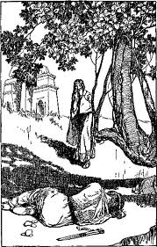
The lioness mauled the veil which Thisbe had dropped
Pyramus found the bloody veil; and, thinking that he had caused his lover’s death, killed himself with his sword
The berries of the mulberry tree under which he had fallen turned from white to purple
Upon discovering the body of Pyramus, Thisbe took his sword and killed herself
Their bodies were cremated and their ashes rested in a single urn

Slide 18
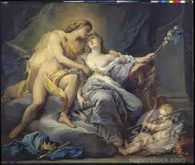
HELIOS & LEUCOTHOË

Slide 19
This myth also comes from Book IV of Ovid’s Metamorphoses
It is Leuconoe’s turn to tell a story to her sisters as they continue their weaving
Helios (later poets ascribe Hyperion or Apollo) was caused to fall in love with Leucothoë, the daughter of the Persian king Orchamus, by Venus for disclosing her affair with Mars to Vulcan
The daughter was so well protected that he had to visit her in the form of her mother
Having dismissed the twelve hand maidens, Helios returned to his form and seduced Leucothoë
The Oceanid Clytie who loved Helios became jealous and told Orchamus what had occurred

Slide 20
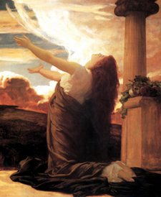
Enraged at his daughter’s seduction, Orchamus had her buried alive
Helios attempted to revive her with a ray of his sunlight but to no avail
She was transformed into a shrub that gives frankincense
Scorned by Helios, Clytie pined away following the path of Helios’ chariot until she was transformed into the heliotrope (sunflower) whose flower always turns toward the sun

Slide 21
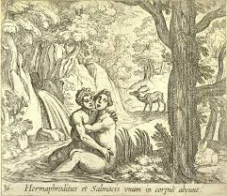
SALMACIS
&
HERMAPHRODITUS

Slide 22
This is the third myth from Book IV of Ovid’s Metamorphoses as told by the daughters of Minyas as they spun their cloth, scorning the rituals of Bacchus
This myth is told by Alchithoe
Hermaphroditus was the son of Mercury and Venus (the name is a combination of the Greek Hermes and Aphrodite)
He was raised by the Naiads of Mt Ida until he was 15 when he left Mt Ida to explore foreign lands
When he had come to the cities of Lycia and Caria, he found a pool of water that looked refreshing
The pool was the home of the Naiad Salmacis who opted for idle play rather than follow Diana in the hunt, although encouraged by the other Naiads to do so

Slide 23
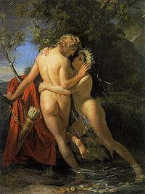
Upon seeing Hermaphroditus, she immediately straightened her dress and tried to make herself look attractive
When he rejected her advances, she offered to leave him alone to bathe in the pool and hid herself in a nearby bush
Thinking himself to be alone, he slipped into the pool
It was then that Salmacis threw herself into the pool and wrapped her arms around Hermaphroditus
She prayed that the gods would keep them forever entwined in this manner
Her prayers were answered as the gods joined them together into one body, half man, half woman

Slide 24
Realizing what had happened, Hermaphroditus then asked the Mercury and Venus to curse the pool by making anyone who bathed in the pool to become effeminate and half man, half woman
His prayers were also answered giving the pool a strange magic
After her story was told, the sisters continued to weave and to ignore Bacchus
As the sound of the rituals grew louder in their ears, their thread turned green and their weavings were transformed into ivy; and the sisters were turned into bats

Slide 25
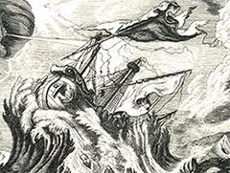
CEYX
&
ALCYONE

Slide 26
In Book XI of the Metamorphoses Ovid describes the death of Ceyx
Ceyx was the son of Lucifer, the Morning Star, and was married to Alcyone, the daughter of Aeolus and Enarete
Ceyx was the king of Trachis who had given shelter to Peleus who had killed his half brother, Phocus
Peleus left Trachis at the command of the Fates who sent him to Magnesia
Ceyx had been troubled by the threat of supernatural things and miracles that he could not explain; and determined to seek answers at the oracle of Claros
Not wanting to take the road, since it had been made hazardous by Phorbus, a henchman of the Phlegyans who lived by robbing temples and shrines, Ceyx decide to sail to the oracle

Slide 27
Alcyone tried to dissuade her husband from sailing, knowing how uncertain the winds are on the sea but to no avail
Ceyx set sail and was drowned after the winds destroyed his ship
Unaware of her husband’s death, Alcyone paid her services to the gods and prayed daily to Juno for his safe return
Juno could bear it no longer and summoned Iris to go to the chambers of Sleep (Somnus) and have him send a dream to Alcyone of her husband’s death
Here Ovid describes three of Sleep’s sons: Morpheus who was an actor of great skill; Icelos who could be bird or beast; and Phantastos who could imitate rocks, trees, waterfalls or stones

Slide 28
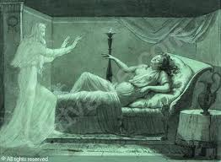
Sleep chose Morpheus who appeared to Alcyone in a dream as her drowned husband
The next morning she began to walk the shoreline and soon the body of Ceyx washed up on the beach
The gods out of pity transformed them both into kingfishers
For seven days in winter Aeolus forbids the winds to blow while the kingfisher sits on her eggs as the nest floats on the sea to protect his grandchildren
These days are called halcyon days

Slide 29
Apollodorus claims that they were transformed into kingfishers because they called each other Zeus and Hera
He claims that Ceyx was changed into a gull which is what his name means

Slide 30
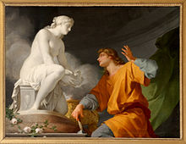
PYGMALION &
GALATEA

Slide 31
The myth of Pygmalion is found in Book X of Ovid’s Metamorphoses
The Propoetides were the daughters of Propoetus of Amathus in Cyprus who scorned Venus and became prostitutes
The Cerastae, who wore crooked horns on their head, were also despised by the goddess
Pygmalion knew of these women and refused to sleep with them but instead sculpted a beautiful woman out of ivory
He brought her gifts and dressed her like a queen
When the Feast of Venus arrived, all of Cyprus participated in the celebration
Pygmalion offered his devotions to Venus and then prayed that she would give him a wife just like his statue

Slide 32
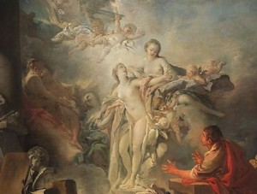
Venus, who had come to the celebration herself, knew what Pygmalion desired
Three times the flames on his altar burned white and three times they leaped floating in the air which were six omens of the intentions of Venus
When he returned home and kissed the statue, he found that she had come to life
Venus attended the wedding of Pygmalion and Galatea (a name that was ascribed by post-classical poets)
They had a daughter, Paphos, whose harbor still bears her name (some sources say that Paphos was their son)

Slide 33
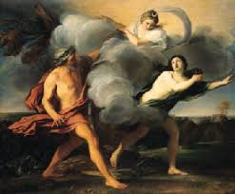
ALPHEUS
&
ARETHUSA

Slide 34
Arethusa was the daughter of Nereus whose name means “the waterer”
Her myth is recounted in Book V of Ovid’s Metamorphoses
Ceres, while searching the earth for Proserpina, rested by a stream on Ortygia, in Syracuse, Sicily (this the same island where Diana was born, Quail Island)
Arethusa appeared from the stream and related to Ceres that she had seen her daughter in the Underworld
She begged Ceres to restore the land which she had punished while searching for her daughter because she had come to love the new land she called home
Overcome with grief Ceres boarded her chariot, pulled by two dragons and flew to Olympus to confront Jupiter

Slide 35
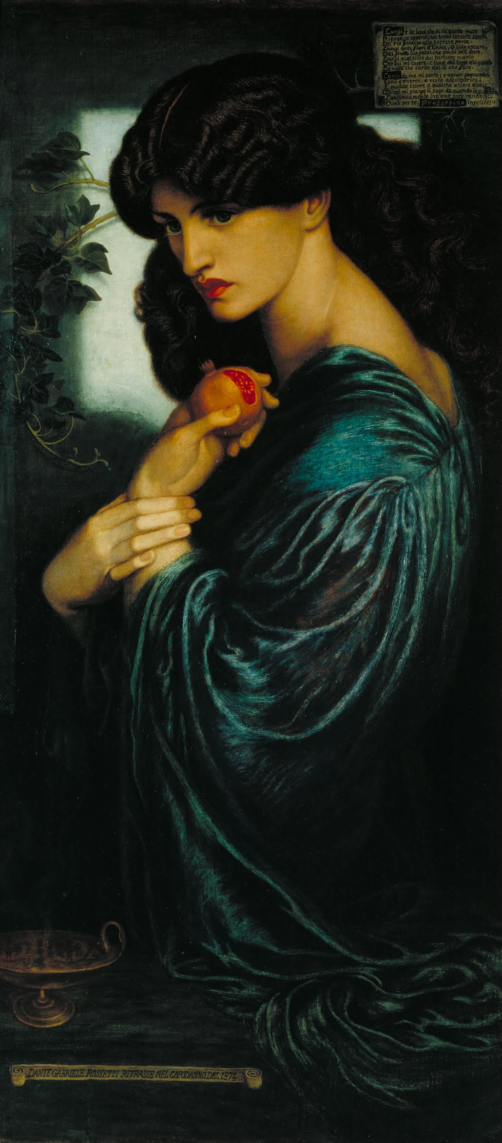
After hearing the pleas of Ceres, Jupiter agreed to restore Proserpina to heaven on the condition that no food of Avernus had touched her lips
While walking through the Underworld, Proserpina had eaten seven seeds of a pomegranate
Her eating of the fruit was revealed by Ascalaphus the son of Orphne and Acheron
For betraying her, Proserpina turned him into the screech owl, which later became an attribute of Pluto (Dis, Orcus, Hades)

Slide 36
The Sirens were also friends Proserpina who helped Ceres in the search for her daughter
They had young, girlish faces and prayed to the gods to give them wings in order to aid in their search for Proserpina
Their prayers were answered and they kept their faces as well as the wings and claws of birds
Jupiter then decided that Proserpina would spend six months on earth (spring, summer) and six months in the Underworld (fall, winter)
At ease with the decision of Jupiter, Ceres asked Arethusa how she had come to Ortygia

Slide 37
Arethusa told Ceres how she had been a nymph of Achaia in the train of Diana
On a hot day she came to a river that was clear and almost motionless and slowly eased herself into the water, leaving her clothing on willow branches
Diving under the surface, she heard a voice calling to her from the depths of the river
It was the river god Alpheus who began to chase after her
Climbing to the opposite bank of the river, Arethusa ran naked through the fields of Orchomenus, Psophis, Cyllene and the gulf of Maenalus
Although she could run fast, her strength began to fail and Alpheus soon caught up with her

Slide 38
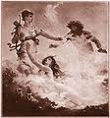
Half dead from running, Arethusa called to Diana for aid
Diana shrouded her in a dense, white mist which Alpheus could not pierce with his eyes, yet he could see no tracks leaving the mist
Then a freezing sweat poured down her legs and she was changed into a river
Alpheus could still see her as she tried to escape in her new form
Diana opened the earth and she escaped to the island of Ortygia

Slide 39
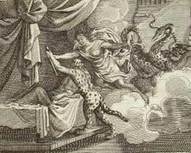
When Arethusa had finished, Ceres mounted her chariot and flew to Athens where she gave her chariot to Triptolemus to spread seeds over the lands that had become barren
He went over Europe and Asia and then to Scythia where he arrived at the palace of Lyncus who was the king
Triptolemus told Lyncus that he had come with seeds for planting which would grow crops free of weed and thorns
Lyncus, thinking that it would be better if his people thought that he was responsible for their good fortune, attempted to kill Triptolemus but was changed into a lynx by Ceres as his sword touched his breast

Slide 40
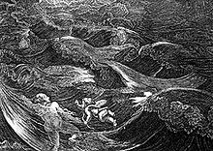
HERO
&
LEANDER

Slide 41
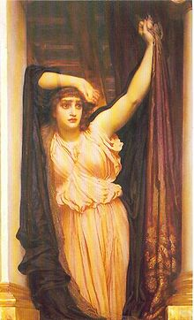
Leander was a young man from Abydos on the Asian side of the Hellespont
Hero was a priestess of Aphrodite in Sestos on the European shore and was loved by Leander
He would swim the Hellespont each night to visit Hero guided by a light placed in a tower by her on the shore
One stormy night the light was extinguished by the winds and, without his beacon for guidance, Leander was drowned
Hero found his body washed up on the shore the next day and threw herself from the tower to join him in death

Slide 42
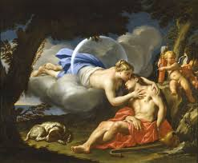
ENDYMION
&
SELENE

Slide 43
Selene, the daughter of Hyperion and Theia, was a moon goddess
She also drove a chariot but only with two horses
According to Apollonius of Rhodes, Selene fell in love with the mortal Endymion who was a shepherd and a son of Zeus
Night after night she would lay beside him in his cave on Mt Latmus in Caria
Selene asked Zeus to give him perpetual youth with perpetual sleep
Depending on the source this was either a punishment since Selene was abandoning her duties as moon goddess, or the fulfillment of her wishes for the one that she loved
Other sources say that Endymion selected perpetual sleep and youth

Slide 44
REFERENCES
Gayley, Charles Mills. The Classical Myths in English Literature and in Art. New York: Blaisdell Publishing Company, 1963.
Hamilton, Edith. Mythology. New York: Grand Central Publishing, 2011.
Morford, Mark P. O. Classical Mythology. New York: Longman, Inc., 1977.
Ovid. Metamorphoses. New York: Signet Classics, 2009.
Tripp, Edward. The Meridian Handbook of Classical Mythology. New York: Penguin Books, 1974.
www.wikipedia.org/greek mythology. 2014.

