Slide 1
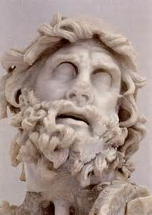
ODYSSEUS
W. D. Griffin, Jr
December 1, 2013

Slide 2
PART I: LINEAGE
Version I (Bibliotheca, Library of Apollodorus)
Son of Laertes and Anticlea and paternal grandson of Acresius, son of Cephalus and grandson of Aeolus
Maternal grandfather is Autolycus, son of Hermes and Chione
Non-Homeric version is that his father was Sisyphus
Laertes purchased him from Sisyphus
Book XV of The Odyssey mentions a younger sister named Ctimene

Slide 3
LINEAGE (cont’d)
Version 2 (Homer, Ovid, Aristotle, Higenus, Eustathius’ scholia on The Odyssey
Acresius was the son of Zeus and Euryodeia (Eustathius)
Cephalus instructed by an oracle to mate with the first female that he met (Aristotle)
First female was a she-bear with which he mated and she was instantly transformed into a woman who bore him Acresius (Aristotle)
Zeus declared the linage of Acresius to be of one sons
Acresius married Chalcomedusa whose name means “guardian of copper” (referred to as Protectress of the Bronze Age (Homer, Higenus)
Laertes only son of Acresius; Odysseus only son of Laertes; Telemachus only son of Odysseus and Penelope; Telegonus only son of Odysseus and Circe(Eustathius)

Slide 4
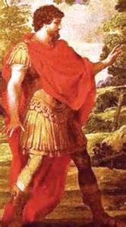
LINEAGE (cont’d)
Epithets
Odysseus metis (cunning intelligence), Odysseus the Cunning
Odysseus is translated as “to wroth against, to hate” (given this name by Autolycus when Euryclea was trying to name him in Book XIX of The Odyssey)
Euryclea wanted to name him Polyaretos or one who has much been prayed for
Patronym is Laertiades, son of Laertes

Slide 5
PART II: THE RETURN FROM TROY
The Odyssey
Consists of 24 books
Book 1
Odysseus is captive on the island of Calypso for 7 years
While Poseidon is in Ethiopia at a festival in his honor, Athena petitions Zeus on behalf of Odysseus
Zeus sends Hermes to Ogygia to tell Calypso that Odysseus must leave

Slide 6
THE RETURN FROM TROY
Book 1 (cont’d)
Athena goes to Ithaca to find Telemachus
She appears to Telemachus disguised as Menetes, king of the Taphians
Telemachus brings her into the house and treats her with the customary hospitality
She tells Telemachus that Odysseus is alive but probably stranded on some island and to seek counsel from Nestor and Menelaus
The primary suitors, Antinous and Eurymachus are introduced

Slide 7
THE RETURN FROM TROY
Books 2-8
Telemachus criticizes the suitors
Zeus sends two eagles side by side over the courtyard glaring death into the eyes of the suitors and clawing and tearing at each other and then departed
Prophet Halitherses indicates it is an omen that Odysseus is alive and will soon return
Mentor, the overseer of Odysseus’ estate, chides the suitors
Telemachus prays to Athena for guidance and she appears to him disguised as Mentor and encourages him to set sail quickly

Slide 8
THE RETURN FROM TROY
Telemachus returns to the palace and has Euryclea prepare rations of food and wine for the journey and swears her to secrecy not to tell Penelope for 12 days unless directly asked
Athena disguises herself as Telemachus and assembles a crew for the journey and equips the ship herself
Telemachus sets sail at sunset and reaches Pylos at dawn where sacrifices were being made to Poseidon
Telemachus and Athena (still disguised as Mentor) offer prayers to Poseidon and dine with Nestor and his son Pisistratus
Nestor does not know the fate of Odysseus as he does the others

Slide 9
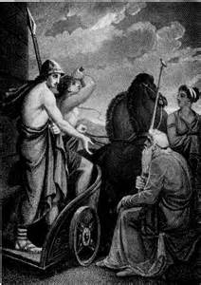
THE RETURN FROM TROY
Nestor relates the travels of Menelaus and advises Telemachus to visit with him either by sea or by land
Nestor offers his home to his guests
Athena refuses but advises Nestor to house Telemachus and to give him a chariot to travel to Sparta along with his son
Athena reveals herself by flying off in the form of an eagle

Slide 10
THE RETURN FROM TROY
The next morning Nestor gathered his sons and made a sacrifice to Athena who attended the ceremony herself
Nestor sends Pisistratus with Telemachus to Sparta
They reach Sparta during the wedding of his son, Megapenthes (by a servant since Helen could have no more children) to a daughter of Alector and his daughter, Hermione to Neoptolemus
During the feast Menelaus describes his travels to Africa
The next morning Menelaus recounts his wrestling with Proteus and learned that Odysseus was alive on an island
Antinous learns of Telemachus’ journey to Pylos and plots to kill him before he can return to Ithaca

Slide 11
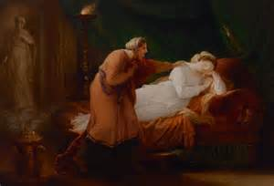
THE RETURN FROM TROY
The servant Medon tells Penelope what he has learned
Euryclea tells Penelope about her promise to Telemachus
Penelope prays to Athena
Athena sends a vision to Penelope of her sister Iphthime to tell that no harm will come to Telemachus
Antinous hides his ship in a harbor between Ithaca and Samos
Meanwhile back on Ogygyia Hermes has delivered Zeus’ orders to Calypso

Slide 12
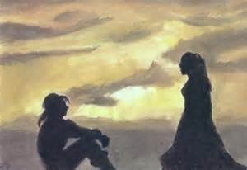
THE RETURN FROM TROY
Reluctantly Calypso provides Odysseus with the tools and the trees to build a seaworthy raft
Calypso sends him off on the 5th day with fair winds and provisions
After 18 days he reaches the shores of Phaeacia (Scheria)
Poseidon sees the raft and sends a violent storm to punish him
Leucothea (Ino, daughter of Cadmus turned sea goddess) aids him to the shore with her veil while Athena binds all the winds except one

Slide 13
THE RETURN FROM TROY
After two days Odysseus finally reaches land with the aid of Athena
Athena goes to the palace of Alcinous and appears to his daughter Nausicaa in a dream telling that she should wash her garments by the river in the morning
Nausicaa gives him oil for bathing and clothing and tells him to wait in a grove sacred to Athena until such time as she has had to reach the palace and then make his way there
Odysseus offers thanks to Athena who alters his appearance to make him look more regal
As he makes his way to the palace, Athena places him in a thick mist to protect him

Slide 14
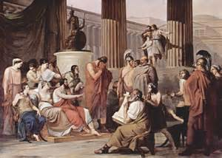
THE RETURN FROM TROY
Athena then disguises herself as a young girl and approaches Odysseus
She shows him the way to the palace instructing him not to talk to anyone since they were wary of strangers
At the palace she instructs Odysseus to seek out Arete, the queen who is well-respected and loved by all
Arete and Alcinous receive him and offer hospitality
The next day Alcinous orders a ship and crew be prepared to take Odysseus back to his home

Slide 15
THE RETURN FROM TROY
Next games are held at which Odysseus befriends Laodamus the son of Alcinous
After the games another feast is held and it is here that Odysseus recounts his travels to Alcinous and Arete
Books 9-16
Odysseus reveals himself telling of leaving Troy and landing in Thrace and the sack of Ismarus, the home of the Cicones
Maron, the priest of Apollo had been spared and in return gave them 12 jars of fragrant red wine (foreshadowing)
They were attacked on the shores by the surviving Cicones as they celebrated their victory and driven to their ships

Slide 16
THE RETURN FROM TROY
He tells of losing six men from each of his ships
They arrived at the land of the Lotus eaters after being driven southward by a violent storm
Those who tasted of the fruit wished to remain, but Odysseus forced them back to the ships
Next they arrived at the land of the Cyclopes
Odysseus takes 12 men and a jar of wine, exploring the land and finding a large cave which belonged to Polyphemus, the son of Poseidon
Polyphemus returns and covers the doorway with a large boulder to prevent his flocks from wandering off during the night

Slide 17
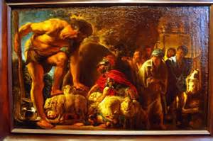
THE RETURN FROM TROY
Polyphemus eats two of the men for his dinner, two for breakfast and two for dinner the second evening
Odysseus offered him some of the wine of Maron which he drank eagerly
Polyphemus offers to eat Odysseus last in return for the wine
Odysseus tells him that his name is Noman
When Polyphemus passes out from the wine, Odysseus and his men sharpen a large wooden stake and heat it in the fire
Then the stake is driven into the eye of Polyphemus

Slide 18
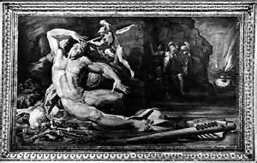
THE RETURN FROM TROY
When asked by the other Cyclopes who has injured him, he responds “Noman”
They think that he has incurred the wrath of the gods and is being punished
Odysseus straps his men to the bellies of the fattest sheep
Polyphemus does not check the bellies and Odysseus and his remaining men escape to the ships
The seer Telemus had foretold Polyphemus’ fate earlier
As he sailed away Odysseus tells him that it was Laertiades who had blinded him

Slide 19
THE RETURN FROM TROY
Polyphemus hurls the top of mountain toward the sound of Odysseus’ voice which propels them further to sea
Polyphemus prays to Poseidon that Odysseus may not be returned home, but, if it is fated to do so, that it take a long time and that he return in another’s ship and his home in disarray (prayer heard)
Next they arrive at Aeoli, the floating island of the king of the winds, Aeolus
Aeolus has six sons and six daughters who were forced to marry each other by Aeolus
Aeolus entertains Odysseus for a month and gives him a gift-a leather pouch full of favorable winds to carry him home

Slide 20
THE RETURN FROM TROY
Sailed for 9 days with Odysseus taking the helm until they could see the shores of Ithaca
On the 10th day sleep overtook Odysseus and his men opened the leather pouch, thinking it to be some riches not to be shared
The winds drove them back to Aeoli and the appeals of Odysseus fell on deaf ears (Aeolus thinking him to be in ill favor the Olympians)
After 7 days they reach the city of the Laestrygonians, Lamus-Telepylus whose harbor is surrounded by high cliffs
All but Odysseus’ ship enter the harbor

Slide 21
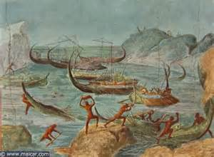
THE RETURN FROM TROY
Three men are sent to inquire of the inhabitants and they find the daughter of Antiphantes the king
She leads them to the palace where her father immediately kills one and begins to eat him
The others return to the ships but they are destroyed by the Laestrygonians (Homer describes it as like spearing fish in a pond)
Odysseus sails away to Aeaea the island of Circe (famous aunt of ?)
Odysseus divides his men into two groups: one sent to meet the ruler (23 men), the other stayed with Odysseus

Slide 22
THE RETURN FROM TROY
Eurylochus leads the group to Circe and all are turned into swine after eating her food, except for Eurylochus who escapes to tell Odysseus
Odysseus sets out to save his men and is met by Hermes and is given the moly which is an antidote for Circe’s magic
Circe attempts to transform Odysseus into a pig (epic fail) and Odysseus threatens to kill her if she does not release his men from her spell
Stays for a year and has a son, Telegonus
Soon the men urge Odysseus to ask Circe to help them get home

Slide 23
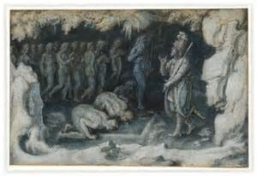
THE RETURN FROM TROY
Circe reveals to Odysseus that he must go to the shores of Hades and speak with Tiresias before he can return home
They travel to the shores of Hades where the Phlegethon and Cocytus flow into the Acheron
Here they perform the sacrificial ritual that allows them to summon the spirits of the dead
Those to whom he would speak are allowed to drink the blood while the remainder are kept away by the sword of Odysseus

Slide 24
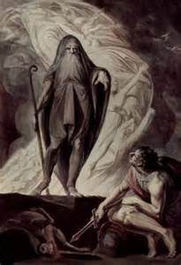
THE RETURN FROM TROY
Tiresias warns of Odysseus of the dangers to come and of the troubles in Ithaca and that he must return to Circe for advice on how to avoid the future dangers
He also warned him not to touch the cattle of the Sun on Thrinacia
Here he also sees Anticlea, Agamemnon, Achilles and Ajax Telamon
Achilles tells Odysseus that “he would rather be a poor man than the king over all the souls of the dead”

Slide 25
THE RETURN FROM TROY
Ajax would not speak (remember the contest)
He also sees the shade of Heracles (remember he was made immortal)
Here they also see Elpenor who had not been properly buried
He had fallen off Circe’s roof when aroused from a drunken sleep by the shouts of the men as they prepared to leave
He died of a broken neck
Odysseus agreed to give him a proper burial once they had reached Aeaea
Homer offers a long list of souls including Leda, Jocasta, Alcmena and Tyro
They return to Aeaea and give a proper burial to Elpenor

Slide 26
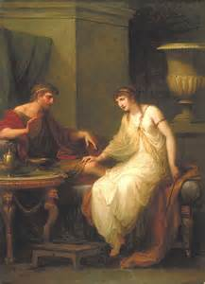
THE RETURN FROM TROY
Circe then warns Odysseus of the Sirens (2 in number according to Homer)
She instructs him to put wax in the ears of his men and have them tie him to the mast so that he might hear their song and yet safely pass them
She then warns him of the Planctae, or wandering rocks
To avoid the wandering rocks he must pass two high cliffs
Charybdis lived in the lower cliff; Scylla in the higher
Charybdis would suck the water out of the strait 3 times a day and spew it upward to the sky (certain destruction)

Slide 27
THE RETURN FROM TROY
Scylla, the daughter of Phorcys and originally a sea nymph changed into a monster by Amphitrite, had a girth of 6 dog heads and 12 feet which she used to snatch sailors from passing ships
Next she warns Odysseus of the cattle of Hyperion on Thrinacia which are guarded by his daughters Phaethusa and Lampetie (mother is Neaera)
They depart the next day at dawn
As they approached the Sirens Odysseus plugged the ears of his men with wax while Eurylochus and Perimedes tied him to the mast of the ship and kept him there until they had passed the Sirens

Slide 28
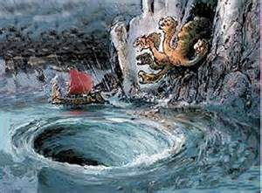
THE RETURN FROM TROY
Once they had passed the Sirens they heard the roar and saw the spew of Charybdis
Odysseus had his men sail close to Scylla knowing that he must lose 6 of them
The rest passed unharmed
Next they arrived at Thrinacia and became stranded due to adverse winds for a month
Eurylochus begins to stir the men to slaughter some cattle for meat which they do while Odysseus sleeps (big boo-boo)
Lampetie tells Hyperion what has happened and he appeals to Zeus for retribution

Slide 29
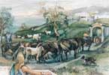
THE RETURN FROM TROY
The slaughter of the cattle went on for six days
The gods began to rebuke them by making the bones reshape themselves and the meat on the spits lowing
On the 7th day the winds became favorable and they set sail
Once at sea Zeus sent another storm and destroyed the ship with his lightning bolts
All were killed except Odysseus who drifted back to Charybdis and clung to a tree until the mast was spewed up
He drifted to Calypso’s island on the mast

Slide 30
THE RETURN FROM TROY
This ends Odysseus’ recounting of his adventures to Alcinous and Arete
The next morning the ship bears Odysseus with many riches to Ithaca
The Phaeacians lay him as he slept on the shore and place his gifts next to the root of an olive tree
Poseidon is now upset that his own descendants have transported Odysseus to Ithaca and given him more riches than he had when returning from Troy
Zeus gives him permission to change the ship to stone as it returns to Phaeacia as a warning to stop transporting strangers to safety and to bury it under a mountain

Slide 31
THE RETURN FROM TROY
Upon seeing the ship turn to stone Alcinous recalls a prophecy that the city would be buried under a mountain when a ship was turned to stone in the harbor
He immediately demands that 12 bulls be sacrificed to Poseidon to prevent this from occurring
At this moment Odysseus awakens and encounters Athena, who has covered the harbor in a mist, disguised as a young shepherd
She tells him that he is in Ithaca, but Odysseus, being uncertain, tells her that he has come from Crete, being hunted for the death of Idomeneus’ son

Slide 32
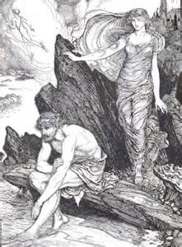
THE RETURN FROM TROY
Athena reveals herself to Odysseus and removes the mist so that he recognizes that he is home
She helps him store his gifts in a cave sacred to the Naiads of the island
They plot how best to rid the island of the suitors who have lived off his land for the past 3 years
She disguises Odysseus as a beggar and tells him to locate his swineherd to find out what is really occurring
She assures him that Telemachus is safe with Menelaus and that, although some of the suitors plan to ambush him, no harm will come to him

Slide 33
THE RETURN FROM TROY
Odysseus seeks out the swineherd who is his faithful servant Eumaeus
He stays with him and tells him that Odysseus is alive and will return but Eumaeus is skeptical
Athena tells Telemachus to hasten back to Ithaca and warns him of the ambush and how to avoid
Once he has reached Ithaca he is to seek out Eumaeus
The next morning Telemachus tells Menelaus that he must hurry back to Ithaca
Menelaus gave him a silver mixing bowl, Megapenthes a double cup and Helen a fine robe as parting gifts

Slide 34
THE RETURN FROM TROY
As they prepare to leave an eagle appears with a goose in its talons
Helen interprets it as omen that Odysseus is still alive and will take vengeance on the suitors
Telemachus hastens back to Pylos and prepares to sail home
Theoclymenus (a descendant of Melampus) seeks passage from Argos with Telemachus, who grants his request, and they set sail at dusk
Odysseus tests the hospitality of Eumaeus by offering to go and beg at the palace but Eumaeus refuses to let him go until Telemachus returns
Eumaeus tells Odysseus of his kidnapping by Phoenician traders

Slide 35
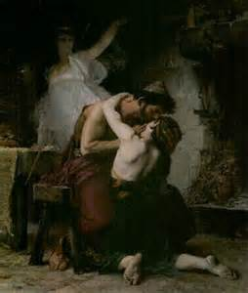
THE RETURN FROM TROY
Telemachus arrives in Ithaca and has his men row the ship into the harbor
As he prepares to depart a hawk appears at his right hand plucking the feathers from a dove
Theoclymenus interprets this as a sign that the house of Odysseus will survive
Piraeus offers to house Theoclymenus until it is safe for him to go to the palace
Telemachus reaches the hut of Eumaeus who explains that the stranger is a Cretan

Slide 36
THE RETURN FROM TROY
Eumaeus excuses himself to go to Laertes and tell him that Telemachus has safely returned but Telemachus tells him to have his mother send one of her attendants to tell him
Athena appears to Odysseus, but not to Telemachus and tells him that he must reveal himself to his son
Athena changes his appearance from the beggar to a regal one
Odysseus reveals himself to Telemachus and they lay their plan to remove the suitors
Odysseus tells Telemachus to remove the armor except for 2 swords, spears and shields

Slide 37
THE RETURN FROM TROY
Eumaeus delivers the message to Penelope and returns to the hut
The suitors who had planned to ambush Telemachus return to Ithaca
Antinous still wants to kill Telemachus but Eurymachus and Amphinomus advise against it
Penelope rebukes Antinous for his attempt to kill her son
Athena changes Odysseus back to the beggar as Eumaeus arrives at the hut
He tells of the suitors return from their ambush and their discontent at having failed at which Telemachus smiles at his father

Slide 38
THE RETURN FROM TROY
Books 17-24
The next morning Telemachus returns to the palace while instructing Odysseus to come to town and beg
At the palace Telemachus informs Penelope of what he has learned from Menelaus
Theoclymenus, who has been brought to the palace by Piraeus, reinforces that Odysseus is alive and even now is on the island looking for weaknesses among the suitors
As Odysseus and Eumaeus approach the palace, they are ridiculed by Melanthius, Odysseus’ goatherd, who also kicks Odysseus
Odysseus invokes the nymphs of the fountain to make him go back to his fields and tend to the goats

Slide 39
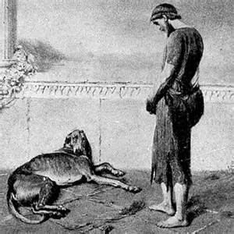
THE RETURN FROM TROY
When they arrived at the palace, they determine that Eumaeus should enter first
Odysseus sees his faithful hound, Argus laying on a manure pile and inquires of Eumaeus about the dog
Hearing Odysseus’ voice he raises his head and perks his ears and then dies
Eumaeus goes into the palace and sits next to Telemachus who gives him a loaf of bread and meat.
Telemachus instructs Eumaeus to give the meat and bread to Odysseus and to have him beg from the other suitors

Slide 40
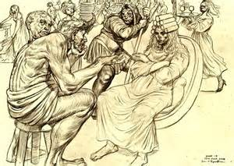
THE RETURN FROM TROY
Odysseus does as instructed
After learning from Melanthius that Eumaeus had brought the beggar into the palace, Antinous lashes out at Eumaeus
All suitors give food to Odysseus who hits him with a stool which distresses the other suitors
Penelope confides to her nurse Eurynome that she would have all the suitors killed
Upon hearing of Antinous’ outburst she asks Eumaeus to bring the beggar to her to inquire if he knows of the fate of Odysseus
Odysseus agrees but only later in the evening to avoid the suitors

Slide 41
THE RETURN FROM TROY
Odysseus is confronted by another beggar, Arnaeus, who was called Irus by the suitors because of his running errands for them
He challenges Odysseus to a fight and is beaten with one blow (a little aid from Athena)
Penelope decides to confront the suitors and is put into a deep sleep by Athena to make her look even more attractive
She is accompanied by her handmaids, Autonoe and Hippodamia
Once she returns upstairs, other maids offer to hold torches to light the room for the other suitors
Odysseus tells Melantho, who was secretly in love with Eurymachus, to go upstairs (demands that all go upstairs)

Slide 42
THE RETURN FROM TROY
Odysseus insults Eurymachus who also throws a stool at him
Eurymachus’ throw strikes Amphinomus causing him to fall over Odysseus
Telemachus reprimands the suitors for their behavior
Amphimonus mixes another offering of wine and water which is served by his servant Mulius
After the suitors leave, Telemachus has Euryclea lock the maid in their quarters while he and Odysseus hide all the armor and weapons except for their own
Athena lights the way to the storeroom for them

Slide 43
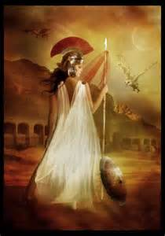
THE RETURN FROM TROY
Melantho accompanies Penelope to meet Odysseus and immediately begins to chide him
Odysseus warns her that the master of the house may soon return and that Telemachus is taking note of all deeds
Penelope hears her comments and rebukes her as well
Penelope reveals to Odysseus how she put off the suitors for three years claiming that she must complete the funeral shroud for Laertes and each night undoing what she had done until caught by the maids

Slide 44
THE RETURN FROM TROY
Odysseus tells Penelope that he is the younger brother of Idomeneus, Aethon, and had seen Odysseus and offered him hospitality in Crete
Odysseus tells several tales of his adventures and of himself
Penelope has one last test and asks the beggar what Odysseus was wearing
He describes the purple cloak held by a gold brooch in the shape of a dog strangling a fawn and shirt that fit like the skin of an onion
Penelope is convinced and tells him that he will be an honored guest in the house
He then tells her that Odysseus is on his way home

Slide 45
THE RETURN FROM TROY
Penelope orders the maids to wash the feet of the beggar but Odysseus refuses to let them wash his feet, preferring an older servant
Euryclea is given the task and recognizes the scar on his leg that he received from a boar while hunting with Autolycus
Odysseus swears her to secrecy and hides the scar from Penelope
Penelope then asks that he give an interpretation of her dream about an eagle that swoops down from the mountain and kills her 20 geese
Odysseus tells her that it means that the death of the suitors is impending

Slide 46
THE RETURN FROM TROY
She tells him that she must hold the tournament of the axes the next day to determine whom she will marry
Each suitor must attempt to string the bow of Odysseus and then shoot an arrow through the rings of 12 ax heads
Odysseus tells her that her husband will return before any suitor will be able to complete the task
Odysseus and Penelope have fitful nights
Athena assures Odysseus not to worry about the avengers of dead suitors (she will handle that)
Penelope prays to Artemis to take her away like the daughters of Pandareus whose parents were killed by the gods and were made to be handmaids to the Erinyes

Slide 47
THE RETURN FROM TROY
Another omen: Odysseus hears Penelope weeping and prays to Zeus who send thunder through the clear sky
A servant who was grinding meal heard the thunder and prayed that, whoever offered his prayer to Zeus, the prayer would be heard and that this would be the last day of the suitors in the house
Melanthius arrives with more goats for the meal with the cattle herder Philoetius who inquired who the stranger was, stating that he almost could be taken for Odysseus and his anger with the suitors
Odysseus tells him that Odysseus will soon return and slay the suitors

Slide 48
THE RETURN FROM TROY
The suitors began to plot to kill Telemachus but an eagle appears with a dove in its talon (they start to rethink this)
During the meal the suitors with the aid of Athena become even more obnoxious toward Odysseus (wants to really get him angry)
Ctesippus offers another gift to Odysseus and throws the foot of a heifer at him but he misses
Telemachus chides the suitors causing them to laugh and ridicule Odysseus even more
Theoclymenus tells them that they are facing danger and leaves

Slide 49
THE RETURN FROM TROY
Penelope observes the behavior of the suitors
Athena puts in her mind that the time is right for the tournament
She goes to the storeroom and retrieve the bow and quiver of arrows
The bow had been a gift of Iphitus who had received it from his father Eurytus while trying to recover Odysseus’ stolen sheep and Iphitus’ stolen mares
Iphitus was slain by Heracles and kept the mares
Odysseus left the bow and arrows at Ithaca as a keepsake
Penelope carries the bow to the suitors and announces that she will marry the suitor who can string the bow and shoot an arrow through the axes

Slide 50
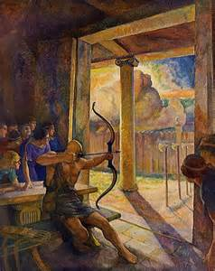
THE RETURN FROM TROY
Eumaeus sets the axes while Telemachus secures them in a straight line
Leiodes was the first (despised the actions of the other suitors)
Antinous attempts to limber up the bow by having Melanthius build a fire and placing the bow next to it while rubbing lard over it
All suitors attempt and fail until Eurymachus and Antinous are left
Eumaeus and Philoetius go outside followed by Odysseus who reveals himself to them and plans with them the fate of the suitors
Eurymachus and Antinous both fail to string the bow and Antinous blames it on a feast of Apollo

Slide 51
THE RETURN FROM TROY
Odysseus asks if he can try but is ridiculed by the suitors
Eumaeus is supposed to take the bow to Odysseus but the anger of Antinous makes him drop
Telemachus orders that he be allowed to try
Odysseus easily strings the bow and shoots the arrow through the axe heads (Zeus sends thunder)
Meanwhile Euryclea has locked all the handmaids in their room and Philoetius has locked the suitors in the house
Telemachus arms himself with sword and spear
Antinous is the first suitor to die, then Eurymachus
Amphinous is slain by Telemachus
Leiodes is the last suitor slain while clutching Odysseus’ knees and begging for mercy

Slide 52
THE RETURN FROM TROY
Odysseus asks Euryclea to gather any handmaids who had been unfaithful to Penelope (12)
Odysseus has them remove the bodies and clean the room and then hangs them in the courtyard
Penelope tests Odysseus by asking Euryclea to move his bed into the hall to which Odysseus responds that the bed cannot be moved as it was made from an olive tree and in built into the room
Odysseus tells Penelope, per Tiresias, that he must still travel far carrying an oar until he came to a place where the people have not heard of the sea and don’t mix salt with their meal
When a strange asks if he carries a winnowing fan, he must there sacrifice a ram, a bull and a boar to Poseidon and then return home and sacrifice to all the gods individually
Then he will lead and long and peaceful life until death comes from the sea

Slide 53
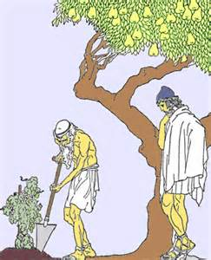
THE RETURN FROM TROY
Hermes escorts the souls of the suitors to Hades where they are confronted by Agamemnon
They tell Agamemnon how they were slain by Odysseus
The next day Odysseus, Telemachus and Philoetius to the house of Laertes
Odysseus finds him working in his vineyard
Odysseus begins to tell another tale but reveals himself when Laertes begins to break down
Odysseus show him the scar and recounts the number and types of fruit trees that he had given as well as rows of grapes

Slide 54
THE RETURN FROM TROY
While Odysseus reunites with Laertes, Eupeithes, father of Antinous is rallying others to take vengeance on Odysseus
Athena seeks the counsel of Zeus who tells her that it is time for all fighting to end
When confronted by Eupeithes, Laertes kills with a spear to the head
As the fighting grows, Athena intervenes and brings about peace after a lightning bolt from Zeus lands in front of Odysseus
Odysseus lives long until he is accidentally killed by Telegonus who was searching for his father

Slide 55
THE RETURN FROM TROY
Other endings to the saga of Odysseus (Footnote fodder)
1) he spent some time among the Thesprotians as a husband to their queen Callidice
2) he returns to Ithaca and Penelope leaving his son by Callidice, Polypoetes, to rule the Thesprotians
3) after his death Telemachus married Circe and Telegonus married Penelope
4) Circe makes them all immortal

Slide 56
REFERENCES
Gayley, Charles Mills. The Classical Myths in English Literature and in Art. New York: Blaisdell Publishing Company, 1963.
Hamilton, Edith. Mythology. New York: Grand Central Publishing, 2011.
Morford, Mark P. O. Classical Mythology. New York: Longman, Inc., 1977.
Ovid. Metamorphoses. New York: Signet Classics, 2009.
Tripp, Edward. The Meridian Handbook of Classical Mythology. New York: Penguin Books, 1974.
www.wikipedia.org/greek mythology. 2014.

