Slide 1
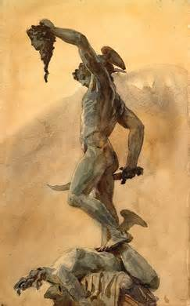
PERSEUS
W.D. Griffin, Jr.
February 1, 2014

Slide 2
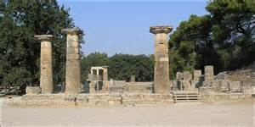
ARGOS
greatest center of the worship of Hera
Heraeum was the hill where the sanctuary of Hera stood
established by Phoroneus who decided in favor of Hera in the contest between Poseidon and Hera for the land
Poseidon dried up all the rivers including Inachus who was the father of Phoroneus
the Argive rivers have been short of water ever since

Slide 3
DANAË
Abas had twin sons, Proteus and Acrisius, who were bitter enemies, quarreling even before they were born
Acrisius had no sons but a daughter, Danaë
An oracle foretold that Acrisius would be killed by his grandson
He built a brazen chamber, or tower, in which he locked Danaë to avoid the oracle’s prediction
Zeus loved her and entered the chamber in a shower of gold, impregnating her
Their son was Perseus

Slide 4
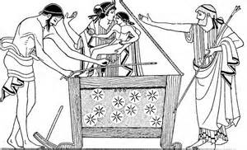
DANAË
After four years, Acrisius hears Perseus playing
Danaë tells him that he is Zeus’ son
Fearing the wrath of Zeus and the Furies, Acrisius places them in a chest and puts them to sea rather than kill them
The chest floats to Seriphos (possibly with the aid of Zeus) where they are rescued by the fisherman Dictys, whose name means “fishing net”

Slide 5
DANAË
Dictys and his wife shelter the two and raise Perseus to manhood
Soon after Perseus reached manhood, Polydectes (his name means “he who receives/welcomes many”, the brother of Dictys, becomes attracted to Danaë but wants nothing to do with Perseus
Polydectes devises a plan to eliminate Perseus
He announces his intentions to marry
All the guests bring horses except Perseus who has no horse to give
Perseus offers to bring Polydectes the head of the Gorgon Medusa

Slide 6
THE GORGONS
Classical traditions
Hesiod (Theogeny): daughters of Phorcys and Ceto and three in number, Stheno (the mighty), Euryale (of the wide sea), and Medusa (the queen)
Euripides (Ion): describes only “the Gorgon” produced by Gaea to aid the Titans against the Olympians; slain by Athena who wore her skin afterwards

Slide 7
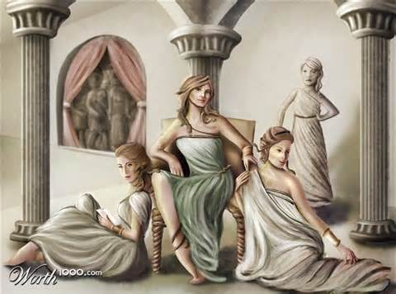
THE GORGONS
Classical Traditions (cont’d)
Apollodorus (Bibliotheca): all three Gorgons had snakes for hair and had the power to turn to stone whomever they gazed upon
Ovid (Metamorphoses): only Medusa had snakes for locks of hair

Slide 8
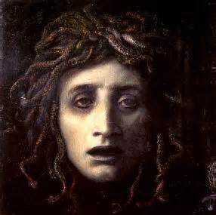
MEDUSA
Ovid describes Medusa as cursed by Athena for defiling her temple by copulating with Poseidon in it
Poseidon had become enamored by her golden hair which was turned into snakes by Athena
Medusa was the only one of the Gorgons who was mortal
Stheno and Euryale were immortal

Slide 9
THE GORGON’S HEAD
Upon leaving the banquet Athena appears to Perseus and tells him to find the land of the Hyperboreans to obtain the weapons necessary to slay Medusa
Hermes offers his assistance by giving him a scimitar that cannot be broken by the scales of the Gorgon; leading him to the Graeae who will tell him how to reach the Hyperboreans
He then tells him how to make the Graeae reveal the path
Athena gives him her polished shield instructing him to kill Medusa by using the reflection from the shield

Slide 10
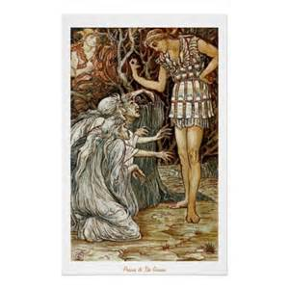
THE GORGON’S HEAD
The Graeae (Gray sisters) had the heads of humans and the bodies of swans with human arms protruding from under their wings
They were also daughters on Phorcys and Ceto
Their names were Deino (dread), Enyo (waster of cities) and Pemphredo (alarm)
They had but one eye and one tooth between them to see and speak
Hermes tells Perseus to wait until they are passing the eye and tooth and take them while between the sisters

Slide 11
THE GORGON’S HEAD
Perseus waited for the right moment and snatched the tooth and eye demanding to know the way to the Hyperboreans
Realizing what had happened they readily told him the path
The Hyperboreans provided him with the Cap of Darkness (renders the wearer invisible, also called the Cap of Hades), winged sandals, and a wallet which would magically stretch to fit its contents called the kibisis
Armed with these weapons, Perseus made his way to the island of the Gorgons

Slide 12
THE GORGON’S HEAD
The Gorgons were sleeping when Perseus arrived
Using the shield of Athena, Perseus cut off the head of Medusa and put it in the kibisis
The other sisters gave chase but were no match for the Cap of Darkness and the winged sandals
From the blood of Medusa sprang the winged horse Pegasus and his brother Chrysaor, “He of the Golden Sword” who was said to either be a giant or a winged boar
Chrysaor married Callirhoë, daughter of Oceanus, who bore him Geryon, whose cattle Hercules later stole, and Echidna

Slide 13
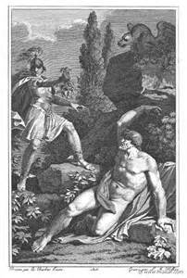
ATLAS
Perseus flew to the western end of the earth where he confronts Atlas
He seeks hospitality claiming to be the son of Zeus
Atlas remembered an oracle that told of a son of Zeus who would attempt to steal his golden apples and refused him hospitality

Slide 14
ATLAS
Atlas tries to throw him out of his realm and Perseus, unable to compete, removes the head of Medusa
His hair became forests; his arms and shoulders, cliffs; his head the mountain top; and his bones, rocks
He increased in size until he became the mountain that supports the heavens and the stars
Another version claims that Atlas was an inhospitable king of Mauritania
Note: This myth is a chronological disconnect with the Heracles myth of the Twelve Labors

Slide 15
ANDROMEDA
Andromeda was the daughter of Cassiopea (Cassiepea) and Cepheus, the King of the Ethiopians
Cassiopea had bragged that she was more beautiful than the Nereids
Result: Poseidon floods the kingdom and sends a sea monster to ravage the land
Cepheus consulted the oracle of Jupiter Ammon in Africa
The only was to appease the monster was to offer Andromeda to it, chained to a rock
some 1st Century A.D. sources indicate that the chains were located in the Palestinian city of Joppa

Slide 16
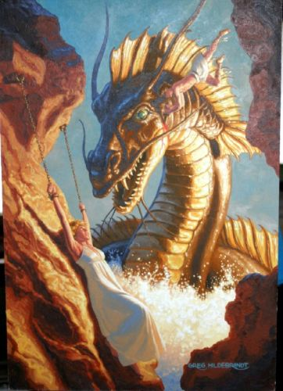
ANDROMEDA
Andromeda was chained to the rock as Perseus flew by (either from slaying Medusa or turning Atlas to stone) and immediately falls in love with her
Perseus offers to slay the monster in return for Andromeda’s hand in marriage
Cepheus and Andromeda readily agree
When the monster, Cetus, appears, Perseus uses the winged sandals and scimitar to slay it
Note: some Renaissance painters portray Perseus on Pegasus

Slide 17
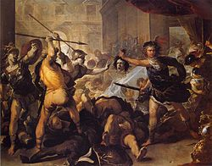
ANDROMEDA
Upon returning to the palace Cepheus orders a banquet in honor of the marriage of Perseus and Andromeda
Phineus, the brother of Danaus, Aegyptus and Cepheus, causes a stir since he was betrothed to Andromeda
Cepheus reprimands Phineus stating that, since it was decreed that Andromeda must be sacrificed, the wedding was off; and, if he really loved her, he would have attempted to save her himself
Phineus throws a spear at Perseus which misses its mark and battle ensues
Perseus uses the head of Medusa to turn his opponents to stone including Phineus

Slide 18
RETURN TO SERIPHOS
Perseus and Andromeda return to Seriphos to find that the wife of Dictys has died and his house abandoned
Dictys and Danaë have gone into hiding in fear of Polydectes whose hand in marriage Danaë had refused
No one on the island will assist Perseus, fearing the ire of Polydectes
It happens that Polydectes is having a feast with only his allies in attendance
Perseus crashes the party and uses the head of Medusa to turn them all to stone
Dictys is made king of Seriphos

Slide 19
BACK TO ARGOS
Perseus returns the sandals, scimitar and kibisis to Hermes who returns them to the Hyperboreans
He gives the head of Medusa to Athena who places it on her shield, the aegis (also called the Gorgoneion)
Danaë and Perseus decide that it is time to reconcile with Acrisius
They travel back to Argos with Andromeda
Having learned that Perseus was still alive, Acrisius fled to Larissa in Thessaly (Larissa is also the name of the acropolis of Argos)

Slide 20
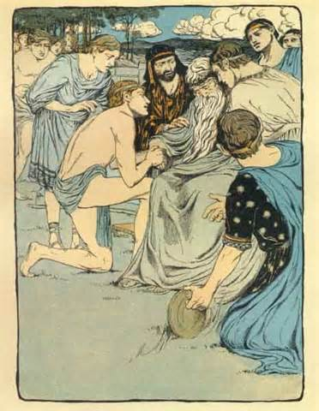
THE DEATH OF ACRISIUS
Perseus followed Acrisius to Larissa where the king was holding funeral games in honor of his father
Participating in the discus toss (or quoits), Perseus’ throw went beyond the mark, striking Acrisius in the foot
Acrisius died from the wound fulfilling the oracle
He was honored as a hero in Larissa
Because he had shed kindred blood, Perseus refused to return to Argos although he was the rightful heir to the throne

Slide 21
PERSEIDAE
Perseus went into voluntary exile in Tiryns where Megapenthes (“great mourning”), the son of Proteus, was king
Perseus and Megapenthes agree to exchange kingdoms
Perseus goes on to found the city of Mycenae
Andromeda bears him seven sons, Perses, Alcaeus, Heleus, Mestor, Sthenelus, Electryon and Cynurus; and two daughters, Autochthe and Gorgophone (Gorgon slayer)
Electryon was the father of Eurystheus and grandfather of Alcmene, the mother of Heracles

Slide 22
REFERENCES
Gayley, Charles Mills. The Classical Myths in English Literature and in Art. New York: Blaisdell Publishing Company, 1963.
Hamilton, Edith. Mythology. New York: Grand Central Publishing, 2011.
Morford, Mark P. O. Classical Mythology. New York: Longman, Inc., 1977.
Ovid. Metamorphoses. New York: Signet Classics, 2009.
Tripp, Edward. The Meridian Handbook of Classical Mythology. New York: Penguin Books, 1974.
www.wikipedia.org/greek mythology. 2014.

