Slide 1
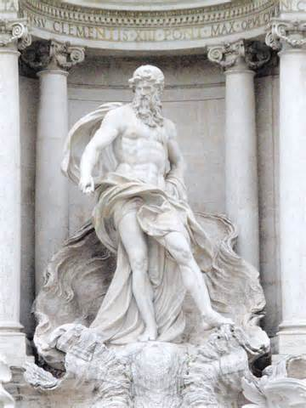
THE HOUSE OF INACHUS
W. D. Griffin, Jr
February 9, 2014

Slide 2
IO
Io was the daughter of the river god Inachus, the first king of Argos
some sources describe her as a priestess of Hera also called Callithyia
Zeus, intrigued by her beauty, decides that he must have her
Zeus enclosed them in a large cloud, which Hera sees and, not finding Zeus on Olympus, investigates
When Hera dispersed the cloud, there stood Zeus with a beautiful heifer which he claimed to have just been born

Slide 3
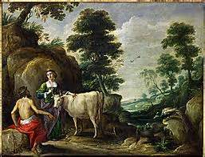
IO
Hera requested that Zeus make it a gift to her
Zeus cannot refuse without giving away his indiscretion
Hera then places Argus Panpontes (all-seeing, ever watchful) to tend to Io
Zeus sends Hermes to rescue Io from the gaze of Argus

Slide 4
PAN AND SYRINX
Hermes’ task was to put Argus to sleep which was difficult since he had 100 eyes (Ovid)
Hermes tried several different songs and tales but none were effective
Then Hermes invited Argus to sit on the rock next to him and began to tell the story of Pan and Syrinx
Pan came upon the nymph Syrinx, a follower of Artemis, and fell in love with her
Pan chased her and overtook her on the banks of a river

Slide 5
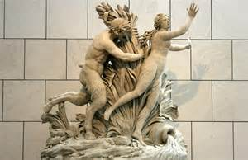
PAN AND SYRINX
Syrinx calls for help
As Pan embraces her, the water nymphs transform her into reeds
In his dismay at the loss of Syrinx Pan sighs into the reeds which makes a beautiful musical sound
Pan then takes the reeds and cuts them into varying lengths and joins them with beeswax
They become an attribute of Pan known as the syrinx or Pan pipes

Slide 6
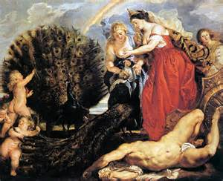
PAN AND SYRINX
Of all the tales told by Hermes the story of Pan and Syrinx put Argus to sleep
Hermes slew Argus which earned him epithet Hermes Argeiphontes (slayer of Argus)
Hera honored Argus by placing the eyes on her favorite bird, the peacock (now you know the rest of the story)

Slide 7
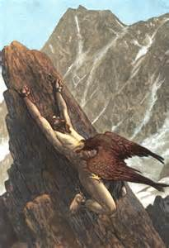
PROMETHEUS
Hera now sent a gadfly to torment Io which followed her throughout Greece and Asia Minor
During her travels she came to Mt. Caucasus where she encountered Prometheus whose liver was plucked daily by an eagle (some sources say a vulture) while chained to the mountain
Zeus had punished Prometheus for giving fire to man and for tricking him into accepting the worse part of a sacrifice and keeping the best part for himself (meat)

Slide 8
PROMETHEUS
Prometheus assured her that she would be transformed to her former self when she reached Egypt
He also told her that the waters beside the cliff along which she had journeyed would be called the Ionian Sea
The narrow crossing that she had forded into Asia Minor between the Propontis and the Black Sea would be called the Bosporus (cow or ox crossing)
He also told her that her sons would found many great cities and from her lineage Heracles would be born

Slide 9
THE DESCENDANTS
The son she bore was Epaphus who was kidnapped by Hera and taken to Syria
Io recovered him from Syria where she became identified with Astarte ( a goddess with the horns of a cow)
Upon her return to Egypt she was worshiped as Isis
Epaphus founded the royal families of Egypt, Argos, Phoenicia, Thebes and Crete
He also founded the royal city of Memphis in Egypt
The north part of Africa was named for his daughter Libya who bore the twin sons Belus and Agenor to Poseidon

Slide 10
THE DESCENDANTS
Agenor was the father of Cadmus, the founder of Thebes, and Europa, who bore Minos to Zeus in Crete
Belus was the father of twin sons Danaus and Aegyptus
Danaus and Aegyptus quarreled and despised each other as much as Acrisius and Proteus
Each brother had 50 sons and 50 daughters
Danaus proposed that their sons and daughters marry as a ruse to take control of the wealth of Aegyptus

Slide 11
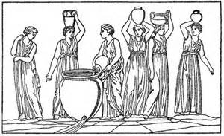
THE DANAIDS
On the night of the wedding Danaus had his daughters slay their bridegrooms
Only Hypermnestra spared her bridegroom, Lynceus, because he respected her wishes to remain a virgin
They married later and were the parents of Abas, the father of Acrisius
The slaughter of the 50 bridegrooms was depicted on the belt of Pallas, befriended by Aeneas
As punishment the Danaids were forced to fill a vat with a sieve or a bowl that could never be filled in Hades

Slide 12
REFERENCES
Gayley, Charles Mills. The Classical Myths in English Literature and in Art. New York: Blaisdell Publishing Company, 1963.
Hamilton, Edith. Mythology. New York: Grand Central Publishing, 2011.
Morford, Mark P. O. Classical Mythology. New York: Longman, Inc., 1977.
Ovid. Metamorphoses. New York: Signet Classics, 2009.
Tripp, Edward. The Meridian Handbook of Classical Mythology. New York: Penguin Books, 1974.
www.wikipedia.org/greek mythology. 2014.

