Slide 1
THE OLYMPIANS
W. D. GRIFFIN, JR
APRIL 23, 2015

Slide 2
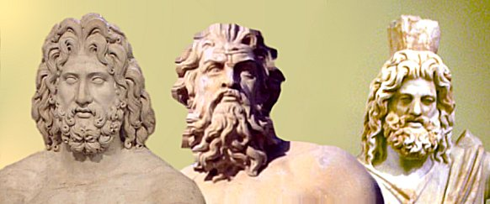
Overview
The first six Olympians were Hestia (first-born), Demeter, Hera,
Hades, Poseidon and Zeus (last-born)
The remaining Olympians were Hephaestus (son of Zeus and Hera, or Hera alone in response to Athena), Ares (son of Zeus and Hera), Apollo and Artemis (twins of Zeus and Leto), Aphrodite (daughter of Zeus and Dione or “foam born” from the blood of Uranus’ castration), Athena (daughter of Zeus and Metis), Hermes (son of Zeus and the Pleiad Maia) and Dionysus (son of Zeus and Semele)
According to most sources the Zeus, Poseidon and Hades drew lots for which realm each would rule

Slide 3
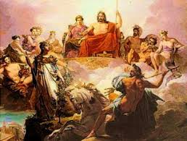
Zeus drew the heavens and established himself as the lord of all gods and men
Poseidon won the realm of the oceans and waterways
Hades won the realm of the Underworld
The blood of the gods was ichor; their food, nectar and ambrosia
The fourteen Olympians were reduced to twelve by removing Hades whose realm was the Underworld; and by replacing Hestia, who had chosen to leave Olympus to tend to her altars on earth, with Dionysus

Slide 4
Hestia (Vesta)
First-born of the Cronus and Rhea
She rejected the advances of both Apollo and Poseidon, wishing to remain a virgin
She is considered a goddess of chastity with Artemis and Athena
Goddess of the hearth and its sacred fire (her name is Greek for hearth)
The hearth was the center of family life as well as the larger political units such as the tribe or city-state (polis)
Presided over both the communal and domestic hearth
Given precedence at banquets and in sacrificial rituals being the first born

Slide 5
Zeus (Jupiter)
Last born of Cronus and Rhea
He is the god of the sky whose etymological root meaning is “bright” (Jupiter’s root meaning also means bright)
His attributes are thunder and lightning and the aegis (originally meant “goat skin” which was worn by shepherds) which is a shield with protective powers
The eagle and the oak are sacred to him
Olympia and Dodona were his most important centers of worship
He has four children with Hera: Eileithyia (goddess of childbirth), Hebe* (goddess of youthful bloom which is the meaning of her name and cupbearer of the gods until replaced by Ganymede), Hephaestus and Ares
* Footnote Fodder: Homer states that it was Hebe who bathes and clothes Ares after he is healed of his wounds inflicted by Diomedes during the Trojan War

Slide 6
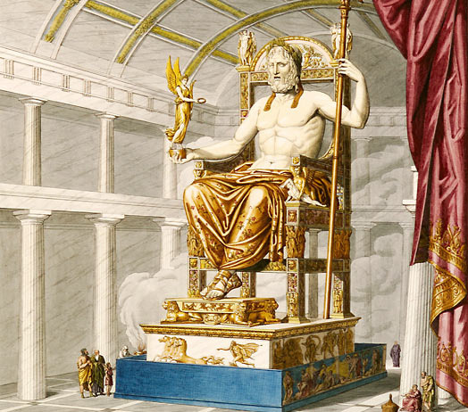
The thunderbolts of Zeus were forged by the Cyclopes Brontes (Thunder), Steropes (Lightning) and Arges (Bright)
The thunderbolts of Zeus were carried to him by Pegasus

Slide 7
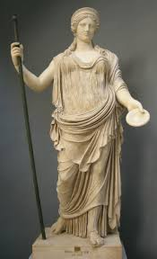
Hera (Juno)
Zeus’ consort and queen
Often punishes and avenges the romantic escapades of Zeus
Homer describes her as ox-eyed and white-armed
Hesiod describes her as golden-sandaled and golden-throned
Goddess of women, marriage and childbirth
The peacock (cf. Io and Argus) and cow are sacred to her
Her most important centers of worship were Argos, Sparta and Mycenae
Her Latin name is derived from the etymological root for “to shine” or “illuminate”
Her Greek name is derived from the etymological root for “beloved”, “cow-eyed” or “mistress”

Slide 8
Hephaestus (Vulcan)
God of creative fire and terrestrial fire, i.e. volcanic eruptions, incendiary flame, the glow of the forge and divine smith
His name means “burning”, “shining” or “ flaming”
His workshop is placed in heaven or on Mt. Olympus
He has gold handmaidens that can move and speak with intelligence to assist him in his duties
Vergil places his workshop on the island of Vulcania near Sicily where he forged the armor of Aeneas at the request of Venus
He also forged the armor of Achilles, the scepter of Pelops, the dwellings of the gods as well as their shields and spears, and the arrows of Apollo and Artemis
At times his forge is under the earth where he may be attended by the Cyclopes

Slide 9
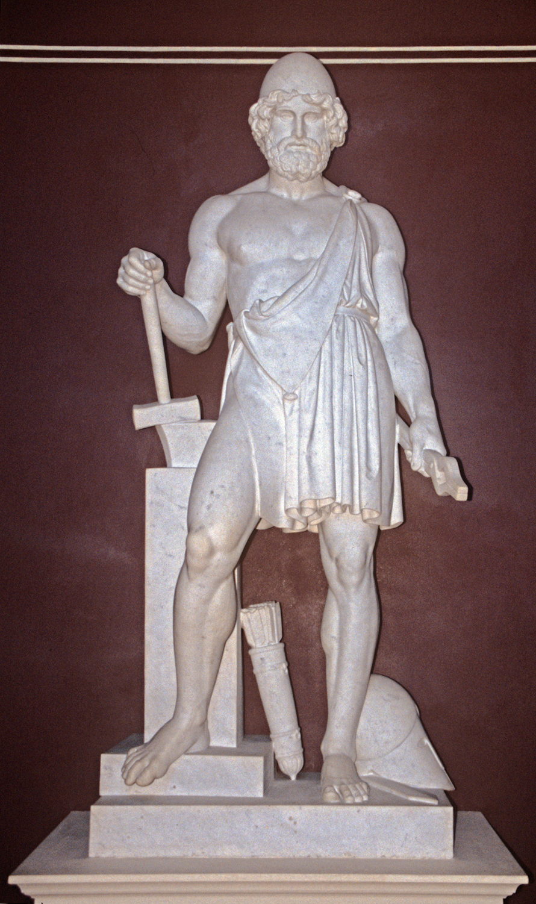
Crippled at birth, he was cast from Olympus by Hera who was ashamed of his deformity but he was rescued and returned to Olympus
On another occasion Zeus was said to have cast him from Olympus in a fit of anger and he landed on Lemnos which became an important center of his worship and cared for by the Sintians according to Homer
Some sources indicate that he was the child of Hera without Zeus since Zeus had borne Athena from his head
His wife is Aphrodite who is unfaithful to him preferring Ares instead
He is made aware of her infidelity by Helios and lays a trap for the lovers
Thinking him to be gone, Ares and Aphrodite lay upon her bed and are immediately shackled to the bed and ridiculed by their fellow male gods
He is sometimes said to be the mate of the Grace, Aglaia, and sometimes Charis, Grace herself
His attributes are the anvil, hammer and thongs

Slide 10
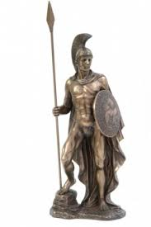
Ares (Mars)
Last born child of Zeus and Hera
God of savage warfare
With Aphrodite he was the father of Eros, Phobos (the god of fear), Deimos (god of terror), Harmonia (goddess of Harmony and wife of Cadmus) and, according to some sources Adrasteia (goddess of revenge)
His Greek name means “slayer”, “avenger” or “the curse”, while his Roman name means “the bright and burning one”
His attributes are the spear and burning torch
The vulture, boar and dog are sacred to him as well as the birds which guarded the Amazon’s temple to him on a coastal island in the Black Sea and had darts for feathers

Slide 11
In battle he is accompanied by Phobos and Deimos, his daughter Adrasteia (goddess of revenge, also identified as Nemesis), Eris, the goddess of discord and Enyo, the destroyer of cities
He was wounded by Diomedes during the Trojan War with the aid of Athena

Slide 12
Poseidon (Neptune)
God of the sea, earthquakes and horses
The Nereid Amphitrite is his consort who bears the same temperament for infidelity as Hera
Triton, the trumpeter of the sea, is the son of Poseidon and Amphitrite and has human form from the waist up and fish from the waist down
Triton is often depicted with his conch
His attribute is the trident
Horses and bulls were sacred to him
His own horses had bronze hooves and golden manes and the seas became calm as they pulled his chariot across the ocean
He is the father of the stallion Arion by Demeter who had disguised herself as a mare while searching for Persephone (Arion was given to Adrastus

Slide 13
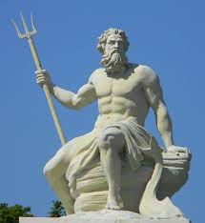
He is the father of Pegasus who sprang from the blood of Medusa when she was slain by Perseus as well as Chrysaor (He of the Golden Sword) who also sprang from her blood
By Ge (Gaea) he is the father of the giant Antaeus, slain by Heracles, and Charybdis
Also was said to have loved Scylla but her bathing pool was poisoned by Amphitrite transforming her into the monster encircled with a ring of dog heads (cf. Glaucus and Scylla in Lesser Divinities and Myths)
Competed with Athena for the control of Athens and the surrounding land of Attica

Slide 14
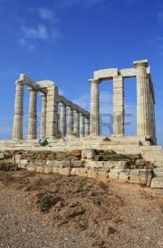
The contest took place on the Acropolis where Poseidon struck a rock with his trident from which sprang either a salt spring or the horse
Athena’s gift was the olive tree
Cecrops awarded control to Athena and in a rage Poseidon flooded the Thriasian Plain
Athena’s victory was immortalized on the west pediment of the Parthenon
The marks of the trident are near his temple on the Acropolis next to the olive tree planted by Athena
His home was located in Aegae on Euboea

Slide 15
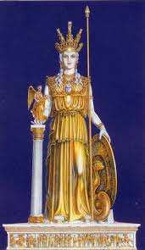
Athena (Minerva)
Goddess of wisdom, courage, inspiration, civilization, law and justice, strategic warfare, mathematics, arts, crafts and skill in Greek religion
Daughter of Zeus and Metis (her name means wisdom) whom Zeus had swallowed out of fear that she would bear a son who would overthrow him
Either Hephaestus, Prometheus or Hermes split open the head of Zeus with an axe to facilitate her birth
Her most noted epithets are Parthenos (Virgin) and Pallas, which she took after the accidental death of her friend of the same name

Slide 16
Pallas was the daughter of Triton to whom Zeus had entrusted the care Athena
While practicing the arts of warfare, the two quarreled and, as Pallas was about to strike Athena, Zeus interfered with the aegis, startling Pallas
Athena took advantage of the surprise and fatally wounded Pallas
In her grief Athena crafted a wooden statue in the image of Pallas and adorned it with the aegis
The Palladium was cast from Olympus by Zeus and landed in Troy
The Trojans built a temple to house it and it was seen as an object to carry the destiny of Troy
Another epithet is glaukopis which means gray-eyed
Her attributes are the spear, shield, aegis upon which the head of Medusa is often depicted, the owl and the olive tree
She is often attended by Nike (Winged Victory)

Slide 17
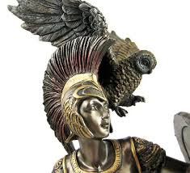
The Panathenaea was celebrated every four years in her honor during which an embroidered robe (peplos) was ceremoniously brought to the goddess
She invented the flute (aulos) which was inspired by the lamentations of the Gorgons after the death of Medusa (hissing of serpents)
She soon grew to dislike the flute (cf. Marsyas in Lesser Divinities and Myths)
Her importance as a goddess of the household arts is related in the myth of Arachne (cf. Lesser Divinities and Myths)

Slide 18
Aphrodite (Venus)
Her name means “foam born” (aphros the Greek for foam) from when, according to Hesiod, the foam of the sea mixed with the blood of the castrated Uranus
According to Homer she is the daughter of Zeus and Dione (feminine form of the name for Zeus)
In Plato’s Symposium they are two separate entities: Aphrodite Urania (celestial and born from Uranus alone) and Aphrodite Pandemos (Aphrodite of all the people or common Aphrodite)
Her most common epithets are Cytherea and Cypris which were two of her major cultural worship centers
Goddess of love, beauty and pleasure
Myrtle, doves, sparrows, horses and swans were sacred to her

Slide 19
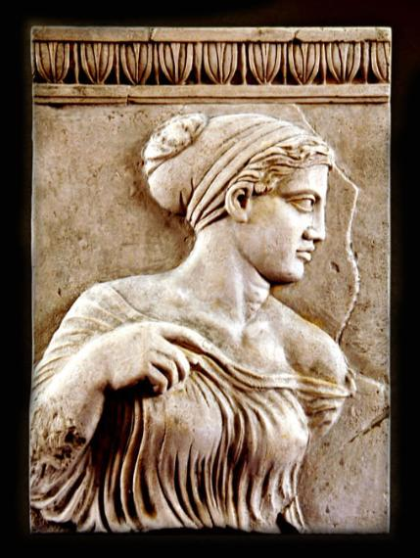
She is often accompanied by the Graces and the Horae (Charites)
She is said to possess a girdle with powers of enticement that were irresistible and that was used by Hera to have her way with Zeus (Homer, Iliad)
Several offspring are attributed to her in addition to those with Ares
These include Hermaphroditus (Hermes), the fertility god Priapus (either Hermes, Dionysus, Pan, Adonis or even Zeus) and Aeneas (Anchises)
She also loved the handsome son of Myrrha, Adonis who was killed by a wild boar

Slide 20
According to Ovid Venus asked Proserpina to change the body of Adonis into a flower just as she had changed the nymph Menthe into the mint plant
Within the hour a red flower sprang from the blood of Adonis
The flower was the anemone, or windflower, which is fragile against the buffeting winds
Another myth has Aphrodite placing the infant Adonis in a chest and giving it to Persephone to keep
Upon seeing the beautiful young boy Persephone refused to give the boy back
Zeus determined that Adonis would spend part of the year with Persephone and the remainder with Aphrodite
The celebration of Easter in Christianity of the dead and risen Christ has its roots with the “dead and risen Adonis”

Slide 21
According to Homer (Homeric Hymn to Aphrodite) the only three immortals not subject to the powers of Aphrodite were Artemis, Athena and Hestia
Since she could bend and sway the hearts of the remaining gods and goddesses, Zeus used his power to cause her to fall in love with the mortal Anchises
Zeus used this to make her suffer the humiliation of falling in love with a mortal as she had made the other gods and goddesses fall in love with mortals
In the Judgment of Paris she offers Helen, the wife of Menelaus, in return for being named “the Fairest”
The poetess of love, Sappho of Lesbos, was a devout follower of Aphrodite
Phaon was a ferryman between Lesbos and Chios carried Aphrodite to Lesbos
Because he would not take payment, she made gave him a salve that made him young and beautiful, causing the women of Lesbos to fall madly in love with him, but none more than Sappho

Slide 22
Artemis (Diana)
Daughter of Zeus and Leto (Latona) and twin sister of Apollo
Goddess of the hunt, wilderness, wild animals, virginity, protector of young girls, bringing and relieving disease in women and childbirth
The cypress and deer were sacred to her
She was the first-born of the twins on the island of Ortygia (Quail Island) which is sometimes a different island from Delos and sometimes they are the same
Soon after her birth she assisted with the birth of Apollo
Occasionally associated with Apollo as in the myth of Niobe, the daughter of Tantalus and granddaughter of Atlas, who was married to Amphion
She boasted that she was more beautiful than Leto and had more children than she, seven daughters and seven sons

Slide 23
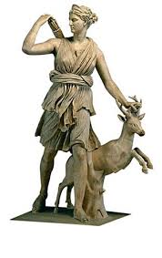
Leto complained to her children who slew the children of Niobe: Artemis the daughters and Apollo the sons
As Niobe pleaded for the life of her last daughter, she was turned to stone and returned to her homeland Phrygia where a rock on Mt Sipylus was identified as Niobe
Several myths illustrate the hallowed purity of Artemis (cf. Actaeon and Arcas in Lesser Myths and Divinities)
She is also associated with Orion
As a moon goddess she is associated with Selene and the fertility goddess Hecate

Slide 24
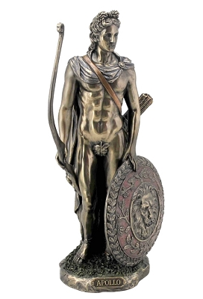
Apollo
God of light and the sun, truth and prophecy, healing, plague, music, poetry, and archery
Epithets include Phoebus (“bright” as the god of light), Cynthius (“born of Cynthus”), Delian (“of Delos”), Delphinius (“dolphin”), Pythius (as the god of prophecy and the oracle at Delphi), and Medicus (physician or healer)
His attributes include the bow and arrow, lyre, plectrum (flat tool used to play the lyre similar to a guitar pick), sword and tripod (prophecy)
Sacred to him were dolphins, wolves, roe deer, swans, hawks, ravens, crows, cicadas (music), mice, snakes (prophecy), palm trees and the laurel tree

Slide 25
According to the Homeric Hymn to Apollo Leto arrives at the island of Delos after giving birth to Artemis
Leto implores the island to allow her to give birth to Apollo but the island is afraid that, once he is born, Apollo will be resentful since the island is rocky and not worthy of a god
Leto swears by the river Styx that he will not and Delos relents and allows Apollo to be born there
Leto is in labor of nine days and nine nights since Hera has kept Eileithyia from assisting her
Iris is sent to summon Eileithyia to Delos and she responds and helps Leto, clinging to a palm tree, bring forth Apollo
In later accounts Hera tries to prevent Leto from finding a place to bear her children
It was through this fear that the whole earth rejected Leto’s attempts to find a place to bear her children

Slide 26
Hera had decreed that her children could not be born in any place where the sun shone
Poseidon kept the island, which floated at that time, covered by his waves and blocked the sun’s rays until the birth of the twins
After their birth, Delos no longer floated and became steadfast in the sea
The second part of the Hymn relates the establishment of the oracle at Delphi
Having descended from Olympus, Apollo searched northern and central Greece for the proper location for his oracle
He chose Crisa beneath Mt. Parnassus where he slew the she-dragon that lived nearby
Some sources state that the dragon was slain because she had tried to kill Leto because of a prophecy that she would bear a child who would slay it
The location was hence called Pytho (pytho is Greek for “I rot”) and Apollo Pyhtian

Slide 27
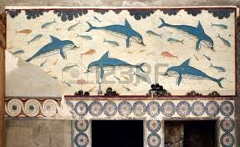
For slaying the serpent Zeus exiled Apollo to Thessaly for a period of nine years (punishment that mirrors religious dictates of ancient society)
The Stepteria was a festival celebrated every nine years at Delphi to commemorate the early events of the sanctuary
Needing attendants for the sanctuary, Apollo noticed a Cretan ship passing nearby
He transformed himself into a dolphin and jumped onto the ship and created such a havoc that the men submitted themselves in fear to him
He guided the ship to Crisa where he revealed himself to them and had them make sacrifices and worship him as Apollo Delphinius

Slide 28
The Pythian games were held every four years at Delphi
The Pythia was the prophetess who uttered the responses of the god which some say were inspired by the vapors that poured from a cave or chasm in the temple
Phenomoë (Prophetic Mind) was the first Pythia
The oracle was open on the seventh day of each month except for the three months of winter
The Pythia was the prophetess specific to Delphi while other prophetesses were called Sibyl, the most famous of which was Deiphobe, the daughter of Glaucus, and known as the Cumaean Sybil, who was the prophetess of Aeneas
Cassandra, the daughter of Priam, was given the power of prophecy after agreeing to give herself to him
When she refused his advances, Apollo asked for one last kiss and spat in her mouth
Thereafter no one would believe her prophecies

Slide 29
Apollo carried away the athletic nymph Cyrene to a site in Libya which would bear her name and where she bore him a son, Aristaeus the father of Actaeon
The best version of Apollo’s love for Daphne is described by Ovid in Metamorphoses
After slaying the Python, Apollo noticed Cupid and began to taunt him
Cupid responded shooting two arrows: one was lead and repelled love, the other, gold and fanned the flames of love
The lead arrow penetrated the heart of Daphne, the daughter of the river god Peneus and a follower of Diana, who wished to remain a virgin; the gold arrow pierced the heart of Apollo
As soon as Apollo saw her, he fell in love with her while she rejected his advances
Apollo pursued her through the forest until she could run no more
Daphne prayed to Peneus to rescue her from Apollo

Slide 30
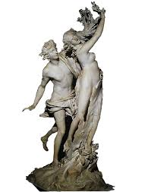
Just as Apollo caught up to her, Daphne was transformed into a laurel tree
Apollo proclaimed that she would always be his tree and that her leaves would wreathe his hair, his lyre and quiver as well as the heads of triumphant Roman generals
Winners of the Pythian games were crowned with laurel wreathes
He attempted to win Marpessa who chose the mortal Idas, fearing that the immortal Apollo would lose interest in her in old age (cf. Lesser Divinities and Myths)
Ovid describes the myth of the Spartan youth, Hyacinthus, in Metamorphoses

Slide 31
According to Ovid, Apollo and Hyacinthus, the son of Amyclas and Diomede, or Pierus and the Muse Clio, were throwing a discus
Apollo made the first throw and, as it returned to earth, Hyacinthus went to pick it up
The discus bounced off the ground and struck Hyacinthus in the head, killing him
Apollo proclaimed that he would become a flower, purple in color, and would bear the letters AI AI on its petals (Ajax Telamon was transformed into a hyacinth after killing himself when he lost the contest for Achilles armor)
Ovid places this myth in the mouth of Orpheus while other sources state that Zephyrus caused the discus to strike Hyacinthus because he also loved him
Still other sources state that he was loved by the bard Thamyris, the first man to love another man

Slide 32
In Book II of Metamorphoses Ovid describes the fate of Coronis of Larissa, another of Apollo’s loves who was pregnant with his child
A raven saw Coronis lying with a young Thessalian named Ischys and reported the indiscretion to Apollo
In anger and jealousy Apollo shot Coronis with one of his arrows
Before she died Coronis asked why he could not have waited until the birth of the child before exacting his punishment
Relenting, he asked the Fates to allow her to live, a request that was refused
As the flames of the funeral pyre burned, Apollo removed his son from her womb and gave him to the Centaur Chiron to raise
The raven was changed from white to black for his report of the infidelity
The child was named Asclepius, whose name means “to cut open” or “cut from the womb”, the god of medicine
Asclepius was the father of Machaon, the physician of the Greeks during the Trojan War, and Hygeia (Health)

Slide 33
He became so skilled in medicine that Artemis asked him to restore her follower Hippolytus to life which he did
This action incurred the wrath of Zeus since it disrupted the balance of nature
Zeus cast him to the Underworld with a thunderbolt which caused Apollo to kill the Cyclopes who forged the thunderbolt
For this crime Apollo was sentenced to live in exile for a year with Admetus, the kind king of Pherae in Thessaly
Apollo felt kindness toward his master and, when he found out that Admetus only had a short time to live, he bribed the Fates with wine
They agreed that he should live only if he could find someone to take his place
The only person who would agree to do so was his wife Alcestis
Alcestis was rescued from the tomb by Heracles, who was visiting them at the time, by wrestling Thanatos (Death) for her life

Slide 34
Apollo’s musical skill was contested by Marsyas and Midas (cf. Lesser Divinities and Myths)
Apollo slew the Euboean giant Tityus who attempted to rape Leto as she traveled to Delphi through the Phocian village of Panopeus
Tityus was punished eternally in Hades where his body was stretched over nine acres where two vultures or snakes ate his heart or liver which was replenished with each new cycle of the moon

Slide 35
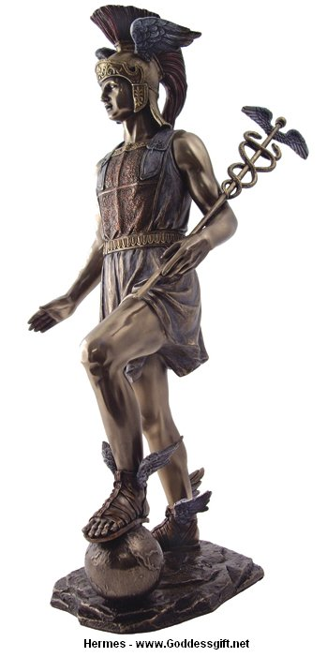
Hermes (Mercury)
Son of Zeus and the Pleiad Maia and the second youngest of the Olympian gods, born on Mt Cyllene
Messenger of the gods and the god of travelers, herdsmen, thieves, orators and wit, literature and poetry, athletics and sports, and commerce and inventions
His attributes were the talaria (winged sandals), petasus (winged cap) and the herald’s staff (in Greek, the kerykeion; in Latin, the caduceus) which was a winged staff entwined with snakes
Sacred to him were the herma (good luck statues placed at crossroads, country borders, and boundaries as well as other public places such as tombs, temples, libraries, etc.; also used as a fertility symbol), the rooster and the tortoise

Slide 36
His epithets include Diactoros (Messenger, referred only in Homer’s Odyssey), Argeiphontes (slayer of Argus), Psychopompus (guide of souls to the Underworld) and Agoraeus (of the market)
According to the Homeric Hymn to Hermes, he was born on the fourth day of the month at dawn and by midday had killed a tortoise and invented a lyre made from its shell with strings of sheep gut
That same evening he stole fifty head of the cattle of Apollo and drove them to the river Alpheus by driving them backward through Boeotia while wearing sandals made of brush to cover his own tracks
As he passed through Onchestus, he met an old man named Battus whom he bribed not to reveal what he had seen (some sources indicate that he did not trust Battus and, when he returned in disguise, Battus revealed what he had seen and was turned to stone by Hermes)
Once he had reached the river Alpheus, Hermes created fire sticks and fire and sacrificed two of the cattle, offering a portion to each of the twelve gods

Slide 37
He did not partake of any of his portion of the meat nor of the other gods and then burned the remaining evidence and returned to his crib
Upon discovering the theft, Apollo made his way to Onchestus where he also found Battus clearing weeds from the meadows
Battus told Apollo that he had seen a child carrying stick driving the cattle backwards
Apollo then goes to the cave of Maia and takes Hermes to Olympus to plead his case to Zeus while Hermes denies any knowledge of the theft
Zeus hears Apollo’s pleas and laughs, instructing Hermes to return the cattle to Apollo
After the cattle are returned, Hermes gives Apollo the lyre that he had invented
In return Apollo gives Hermes the art of divining by pebbles which was in the keeping of the Thriae, the nymphs of Mt Parnassus, and received the shepherd’s staff as a symbol of his office

Slide 38
The caduceus was his symbol as the messenger of the gods which he was said to have placed between two fighting snakes
The snakes made peace and entwined themselves around the staff
One of his greatest passions was for Aphrodite who rejected his advances
Zeus took pity on him and sent an eagle to steal one of her sandals while she bathed in the Achelous River which was taken to Hermes in Egypt
He refused to return it until she slept with him
Hermaphroditus was the result on the union (cf. Noted Couples of Myth)
His other offspring include Pan (Orisnoë or Dryope), Myrtilus, the charioteer of Oenomaus (Clytië), Eudorus (Polymele), the Argonauts Erytus and Echion (Antineira), the herald of the Argonauts Aethalides (Eupolemeia), Cephalus (Herse) and the greatest of all thieves Autolychus (Chione)
Some sources state that the reason for assisting Perseus is that Hermes found him attractive

Slide 39
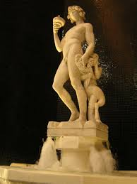
Dionysus (Bacchus)
Greek god of wine and vegetation
Also called Bacchus by the Greeks as well as the Romans who also called him Father Liber
The grapevine, ivy and fig are sacred to him; his primary attribute is the thyrsus which is a staff covered with ivy
There are several versions of his birth
One version from the late Classical writers states that Zeus slept with Persephone disguised as a snake
The result of the union was Zagreus whom Hera, in a fit of jealousy, persuaded the Titans to tear to pieces and devour
Athena saved his heart which Zeus swallowed and then fathered a second child with Semele

Slide 40
The more widely accepted version is that Zeus seduced Semele and, when Hera discovered that Semele was pregnant with Zeus’ child, Hera disguised herself as Semele’s nurse Beroë
Hera convinced her to insist that her divine lover appear to her in his full majesty
Semele then made Zeus promise to grant whatever she asked, which he reluctantly agreed to do
The radiance of Zeus either killed her or frightened her to death (some sources state that he appeared as a thunderbolt)
Zeus snatched the unborn child from the ashes and sewed it into his thigh
When it was time, Zeus removed the infant from his thigh
Both stories provide the epithet Dithyrambos which means “twice-born”
Other epithets include Bromios (Thunderer), Lenaeüs (He of the Wine Press), Lyaeüs (He Who Frees) and Dendrites (He of the Trees)

Slide 41
Dionysus is often accompanied by the Sileni who were the follower of Silenus, his tutor; the Maenads, or Bacchanals; and satyrs
The religion of Dionysus embodies the dual nature of man and sin, resurrection, life after death, reward and punishment which links him to the religious messages of Orpheus and Demeter
As a resurrection god, he was said to have gone to the Underworld and retrieved Semele whom he brought back to Olympus where she was given the name Thyone
Those who opposed him usually met with terrifying ends, such as Pentheus (cf. Antigone ppt.)
Proëtus was another who opposed Dionysus; and, his daughters were driven to behave like cows and began grazing in the mountains of Argos and eating their children
They were cured by Melampus through therapeutic dances and herbs

Slide 42
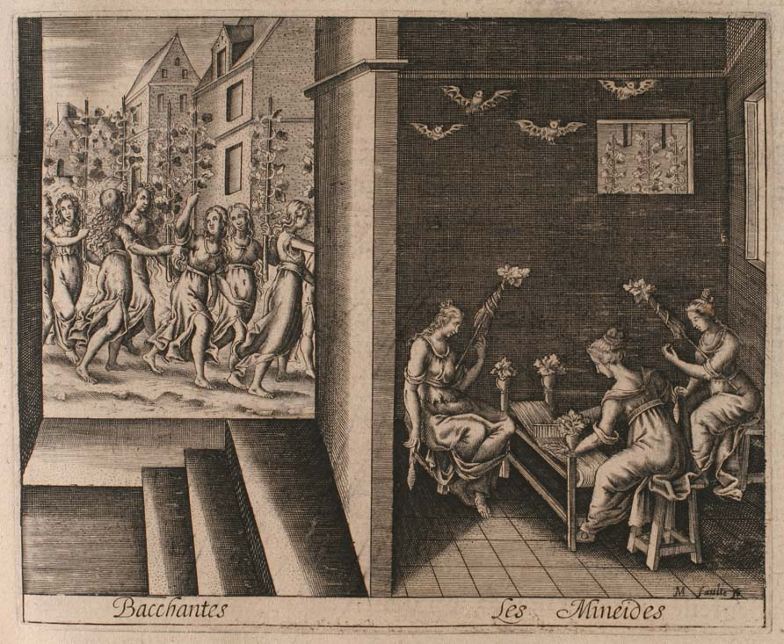
In Orchomenus the daughters of Minyas chose to weave as opposed to participating in the rituals of Dionysus
After they were driven mad, one of the daughters, Leucippe, had a son, Hippasus, who was torn to pieces like Pentheus by the sisters; and, afterwards turned into bats
Lycurgus chased the Maenads and Dionysus to the sea where they were comforted by Thetis
Having angered all the gods, Lycurgus was blinded by Zeus and died soon after

Slide 43
Dionysus drove Antiope mad after she was slain by Amphion and Zethus because she had been a votary of Dionysus
While in Attica during the reign of Pandion, Dionysus met Icarius who treated him with kindness
In return Dionysus gave him the gift of wine
When the people felt the effects of the wine, they thought that they had been poisoned and killed Icarius
Erigone, his daughter, and her dog, Maira, searched for her father; and, when they found his body, she hanged herself and the dog threw himself into a well
Dionysus caused the Athenian girls to hang themselves from trees until the murderers had been caught and punished and, following the advice of Apollo, they instituted “the swinging festival” in honor of Icarius and Erigone
Icarius was placed in the stars as the constellation Boötes, Erigone as Virgo and Maira as the dog star

Slide 44
He was kidnapped by Tyrrhenian pirates from the island of Icaria
Thinking him to be the son of a wealthy family, they thought of seeking a large ransom
The helmsman, Acoetes, tried to dissuade the pirates but to no avail
In spite of a strong wind the ship stood still and was covered in ivy and grapevines and wild animals—lions, panthers and bears-- appeared on the deck
Those that were not eaten jumped overboard and transformed into dolphins which accounts for the friendliness of dolphins toward humans
Acoetes was spared and gained favor with Dionysus
He found and married Ariadne on Naxos, or Dia, who bore him four sons: Thoas, Staphylus, Oenopion and Peparethus
When he traveled to Aetolia, he met Oeneus who received him hospitably

Slide 45
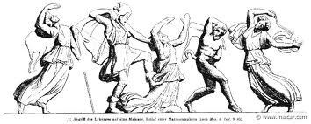
Sensing that Dionysus wanted to sleep with his wife, Althaea, Oeneus arranged to leave Aetolia for a discreet time
When he returned, Althaea was pregnant with her daughter Deianeira
Once his worship had been established from the Mediterranean to India, Dionysus left earth a took his place on Mt Olympus

Slide 46
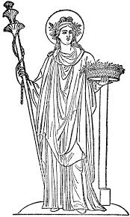
Demeter (Ceres)
She is the daughter of Cronus and Rhea and the goddess of ripe grain, the harvest and fertility
She is the mother of Persephone (Proserpina) by Zeus
At the wedding of Cadmus and Harmonia she was seduced by Iasion to whom she bore two sons, Plutus and Philomelus
Plutus became a god of wealth of the earth while his brother became a poor farmer who invented the wagon (to the delight of Demeter)
Demeter and Persephone represent the death and rebirth of vegetation with Persephone representing tender shoot opposite the ripe grain of Demeter
Persephone is also called Kore (Girl, Maid)

Slide 47
With the aid of Zeus Persephone was kidnapped near Henna by Hades who wanted her for his queen of the Underworld while gathering flowers with the daughters of Melpomene and Acheloüs
Some sources state that in anger Demeter transformed their daughters into the Sirens for not wanting to join the search while Ovid (Metamorphoses) says that they asked for wings to join the search
Demeter searched the earth for nine days and nights for Persephone but to no avail
On the tenth day Hecate revealed the kidnapping to Demeter while some sources state that it was Arethusa, an Argive woman or nymph named Chyrsanthis, or the people of Hermion who betrayed Hades’ deed
She refused to return to Olympus wandering the earth in human form
As she passed through Arcadia, Poseidon attempted to rape her; and she changed herself into a mare to avoid his advances, grazing with the herds of Oncius

Slide 48
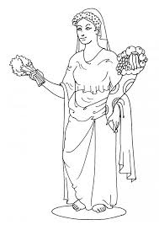
Poseidon mounted her in the form of a stallion and she bore him the steed, Arion (ridden by Amphiarius in the Seven against Thebes), and a daughter Despoina (her name was only revealed during religious ceremonies) and worshipped as the Mistress
She shut herself in a cave on Mt. Elaeüs where she was discovered by Pan who reported her location to Zeus
Zeus sent the Fates to talk with her and they eventually persuaded her to accept the marriage of Persephone and Hades
She was worshipped in this part of Arcadia as mare-headed Demeter and Poseidon the Horse
According to widespread tradition, Demeter visited cities of men, appearing as an old woman; and taught them the cultivation of corn

Slide 49
In towns where she was ridiculed Demeter brought famine or punished the culprits severely
One example is the punishment of Ascalabus who had ridiculed her for greedily drinking the kykeon (water mixed with meal and pennyroyal which is minty herb) that was given to her by his mother
In anger Demeter changed him into a spotted lizard (askalabos)
Her most famous visit was to the town of Eleusis where she was greeted courteously and invited to the palace by the daughters of Celeüs and Metaneira and to whom she introduced herself as Doso
The daughters of Celeüs were Callidice, Cleisidice, Demo and Callithoe
She told them that she was from Crete and had been kidnapped by pirates and offered to do any work fit for an old woman
They explained that their mother had given birth to a long awaited son, Demophon (Demophoön) and was in need of a nurse

Slide 50
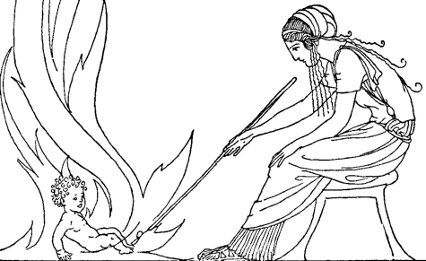
Upon entering the palace Demeter stood in the doorway with her head veiled, refusing to sit at the invitation of Metaneira until the maid Iambe prepared a seat covered with a silvery fleece and was given kykeon
Demeter began to nurse the child feeding him ambrosia and hiding him a fire to make him immortal
One night Metaneira (or a woman named Praxithea) observed Demeter placing him in the fire and screamed in alarm
Demeter flung the child to the ground and revealed herself to Metaneira, explaining that Demophon would have been made immortal but must now live as a mortal but not without great fame and honor

Slide 51
She then taught Celeüs and his followers the rites that were to be conducted in her honor that were celebrated for centuries: the Eleusinian Mysteries
Still grieving for her daughter, Demeter allowed the famine to continue until Zeus sent Iris to beg her to return to Olympus, but she refused to return
Zeus then sent the remainder of the gods to implore her to return and again she refused
Next Zeus sent Hermes to the Underworld to reason with Hades to allow Persephone to return to her mother
Hades consented, but forced her to eat a pomegranate before leaving his realm
Upon returning to her mother it was discovered that she had eaten of the pomegranate which would require that she spend the third part of every year in the Underworld

Slide 52
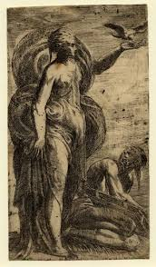
Some sources, including Ovid (Metamorphoses), say that she had eaten seven pomegranate seeds freely, being extremely hungry
Ascalaphus, a son of the Underworld river god Acheron and Orphne or Gorgyra, revealed to Hades that she had eaten the seeds
For his betrayal Persephone turned him into a screech owl by splashing him with water from the Phlegethon
Another source indicates that Demeter pinned him beneath a rock that was later rolled away by Heracles; and then Demeter turned him into the screech owl
Zeus then sent Rhea to reason with her to avoid any more famine
Realizing that Persephone would be with her two-thirds of the year, Demeter relented and allowed grain to grow again

Slide 53
Before returning to Olympus Demeter lent her dragon-drawn chariot to Triptolemus so that he might teach others how to grow corn
Triptolemus was the messenger of Demeter
She also gave a fig tree to Phylatus who had been kind to her during her stay in Eleusis
One account states that Eleusinus was the king of Eleusis and Triptolemus was his son by Cothonea
It was Triptolemus that was nursed by Demeter and Eleusinus was struck dead by her when he protested finding his son in the fire
Upon his return from promoting the use of grain Triptolemus found that Celeüs had been made king and planned to execute for his activities
Demeter intervened and forced Celeüs to turn the kingdom over to Triptolemus who then instituted Demeter’s festival called the Thesmophoria

Slide 54
Eleusinian Mysteries
Because of the influence of Athens, Eleusis was incorporated within the boundaries of Athens
The Eleusinian Mysteries became the best known and most influential of all the religious mysteries of the Greeks
There were two major compulsory stages that had to be undertaken: 1) participation in the Lesser Mysteries which involved preliminary initiation steps; 2) advancement to the Greater Mysteries (teletai proper) which entailed full initiation into the cult
An optional third stage entailed participation in secret rites called the Epopteia

Slide 55
There were two families of priests connected to Eleusis: the Eumolpids, who were direct descendants of Eumolpus who received the rites directly from Demeter and the Kyretes
The Hierophant was the highest priest and only he could reveal the sacred objects or Hiera
The priestess of Demeter was also a prominent figure in the ceremonies and lived in sacred house
Priests received a fee for their services from each initiate (mystes) who was sponsored and directed by a patron (mystagogos)
The Lesser Mysteries were held in Athens usually once a year in early spring
The general purpose was to prepare the initiate and ceremonies probably focused on ritual purification, including sacrifices, prayer, fasting and cleansing with water

Slide 56
The Greater Mysteries were held in September and October during which time a holy truce was declared for 55 days
Heralds were sent out with invitations to neighboring city states who responded with tithes and special delegations
Both Athens and Eleusis were involved in these Mysteries
Preliminary to the festival proper the Hiera were removed from the Anactoron of the Telestrion (the holy of holies of the temple of Demeter) in Eleusis and brought to Athens amid great pomp and ceremony
The procession was headed by priests and priestesses who carried the Hiera in baskets bound by ribbons and was met in Athens and escorted to the Eleusinion, the sanctuary of Demeter in Athens
The next day was the first day of the nine-day celebration which would culminate in Eleusis and end in Athens on the ninth day

Slide 57
Day 1: All people were summoned to an assembly in the Stoa Poikile (Painted Colonnade) and all who could speak Greek and were pure were invited to participate in the Mysteries
Day 2: Those who were participating in the Mysteries were ordered to cleanse themselves in the sea and carried a little pig with them to be cleansed as well for sacrifice
Day 3: This was a day of sacrifice and prayers on behalf of the participants as well as for the states involved
Day 4: This day was spent honoring Asclepius who in previous times had arrived late for the Mysteries; and was a day for latecomers to enroll and make up the missed requirements
Day 5: Priests and laymen led the procession back to Eleusis crowned with myrtle and carrying the mystic bacchus (myrtle branches tied with wool strands). Food and clothing for the stay in Eleusis were carried on staffs or pack animals. A wooden figure of Iacchus was escorted in a carriage. Jeers and insults were made to instill humility in the crowd

Slide 58
Day 5 (cont’d): Torches were lit, prayers were chanted and hymns sung as the participants reached the sanctuary of Demeter in Eleusis. It is here that the women danced with the mystic kernoi (sacred vessels) on their heads
Days 6 and 7: This was the core of the Mysteries which included fasting (foods such as pomegranates, beans and certain fish were banned) and a vigil. The fasting ended with the drinking of the kykeon. The ceremonies consisted of three stages: 1) a dramatic enactment of the Demeter’s activity in Eleusis (dromena); 2) the revelation of the sacred objects (deiknymena); and 3) uttering of certain words (legomena). The center of these activities was the Telestrion proper and the Anactoron (inner sanctuary) of the temple
Day 8: The ceremonies are concluded
Day 9: Participants return to Athens but without a formal procession
The following day the Athenian council of 500 heard a report on the conduct of the ceremonies
As in other ceremonies, the Mysteries have commonality with the belief in the immorality of the soul and an afterlife.

Slide 59
Hades (Pluto, Dis, Orcus)
He was the son of Cronus and Rhea and the brother of Zeus and Poseidon
When the brothers cast lots for their realms after the Titanomachy (the war between the Titans and the Olympians), he drew the Underworld
His name comes from the Greek ‘Aides or Aïdoneus, which means “unseen” or the unseen one
Fearing the use of the term, the Greeks referred to him as Pluto from the Greek, ploutos which means wealth and refers to his to his role beneath the earth, the source of the wealth of crops
The Romans later adopted Pluto and added Dis (riches) and the less-used Orcus
The Greek Underworld, called the House of Hades by Homer, simply became Hades

Slide 60
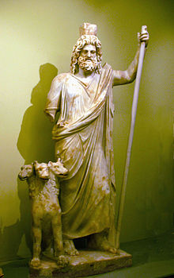
His attributes were the bident, Cerberus, the cypress tree, the narcissus flower, the key to the gates of the Underworld and a drinking horn
He was also said to possess the Cap of Invisibility
Although he shared rule of Olympus and the universe, preferred to remain in the Underworld, leaving only possibly twice
The first, according to Homer, occurred when he was hit by an arrow that was shot by Heracles as he defended the gates of the city of Pylus
He ascended to Olympus to heal his wound and returned to the Underworld
Another interpretation is that Heracles shot Hades at the gate (pylus) of the Underworld

Slide 61
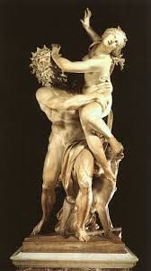
The only other instance of his departure from the Underworld was the taking of Persephone as his bride
Hades dutifully asked Zeus if he could marry Persephone
Zeus gave his permission but warned him that Demeter would never agree to the marriage and advised him to take her by force
Hades left the Underworld in his chariot drawn by four black horses and kidnapped her as she picked flowers
Whether Hades forced Persephone to eat pomegranate seeds or she ate seven out of hunger, she was forced to spend one-third of her time in the Underworld with Hades and the remainder with her mother on the earth

Slide 62
Persephone eventually became accustomed to her new realm and came to be known as a ruler of the dead as well
Hades had some connection with horses as did Poseidon
He also had a herd of cattle which were kept in the Underworld or on the island of Erytheia by Menoetes
Various sources indicate that Hades had three children: Macaria (no mother mentioned) who was the embodiment of a blessed death; Melinoë, the daughter of Persephone and Zeus, disguised as Hades, who was born at the mouth of the Cocytus River, where Hermes was stationed as Psychopomus, and was the bringer of nightmares and madness; and Zagreus (Aeschylus) not to be confused with the Orphic Zagreus
The nymph Menthe (Minthe),associated with the Cocytus River, attempted to seduce Hades but was foiled by Persephone who transformed her into a mint plant (Ovid, Metamorphoses, Book X)

Slide 63
Hades (the Underworld)
The abode of the dead
Early writers placed it at the western edge of the Greek world
Later writers placed it in the underground with entrances at Taenarum in the southern Peloponnesus, the Alcyonian Lake near Lerna in Argolis, and Lake Avernus near Naples
The descended to Hades as shades or phantoms (eidola kamonton), mere resemblances of themselves
If the dead had received the proper burial rites, they were ferried across the Acheron, or Styx, by Charon the ferryman who required a obulus (obul) as payment
The Acheron was a swampy river that was often described as the outer boundary of the Underworld
As a river god Acheron was the father of Ascalaphus, the orchard keeper of Hades, either by Orphne or Gorgyra
Once across they passed through the gates of the Underworld guarded by Cerberus, the three-headed watchdog with a serpent’s tail and a mane of snake heads and offspring of Typhon and Echidna, who allowed the dead to enter but would eat any of the dead who tried to leave

Slide 64
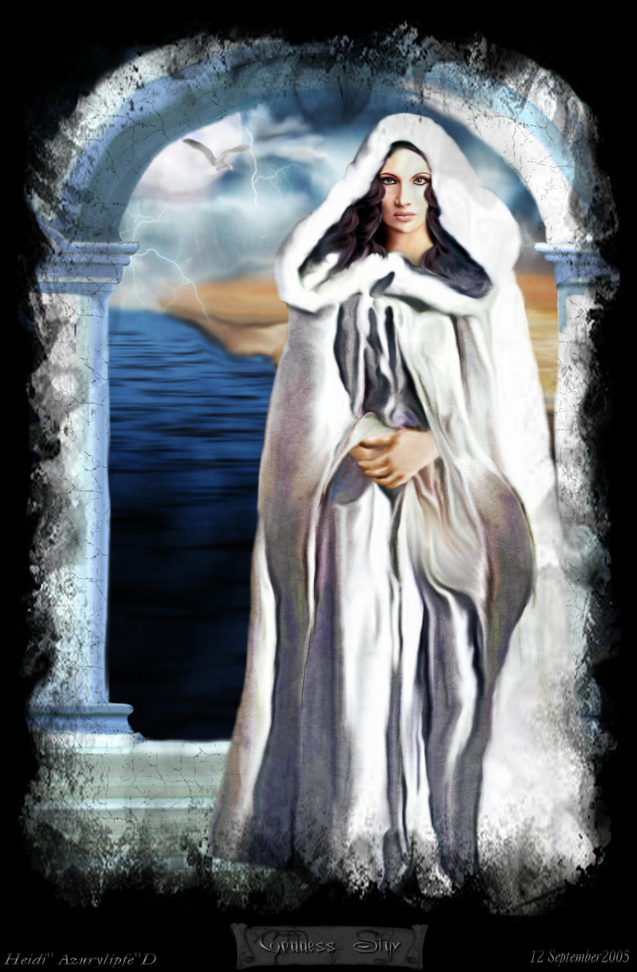
When Heracles removed him from the Underworld as one his Labors, it is said that he turned one person to stone who looked upon him
the poisonous aconite plant sprang from the foam that dripped from his jaws
The Styx River was the chief river of Hades which was said to circle Hades nine times; and is often the river across which Charon is said to have ferried the dead
The goddess Styx, the personification of the river, was the daughter of Oceanus and Tethys
She is the mother of Zelus (zeal or rivalry), Nike (winged victory), Cratus (strength) and Bia (force); and the mother of Echidna by Peiras

Slide 65
Styx lived in a silver-lined chamber in the Underworld
Styx sided with Zeus during the Titanomachy
In return for her support Zeus agreed that her children should stay with him and that the most inviolable oath that could be sworn by the gods would be sworn by her waters (Stygian Oath)
If a god wished to swear by the Styx, Iris was sent to the Underworld to fetch a jug of water from the river and it was poured out while taking the oath
The punishment for breaking the oath was to lie in a coma for one year and to be ostracized from the remaining gods for nine more years
Its waters broke all vessels that attempted to carry them and corroded all materials that touched them except horses hooves
The Cocytus River (River of Wailing) was a branch of the Styx

Slide 66
The Lethe was the river of forgetfulness from which the dead would drink to forget their former lives
The Phlegethon or Pyriphlegethon was the river of fire
Most of the shades of the dead dwelled in the Plains or Fields of Asphodel (no pleasure or pain)
It was here that Achilles complained to Odysseus that he would rather be a poor man’s slave than rule in Hades
Elysium, or the Elysian Fields, was the region where mortals who were made immortal by the gods resided and retained their faculties as shades
Elysium was ruled by Rhadamanthys, one of the judges of the Underworld
Menelaus, Peleus and Cadmus were among those fortunate enough to reside in Elysium
In Works and Days Hesiod describes a similar place called the Isle of the Blessed

Slide 67
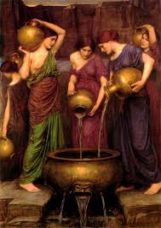
Pausanias describes the Isle of the Blessed in the Black Sea near the mouth of the Danube as related by Leonymus, a general of Crotona, who was sent there by the oracle of Delphi to cure a wound
There he found Achilles, Patroclus, Antilochus, Helen, Ajax Telamon and Ajax Oileus
Tartarus was the area set aside for
the impious or evil where they suffered eternally
Inhabitants of Tartarus
those Titans who had warred against the gods and were guarded by the Hecatonchires
the Danaides who had killed their husbands on their wedding night and were forced to carry water in leaky jars that forever needed to be refilled

Slide 68
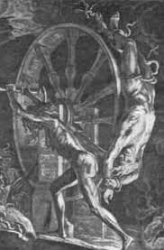
Ixion who had killed his father-in-law, Eioneus, into a fiery pit after failing to provide the agreed upon price for his bride, Dia; finding no one to purify him of the crime of killing first kin, Zeus brought him to Olympus where he tried to seduce Hera, but lay with a cloud in the shape of Hera place in his bed by Zeus; for this betrayal he was chained to a wheel of fire which revolves forever; the offspring of Ixion and the cloud was Centaurus who mated with the Magnesian mares and begat the race of Centaurs; Pirithous was the son of Zeus and Dia
Salmoneus attempted to imitate Zeus by driving his chariot through the streets pulling dried hides and bronze kettles and hurling lit torches to simulate thunder and lightning; Zeus destroyed him and the town with a single thunderbolt; and, according to Vergil suffers an unnamed punishment in Tartarus

Slide 69
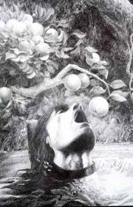
Sisyphus who killed travelers and guests against the practice of Xenia and who revealed to the river-god Asopus where Zeus had taken his daughter, Aegina; he also tricked Thanatos (Death) by chaining him in his own chains until Ares rescued him since war was not the same without death; he eternally pushes a boulder up a hill which rolls back down as soon as it reaches the top of the hill (Sisyphian task)
Tantalus who served his son, Pelops, to the gods; only Demeter partook of the meal out of her dismay at the loss of Persephone; the shoulder of Pelops was replaced with an ivory one; his punishment was to stand in a pool of water and a low-hanging branch of fruit that eternally remained out of his reach (tantalize)
Tityus was the son of Zeus and Elara who attempted to rape Leto at the request of Hera but was slain by Apollo and Artemis; as a punishment he was stretched out over nine acres of Tartarus where two vultures daily ate his liver which was replaced at night

Slide 70
Inhabitants of Hades
Minos, Rhadamanthys (brothers and sons of Zeus and Europa) and Aeacus (son of Zeus and Aegina) who were the judges of the Underworld; Rhadamanthys resided in Elysium; Aeacus held the key to the gates of Hades; and Minos held the scepter of judgment; they sat in judgment in the forecourt of the palace of Hades and Persephone at the trivium (intersection of three roads) which was sacred to Hecate
The Erinyes (Dirae, Furies), Alecto (unceasing anger), Megaera (Jealousy) and Tisiphone (Vengeance); they are the avengers of crime especially murder; renamed the Eumenides after the trial of Orestes
The Moirai (Parcae, Fata, Fates) were three in number: Clotho who spun the thread of life, Lachesis who measured the thread and Atropos who cut the thread at the end of life; they were the daughters of Nyx (Night) or Zeus and Themis); they either carry out the will of the gods or Zeus must obey their will
Hypnos (Somnus) the god of sleep; the river Lethe flows through his cave
Thanatos (Mors) the god of death

Slide 71
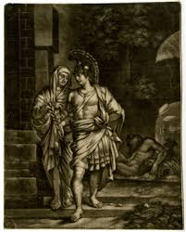
Mortal Visitors to the Underworld
Odysseus to seek the advice of Tiresias
Orpheus to bring back Eurydice
Heracles to capture Cerberus
Theseus to assist Pirithous in kidnapping Persephone; both chained to the Chair of Forgetfulness; Theseus rescued by Heracles
Psyche to retrieve a box of beauty replenishment for Venus
Aeneas, assisted by the Cumaean Sibyl, to learn the future of the lineage that he was about to establish

Slide 72
The Lesser Divinities of Olympus
Eros, the son of Aphrodite and Ares
Eris, the goddess of Discord
Anteros, the avenger of slighted love; opposes love
Hymen, the god of marriage
Hebe, goddess of youth, cupbearer of the gods until her marriage to Heracles
Iris, goddess of the rainbow, a messenger of the gods, especially Hera
The Charites (Graces), goddesses of charm, beauty, nature and fertility; Aglaia (Splendor), Euphrosyne (Mirth) and Thalia (Good Cheer); daughters of Zeus of Eurynome; Aglaia married to Hephaestus and bore him Eucleia (Good Repute), Eupheme (Acclaim), Euthenia (Prosperity) and Philophrosyne (Welcome)
The Muses who spent most of their time on Mt Helicon
Horae (the Seasons) daughters of Zeus and Themis who guarded the gates of Olympus; Eunomia (Order), Dike (Justice) and Irene (Peace); they gave justice, equality before the law and peace to mortals

