Slide 1
THE TROJAN WAR
W. D. GRIFFIN, JR
OCTOBER 26, 2013

Slide 2
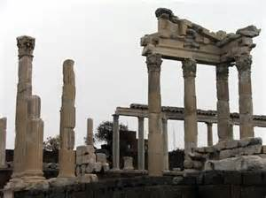
THE TROJAN WAR: PART 1-THE TROJANS
Apollo and Poseidon had built the walls of Troy for Laomedon, who cheated them out of their pay.
As punishment Apollo sent a plague and Poseidon a sea monster to harass the Trojans.
The oracles advised that Laomedon must expose his daughter Hesione to be devoured by the monster.
Heracles offered to rescue Hesione in return for Laomedon’s mortal horses which were a gift of Zeus.

Slide 3
THE TROJANS (cont’d)
When Zeus took Ganymede, who was an uncle of Laomedon, to Olympus to be the cupbearer of the gods, he gave the immortal horses to Tros, the father of Ganymede, in return.
Laomedon eventually inherited the horses.
Once again, Laomedon cheated his benefactor.
Heracles returned to Troy with an army, captured Troy and gave Hesione to Telamon to whom she bore Teucer.
Polydarces was spared by Heracles to become the new king of Troy; his name was changed to Priam.

Slide 4
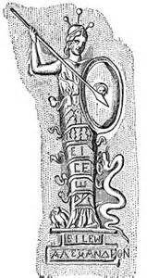
THE TROJANS (cont’d)
After killing Pallas, the daughter of Triton, during a quarrel, Athena made a carving of the girl.
Zeus cast the image from Olympus into Troy where it was worshiped and considered a protector of the city.
This was the Palladium.
When it was stolen by Odysseus and Diomedes, Troy was doomed.

Slide 5
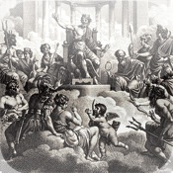
THE TROJANS (cont’d)
Gods supporting Troy:
Aphrodite (Venus)-her son, Aeneas is a Trojan
Ares (Mars)-always followed Aphrodite
Apollo-patron god of Troy
Artemis (Diana)-twin sister of Apollo would follow her brother
Scamander-river god and son of Oceanus and Tethys on whose plains many battles were fought and fought Achilles
Eris, goddess of Discord, and Leto, mother of Apollo and Artemis

Slide 6
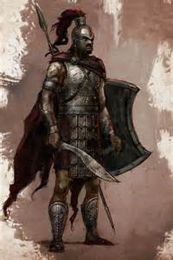
THE TROJANS (cont’d)
Priam
king of Troy and father of 50 sons and 12 (or 50) daughters, of whom 19 were born to his second wife, Hecuba (first wife Arisba is insignificant)
Hector
champion of the Trojans who slew Patroclus thinking him to be Achilles
in turn was slain by Achilles
married to Andromache
his son Astyanax was thrown from the walls of Troy by the Greeks

Slide 7
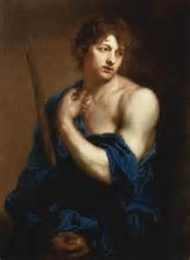
THE TROJANS (cont’d)
Paris
son of Priam and Hecuba who was exposed as an infant on Mt. Ida
Hecuba had dreamed that she had given birth to a firebrand that would destroy Troy
her stepson, the soothsayer Aesacus interpreted the dream as Paris being the downfall of Troy
raised by shepherds
fell in love with the nymph Oenone who had the gift of healing

Slide 8
THE TROJANS (cont’d)
Paris (cont’d)
left Oenone years later for Helen
when he was wounded by Philoctetes, Oenone refused to heal him and he died from the wound
Oenone killed herself in remorse
shot the fatal arrow that killed Achilles guided by the hand of Apollo

Slide 9
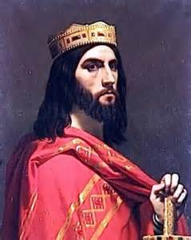
THE TROJANS (cont’d)
Helenus
son of Priam and Hecuba who had the gift of prophecy which he received after serpents licked his ears as child
Calchas ordered that he be captured since he was the only one who could tell the Greeks how to defeat Troy
captured by Odysseus and treated honorably (only son of Priam to survive the war
later married Andromache and became a ruler in Epirus
last seen in the Aeneid when tells Aeneas of his future wanderings

Slide 10
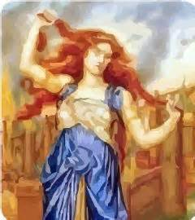
THE TROJANS (cont’d)
Cassandra
daughter of Priam
she was loved by Apollo and given the gift of prophecy by him
rejected his advances and was fated that none of her prophecies would be believed
foretold Troy’s fall and warned against the Trojan horse to no avail
while taking refuge in the temple of Athena, she was dragged from the temple by Ajax the Locrian (Lesser), son of Oileus
for this sacrilege the Locrians sent annually sent two daughters of noble families as temple servants to atone for the crimes of Ajax

Slide 11
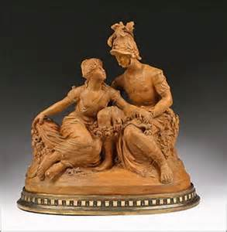
THE TROJANS (cont’d)
Polyxena
daughter of Priam who was claimed by the ghost of Achilles as part of his spoils
sacrificed at his tomb by the Greeks before they set sail for home
Antenor
wanted no part of war and suggested that Helen be returned
saved the Greek ambassadors from the Trojans and protested the breaking of a truce by the Trojans in the last year of the war
spared by the Greeks and allowed him to escape with his wife, Theano, a priestess of Athena
reached Italy and founded the city of Patavium (Padua)

Slide 12
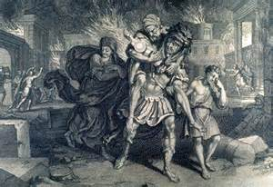
THE TROJANS (cont’d)
Aeneas
son of Anchises and Aphrodite
a mighty warrior in the Iliad but a lesser one than Hector and Achilles
Fights Achilles but is saved from an inevitable death by Poseidon
Poseidon foretells that Aeneas will rule Troy since Zeus has withdrawn his favor from Priam

Slide 13
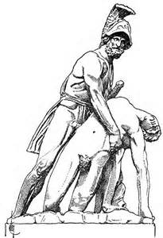
THE TROJANS (cont’d)
Notable Allies
Sarpedon (Lycia)
son of Zeus, killed by Patroclus, but unable to be saved by his father
Zeus rained down drops of blood on earth to honor him
Glaucus (Lycia)
about to fight Diomedes, but realized that they were hereditary guest friends
Exchanged armor and parted friends
Diomedes got the better of the deal as his armor was bronze and Glaucus’ was gold
Killed by Ajax Telamon (the Greater) in the fight over Achilles’ corpse

Slide 14
THE TROJANS (cont’d)
Notable Allies (cont’d)
Rhesus (Thrace)
said to the son of Eioneus (Homer) or the river god Stymon and a Muse, either Calliope, Euterpe or Terpshichore
had beautiful white horses
killed in his tent along with 12 of his men by Diomedes and Odysseus after learning from the Trojan spy Dolon that he had just arrived from Thrace
worshiped as a hero in Thrace

Slide 15
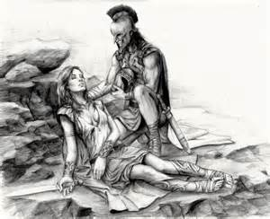
THE TROJANS (cont’d)
Notable Allies (cont’d)
Penthesilea (Amazons)
slain by Achilles in battle
Achilles mourned her for her beauty and was taunted by Thersites for his actions
Achilles slew Thersites and was forced to do penance on Lesbos for one year
Memnon (Ethiopia)
son of Eos and Tithonus, a brother of Priam
Slew Antilochus, son of Nestor, and then is slain by Achilles (both had armor made by Hephaestus)
after his death his followers were turned into birds that fought around his tomb
The tears shed by Eos (Aurora) became the morning dewdrops

Slide 16
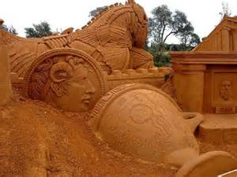
THE TROJAN WAR: PART 2-THE GREEKS
Note: also referred to as Achaeans
Menelaus*
king of Sparta (Lacadaemon) and husband of Helen
does not play a major role except facing Paris in single combat
thwarted by Aphrodite in his attempts to kill Paris
Agamemnon*
king of Mycenae (considered the most powerful of the Greek city-states)
brother of Menelaus and husband of Clytemnestra
father of Iphigenia, Chrysothemis, Orestes and Electra
leader of the Greek forces in the Trojan War
*also referred to a the Atreides, or Atreidae, sons of Atreus

Slide 17
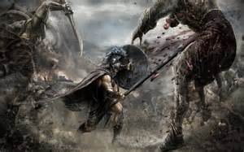
THE GREEKS (cont’d)
Diomedes
king of Argos, son of Tydeus
second only to Agamemnon in rank and power
favored by Athena and with her assistance was able to wound Ares and Aphrodite
often associated with Odysseus
Nestor
son of Neleus and oldest of the Greek leaders
king of Pylos and the most respected of the counselors among the Greeks
similar to Priam in that he was also spared by Heracles who had also killed his father, Neleus

Slide 18
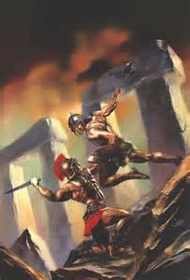
THE GREEKS (cont’d)
Odysseus
king of Ithaca
brave warrior and the craftiest of the Greek warriors
tried to avoid the war by feigning madness when he yoked an ox and a donkey to a plow and began sowing salt
the ruse was uncovered by Palamedes by placing Odysseus’ son Telemachus in the path of the plow
Odysseus swerved to avoid killing his son revealing his sanity
later contrived the death of Palamedes for uncovering his ruse

Slide 19
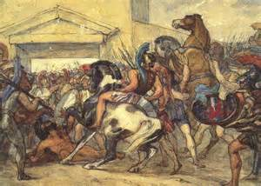
THE GREEKS (cont’d)
Ajax Telamon (the Greater)
prince of Salamis
second only to Achilles as a warrior
Ajax Oileus (the Lesser)
provided a large contingent
less attractive than other leaders because of his sacrilegious violation of Cassandra
Idomeneus
son of Deucalion and leader of the Cretans
only leader to volunteer as opposed to owing service to Agamemnon
lifelong friend of both Menelaus and Agamemnon

Slide 20
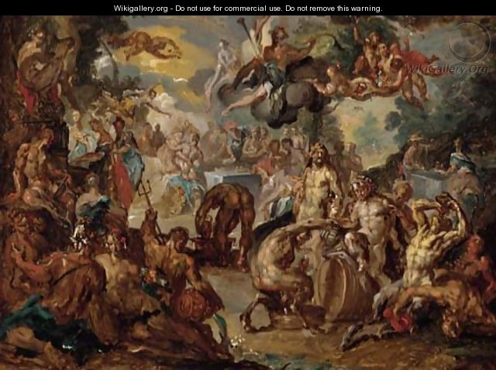
THE GREEKS (cont’d)
Achilles
son of Peleus and Thetis, a sea goddess and daughter of Nereus
Thetis was loved by both Poseidon and Zeus
both withdrew their attention when Prometheus and Themis revealed that Thetis’ son would be greater than his father
Themis was a Titaness who presided over “divine law”
Zeus arranged for Thetis to marry Peleus, a mortal who was no match for Thetis (she had the ability to change into various shapes to escape from him)
all the gods attended the wedding
after Achilles was born, she left Peleus

Slide 21
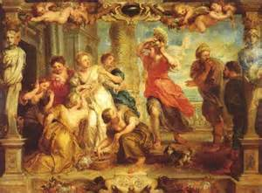
THE GREEKS (cont’d)
Achilles (cont’d)
Thetis attempted to make Achilles immortal by roasting him a fire by night and anointing him with ambrosia by day
the most common myth is that she dipped him in the River Styx rendering him invincible except at the heel where held him
educated by Chiron in music and other skills
while with Chiron, Thetis learned that Troy could not be taken without him (he could live long and die ingloriously or die young and gloriously at Troy)
Thetis sent Achilles to the island of Scyros where he was raised with the daughters of the king Lycomedes disguised as a girl

Slide 22
THE GREEKS (cont’d)
Achilles (cont’d)
here Achilles fell in love with Deidamia who bore him Neoptolemus (Pyrrhus) who took part in the capture of Troy
Diomedes and Odysseus discovered the disguise of Achilles
they brought gifts to the daughters of Lycomedes which included armor and weapons
an alarm was sounded on a signal from Odysseus causing the girls to run for safety
Achilles, thinking it to be a battle signal, put on the armor and picked up the weapons (Statius, Roman poet)
Achilles had no choice but to join the Greek forces at Aulis
Commanded the Myrmidons, fierce warriors whose race sprang from the ants of an oak tree sacred to Zeus to populate the kingdom of Aeacus (Ovid)

Slide 23
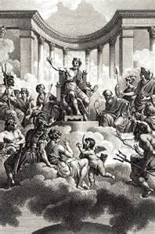
THE GREEKS (cont’d)
Gods who supported the Greeks
Hera (Juno) and Athena (Minerva) after both were snubbed by Paris
Poseidon (Neptune) since the Greeks were great sailors
Hermes (Mercury) although sometimes favoring the Trojans
Hephaestus (Vulcan)who crafted the armor of Achilles to replace the armor taken by Hector
Thetis the mother of Achilles
Hades (Pluto) and Zeus (Jupiter) remained neutral although Zeus favored the Trojans

Slide 24
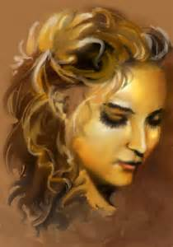
THE GREEKS (cont’d)
The face that launched a 1,000 ships?
The main Greek contingents in the Homeric Catalogue:
Agamemnon, 100 ships
Nestor, 90 ships
Diomedes and Idomeneus, 80 ships each
Menelaus and Achilles 60, ship each
Ajax the Lesser, 40 ships
Ajax the Greater and Odysseus, 12 ships each
More like 534 ships, but who’s counting?
(In Book II of The Iliad Homer enumerates almost 1200 ships with full crews.)

Slide 25
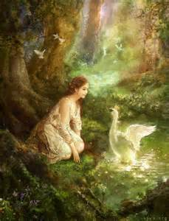
THE TROJAN WAR: PART 3-THE ORIGIN
Leda
wife of Tyndareus, king of Sparta
seduced by Zeus in the form of a swan
she bore four (4) children:
Castor and Clytemnestra by Tyndareus (mortal)
Polydeuces (Pollux) and Helen by Zeus (immortal)
Castor and Pollux are referred to as the Dioscouri (striplings of Zeus) or the Tyndaridae (sons of Tyndareus)
neither took part in the Trojan War

Slide 26
THE ORIGIN (cont’d)
Helen
the most beautiful woman in Greece
chose Menelaus out of all her suitors who swore to respect her choice and assist Menelaus in time of need
bore Menelaus a daughter, Hermione
seduced by Paris (a.k.a. Alexander) while Menelaus was in Crete and taken to Troy with him
Agamemnon raised the expedition against Troy to recover her and to vindicate the rights of Menelaus
Helen was also made to be unfaithful by Aphrodite when her father failed to make sacrifices to her
some historical data indicates that is was most likely a trade rivalry

Slide 27
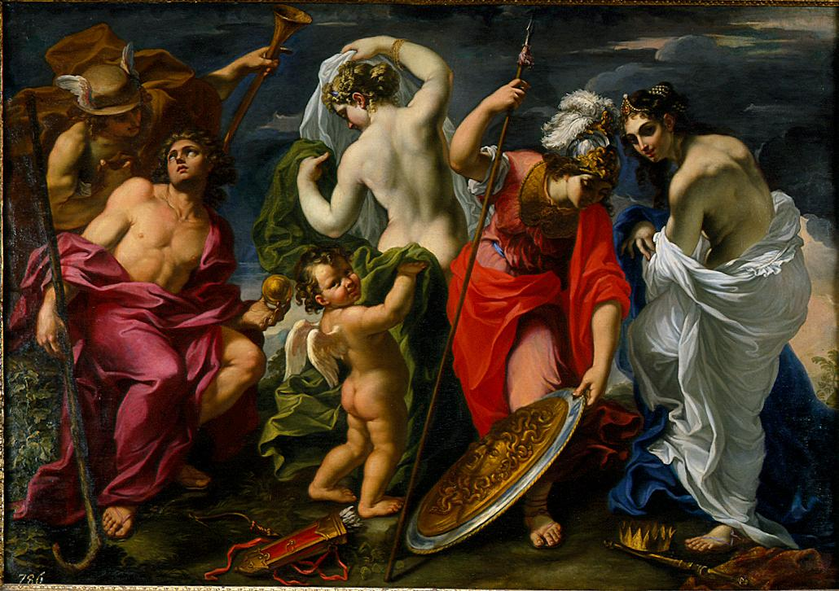
THE ORIGIN (cont’d)
Zeus’ Plan
Due to his numerous amorous adventures Zeus felt that it was time to reduce the population of the world, especially of his demigod descendants
Judgment of Paris
All gods and goddesses attended the wedding of Thetis and Peleus except Eris, the goddess of Discord
Discord was stopped at the door by Hermes by order of Zeus
She threw an apple onto the table with the word “To the fairest”
The prize was claimed by Hera, Athena and Aphrodite
Zeus decided that Paris should make the decision

Slide 28
THE ORIGIN (cont’d)
The Judgment of Paris (cont’d)
Hermes led the three goddesses to Paris who was tending sheep on Mt. Ida
Hera promised him royal power
Athena promised him victory in war
Aphrodite promised him Helen
Paris chose Aphrodite causing unrelenting anger toward the Trojans from Hera and Athena
his decision set in motion the events leading to the Trojan War

Slide 29
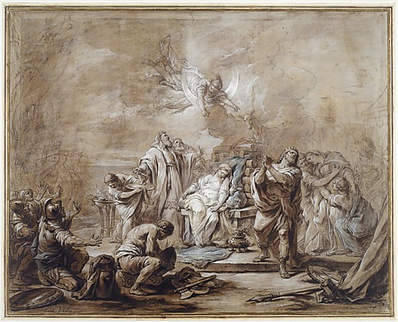
THE TROJAN WAR: PART 4: PREPARATIONS
The Sacrifice of Iphigenia
the Greek forces assembled at Aulis
ill winds prevented the ships from sailing
Agamemnon consulted the Greek seer, Calchas
Calchas knew that Agamemnon had offended Artemis by killing a stag sacred to her
Calchas advised that only the sacrifice of his daughter to Artemis would appease her and allow favorable winds for the expedition
Agamemnon sent for Iphigenia on the pretext that she was to marry Achilles and was sacrificed
Euripides indicates that she was taken from the altar by Artemis to her temple in Tauri (Crimea) to be her priestess

Slide 30
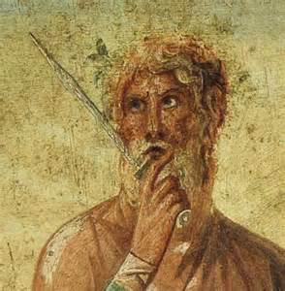
PREPARATIONS (cont’d)
Another Omen
at Aulis a snake climbed a tree and devoured eight chicks and then the mother
Zeus then turned the snake into stone
Calchas interpreted this to mean that the war with Troy would last nine years with the city being captured in the tenth
The Journey Begins
Philoctetes guided them to the island of Chryse to make sacrifices to its goddess

Slide 31
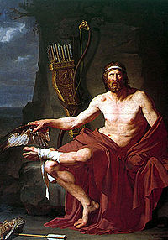
PREPARATIONS (cont’d)
The Journey Begins (cont’d)
Philoctetes was bitten by a snake on Chryse
as the fleet sailed on to Troy, the wound began to smell
the smell was so bad that he was left on the island of Lemnos
Philoctetes was the son Poeas who had lit the funeral pyre of Heracles and to whom Heracles had given his bow and arrows
Philoctetes now had the bow and arrows of Heracles

Slide 32
PREPARATIONS (cont’d)
The Journey (cont’d)
when Helenus was captured, he prophesied that Troy could not be captured with the bow and arrows of Heracles
Diomedes and Odysseus returned to Lemnos and returned with Philoctetes and the bow and arrows
the wound was healed by Machaon and Podalirius, sons of Aescelapius the god of medicine
Paris was killed by Philoctetes with the bow and arrows of Heracles

Slide 33
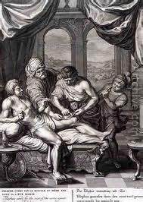
PREPARATIONS (cont’d)
The Journey (cont’d)
Telephus, son of Heracles and king of Mysia is wounded by Achilles
when the wound would not heal, Delphi was consulted with the reply “he that wounded shall heal”
Telephus entered the Greek camp disguised as a beggar and asked Achilles to cure his wound
Achilles said that he was not physician and could heal the wound, but Odysseus pointed out that it was his spear that wounded him
Straps from the spear were applied to the wound and Telephus was healed

Slide 34
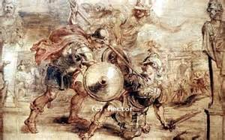
PREPARATIONS (cont’d)
The Journey (cont’d)
it was foretold that the first Greek to set foot on Trojan soil would be killed
Greeks were hesitant to depart their ships
Odysseus threw his shield on the beach and jumped onto it
Protesilaus jumped onto the beach and was slain by Hector in single combat as his foot was first to touch Trojan soil
Laodamia his wife could not be comforted
Hermes brought him back from Hades for a few hours and when he returned she killed herself
Cycnus the son of Poseidon was killed by Achilles and turned into a swan

Slide 35
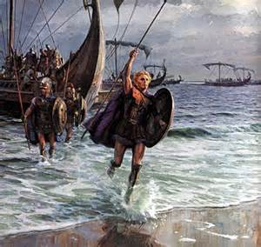
THE TROJAN WAR: PART 5-THE WAR
with the deaths of Cycnus and Protesilaus the Greeks pulled their ships to shore and laid siege to Troy
being well-fortified the war was in the ninth year when the quarrel between Achilles and Agamemnon began (principal theme of The Iliad)
Agamemnon had been given Chryseis, the daughter of Chryses, a priest of Apollo
Achilles was given Briseis with whom he fell deeply in love
Agamemnon refused to allow Chryses to ransom his daughter
Chryses prayed to Apollo to punish the Greeks
Apollo sent a plague to punish the Greeks and Calchas advised Agamemnon that the plague would end if he returned Chryseis without ransom

Slide 36
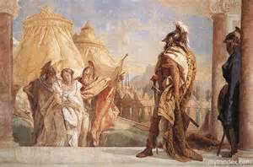
THE WAR (cont’d)
Agamemnon returned Chryseis but was left without any spoils (humiliation for one of the greatest leaders in Greece)
Took Briseis from Achilles which was a dishonor to him
Achilles withdrew the Myrmidons from the war, which is the opening scene of The Iliad

Slide 37
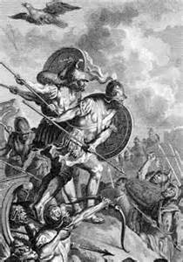
THE WAR (cont’d)
The Death of Palamedes (Apollodorus)
Odysseus had been sent to Thrace to retrieve grain but return with none
Palamedes ridiculed him to which Odysseus challenged him to do better
Palamedes returned with the grain
Odysseus was still angry with him for putting his son in danger and conceived a plot
Odysseus arranged for a Phrygian prisoner to forge a letter from Priam to Palamedes
Odysseus placed the letter and gold in the tent of Palamedes which was later “discovered”

Slide 38
THE WAR (cont’d)
The Death of Palamedes (cont’d)
Agamemnon had him stoned to death for treason
Nauplius, the father of Palamedes, sailed to Troy to seek justice for his son’s death but was refused
He traveled about the Achaean kingdoms telling the wives of the Greek leaders that their husbands were bringing Trojan concubines to dethrone them
Clytemnestra was one of the most famous Greek wives who was seduced by Aegisthus, son of Thyestes

Slide 39
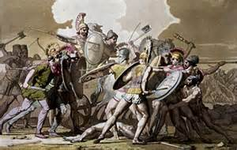
THE WAR (cont’d)
The Death of Patroclus
Achilles’ withdrawal emboldens both sides to meet head on
Paris and Menelaus fight a duel but Aphrodite saves Paris from death
Diomedes kills Pandarus and wounds Ares and Aphrodite with the aid of Athena
Trojan forces then push through the Achaean wall and enter the Greek camp almost setting fire to the Greek fleet
Achilles yielded to the pleas of Patroclus to allow him to wear his armor and fight after the Trojans set fire to Protesilaus’ ship
Patroclus was successful, killing Sarpedon and driving the Trojans back to the walls of Troy but was stopped from entering by Apollo

Slide 40
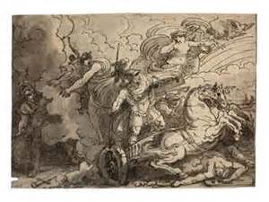
THE WAR (cont’d)
The Death of Patroclus (cont’d)
Hector slays Patroclus and takes the armor of Achilles
Achilles puts aside his quarrel with Agamemnon and Briseis is returned to him untouched
Achilles leads the Greeks and drives the Trojans back to the city walls
Hector alone stays outside the gates after being tricked by Athena to fight Achilles which ends in Hector’s death
Achilles had 12 Trojan prisoners sacrificed at the funeral of Patroclus and defiled the body of Hector in a manner that went against all Greek ethics

Slide 41
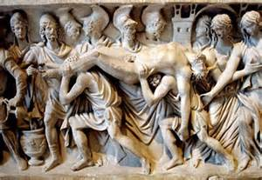
THE WAR (cont’d)
The Death of Patroclus (cont’d)
Achilles dragged the body of Hector around the city walls for 12 days with Apollo restoring the defiled body each day
Hermes assisted Priam in reaching Achilles’ camp
Priam ransomed the body of Hector
Achilles grief ends
The Iliad ends with the funeral of Hector

Slide 42
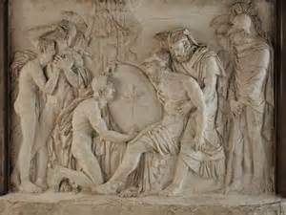
THE WAR (cont’d)
The Death of Achilles
Achilles slays Penthesilea and Memnon
Achilles is slain by Paris with the aid of Apollo while pursuing the Trojans
Ajax Telamon recovered the body of Achilles after fierce fighting
Thetis and the sea nymphs attended the funeral of Achilles
Thetis is said to have removed the body to the island of Leuce in the Black Sea and restored it to life giving him immortality
Homer sends Achilles to the Underworld where his shade meets Odysseus and complains of his fate
Achilles’ body was buried at Sigeum, the promontory near Troy

Slide 43
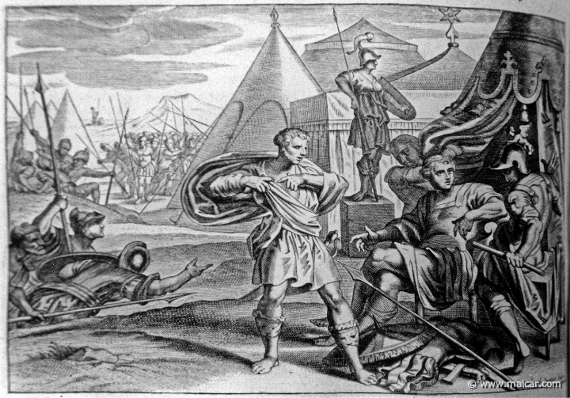
THE WAR (cont’d)
The Armor of Achilles
Odysseus and Ajax Telamon both claimed the armor of Achilles, being the surviving leading warriors of the Greeks
Athena presided over an assembly of the Greeks and their Trojan prisoners
Ajax and Odysseus made speeches to argue their claim to the armor
Trojan prisoners claimed that Odysseus did more harm to them than Ajax and the armor is awarded to Odysseus
Ajax is driven mad by the disgrace of losing and slaughters a flock of sheep
Ajax kills himself when he regains his sanity
a flower springs from his blood with the initials AI-AI on the petals

Slide 44
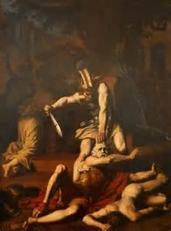
THE TROJAN WAR: PART 6: THE FALL OF TROY
Prophecies of Helenus
After the death of Achilles, Helenus was captured by Odysseus and Diomedes while he was traveling to Mt. Ida.
He was forced to reveal the conditions for the Greeks to win the war.
Troy could not be taken without the bow of Heracles (Philoctetes)
Neoptolemus (Achilles’ son) must be persuaded to fight with the Greeks
Pelops’ bones must be brought to Troy in order for the Greeks to win (according to Pausinas the ivory shoulder was brought)
the Paladium must be stolen and removed from the city walls

Slide 45
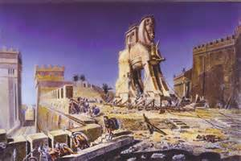
THE FALL OF TROY (cont’d)
The Trojan Horse
Odysseus entered Troy disguised as a beggar but was recognized by Helen who plotted with him to steal the Paladium (homesick)
Odysseus and Diomedes return and steal the Paladium
Odysseus’ plan was to craft a wooden horse and hollow inside to hold 50 Greek warriors
Epeus was given the task of building the horse
Sinon was to be left with the horse outside the city gates while the remaining forces withdrew to the island of Tenedos

Slide 46
THE FALL OF TROY (cont’d)
The Trojan Horse : Sinon
Sinon claimed hatred for Odysseus and many of the Greek leaders to Priam
Athena had become angry at the theft of the Palladium
The oracle claimed that her appeasement could only come at the sacrifice of a Greek since the expedition began with one
Sinon was the Greek that was to be sacrificed
The horse was an offering to Athena but it was made too large since the oracle also stated that if within the city walls, Troy could not be taken
Cassandra was the first to doubt his story, but her prophesy would not be heeded (remember Apollo’s curse)

Slide 47
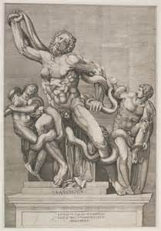
THE FALL OF TROY (cont’d)
The Trojan Horse: Laocoon
Laocoon was a priest of either Apollo (Sophocles and Apollodorus) or Poseidon (Vergil)
Apollo or Poseidon became angry with him because he had married and consummated the marriage on the sacred altar
Laocoon threw a spear into the side of the horse causing the Greek armor to rattle but no one could hear it over the celebration in Troy
“Equo ne credite, Teucri/Quidquid id est, timeo Danaos et dona ferentis” (The Aeneid)
Drakones Troiades (Trojan Dragons) were sent by either Apollo as he was sacrificing to Poseidon; by Poseidon for his sacrilege; or by Athena to support Sinon’s tale
Laocoon and his sons, Antiphantes and Thymbraeus, were strangled by the serpents
Curissia and Periboea (Porces and Chariboea), offspring of Typhoeus, were the serpents that strangled Laocoon and his sons

Slide 48
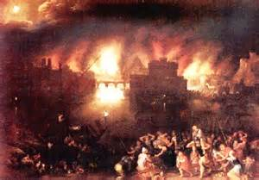
THE FALL OF TROY (cont’d)
The Sack of Troy
The Trojans returned to their homes in peace
Sinon opened the door of the horse
The Greeks climbed from inside the horse and opened the gates
Trojans were put to the sword
Neoptolemus (Pyrrhus) slew Polites, the youngest son of Priam, and then slew Priam at the altar of Zeus of the Courtyard

Slide 49
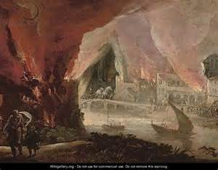
THE FALL OF TROY (cont’d)
Aeneas
Only Trojan leader to escape
Anchises (father) and Ascanius, or Iulus, (son) escaped with him
Creusa his wife got separated during the escape and was killed
Lares and Penates are brought to Italy by Aeneas
Passed Helen in the temple of Hestia but advised by Aphrodite to keep moving after casting angry words at her
Anchises wanted to remain in Troy and die there but Aphrodite sent an omen, a glowing light above his head followed by thunder and a shooting star

Slide 50
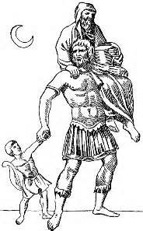
THE FALL OF TROY (cont’d)
Aeneas (cont’)
Androgeos, a Greek warrior, is slain by Aeneas when he mistook Aeneas for another Greek warrior
Coroebus, a companion of Aeneas, put on the armor of Androgeos and continued the fight out of the city
Aeneas gathered the survivors on Mt. Ida before beginning his journey to Italy

Slide 51
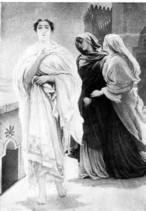
THE FALL OF TROY (cont’d)
The Trojan Women
Hecuba
given to Odysseus as part of his spoils
when they landed in Thrace, the body of her son Polydorus washed up on the shore
Polydorus had been sent to stay with Polymestor, the local king, with a sizeable treasure
enticed Polymestor and his two sons into her tent with an offer of more treasure
Hecuba’s handmaidens slay the children of Polymestor and blind him with their brooches

Slide 52
THE FALL OF TROY (cont’d)
Hecuba (cont’d)
Hecuba was turned into a bitch
when she died, her place of burial was called Cynossema, the tomb of the dog
Andromache
Widow of Hector and given to Neoptolemus as part of his spoils
begged for the life of her son, Astyanax
Astyanax was thrown from the walls of Troy either out of hatred for the Trojans or fear of retribution when was grown

Slide 53
THE FALL OF TROY (cont’d)
Andromache (cont’d)
later married Helenus and with him plays a prominent role in Book 3 of The Aeneid
founded the Molossian dynasty with Helenus
Cassandra
awarded to Agamemnon as part of his spoils
raped by Ajax Oileus in the temple of Athena
predicted that Clytemnestra would kill Agamemnon and herself
prophecy ignored and both were killed by Clytemnestra and Aegisthus

Slide 54
THE FALL OF TROY (cont’d)
Polyxena
daughter of Priam
sacrificed on the tomb of Achilles by Neoptolemus after Achilles’ ghost appeared and claimed her as part of his spoils
Helen
led by Aphrodite to Menelaus who returns her to Sparta
Menelaus threatens death for her infidelity but surrenders to her beauty once again

Slide 55
THE FALL OF TROY (cont’d)
The Trojan Women is the third part of a trilogy concerning the Trojan War by Euripides
Alexandros is the first concerning his abandonment on Mt. Ida and his rediscovery
Palamedes is the second dealing with the treatment of Palamedes by his fellow Greeks
Troiades is the name of the trilogy.

Slide 56
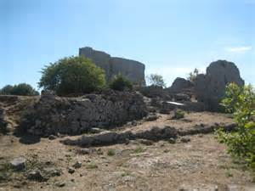
THE TROJAN WAR: PART 7: THE RETURNS
Nostoi: lost epic that chronicles the returns of the Greek leaders to their homes
Gods were angry with the destruction and sacrilegious acts committed in their temples and decided that few should return to Greece
Nestor
set sail with Diomedes and Menelaus
had the best conduct of the Achaean leaders; safest journey home
took no spoils for himself
later colonized Metapontium in Southern Italy

Slide 57
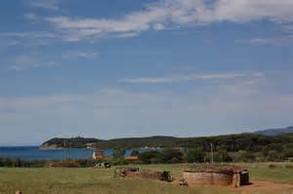
THE RETURNS (cont’d)
Menelaus
set sail with Nestor but a storm destroyed all but five (5) of his ships
reached Egypt and spent eight years wandering over North Africa before returning to Sparta
transported to the Elysian Fields at death where he and Helen live forever
Diomedes
reached Argos but lost much of his fleet to Nauplius who decoyed many of the ships onto the rocks using a false beacon
Aegialia, his wife, committed adultery due in part to Nauplius’ story of Trojan concubines and in part to the vengeance of Aphrodite for the wound she received from Diomedes

Slide 58
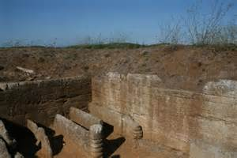
THE RETURNS (cont’d)
Diomedes (cont’d)
wandered over the Mediterranean
settled in Italy and refused to aid the Italians against the Trojans when Aeneas reached Latium
buried on an island off the coast of Apulia in Southern Italy
followers were changed into sea birds (shearwaters) that sprinkle the tomb with water and are hostile to all except Greeks
worshiped as a hero in many areas esp. around the Adriatic Sea
Idomeneus
Meda, his wife, committed adultery with another Cretan, Leucus
Leucus then killed her and her daughter taking over 10 of the 100 cities on Crete
Idomeneus was unable to unseat Leucus and was driven from Crete

Slide 59
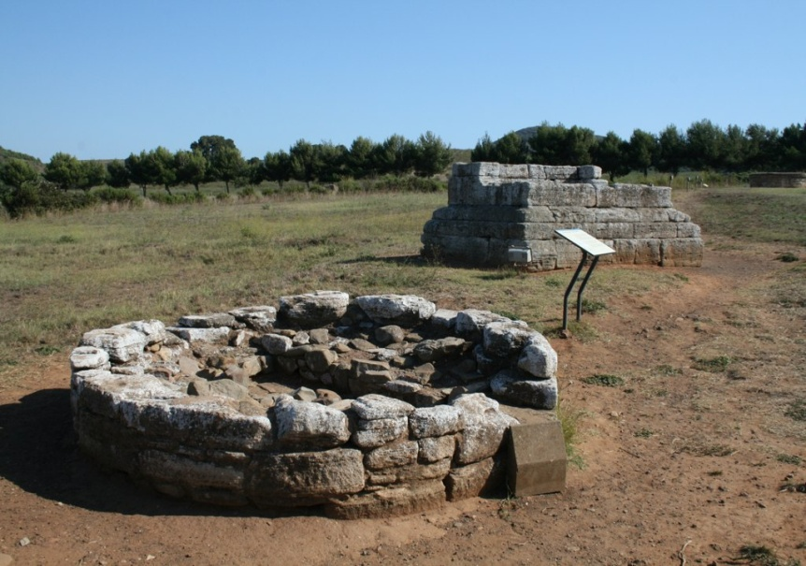
THE RETURNS (cont’d)
Idomeneus (cont’d)
The Aeneid states that during a storm on his return he offered to sacrifice the first thing that he saw to Poseidon if he reached shore safely
The first thing that he sees upon his safe return is his son whom he sacrificed
a pestilence struck Crete which the Cretans took as punishment for Idemeneus’ cruelty and exiled him from Crete
settled in Calabria in Southern Italy
Philoctetes
driven from his own city of Melboea and settled in Campania
inaugurated a cult of Apollo the Wanderer to whom he dedicated the bow of Heracles
died fighting a Southern Italian tribe; worshiped as a hero

Slide 60
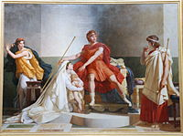
THE RETURNS (cont’d)
Neoptolemus
warned by Thetis not to return by sea
took the long land route to Greece
went to Epirus rather than Phthia
had a son by Andromache, Molossus, to who he gave the throne of Epirus
went to Phthia when Peleus died and left Andromache with Helenus
married to Hermione, daughter of Menelaus and Helen, who had been betrothed to Orestes
killed by Orestes at Delphi because his marriage to Hermione
buried within the precinct of Apollo’s temple (a unique honor among Greek heroes
Alexander the Great claimed the lineage of Achilles through him

Slide 61
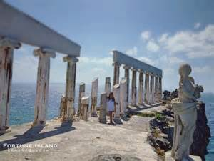
THE RETURNS (cont’d)
Ajax Oileus (the Lesser)
sailed with Agamemnon from Troy
Athena raised a violent storm off the island of Tenos wrecking many of the ships of both leaders, including that of Ajax for the rape of Cassandra on her altar
swam to a nearby rock to escape and boasted that the gods could not prevent his escape from the dangers of the sea
Poseidon struck the rock with his trident
hurled into the sea and drowned

Slide 62
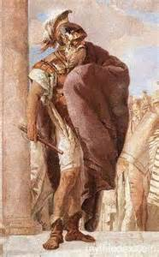
THE RETURNS (cont’d)
Agamemnon
lost many more ships due to the treachery of Nauplius in revenge for Palamedes’ death
finally reached Mycenae only find more of Nauplius’ treachery by causing Clytemnestra to commit adultery with his cousin Aegisthus
failed to heed the warning of Cassandra
murdered by Clytemnestra and Aegisthus while bathing previous to the feast honoring his return

Slide 63
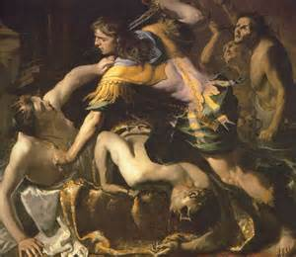
THE RETURNS (cont’d)
Agamemnon (cont’d)
Orestes was also to be killed to prevent any danger when he was of age
sent by his sister Electra to his uncle Strophius where he formed a friendship with his son Pylades
Electra frequently reminded Orestes through messengers of his duty to avenge their father’s murder
consulted Delphi when of age which confirmed his role
returned to Mycenae disguised as a messenger from Strophius carrying an urn with the “ashes” of Orestes
visited his father’s tomb and made the appropriate sacrifices

Slide 64
THE RETURNS (cont’d)
Agamemnon (cont’d)
mistaking Electra for a servant he showed her the urn to protect his identity
Electra grabbed the urn thinking her brother dead and wept until they recognized each other
Orestes slew Aegisthus and Clytemnestra
the murder of Clytemnestra aroused the Furies although her death was the will of the gods
The Furies pursued from land to land with Pylades by his side
second appeal to Delphi instructed him to return a statue of Artemis that had fallen from heaven near Tauri
the inhabitants were barbarous and would have sacrificed them to Artemis but were save by the priestess, Iphigenia

Slide 65
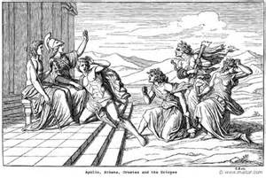
THE RETURNS (cont’d)
Agamemnon (cont’d)
Orestes took refuge with Athena in Athens
Athena provided protection and appointed the court of the Areopagus to decide his fate
Apollo takes the side of Orestes; the Furies, Clytemnestra
both sides present their cases and Orestes is acquitted by the rule of a tie with Athena casting the tying vote
The Furies relent and are called the Venerable Ones by Aeschylus (Orestia) or the Kindly Ones by Euripides (Orestes)
Thus ends the saga of the Trojan War with Odysseus and Aeneas being covered separately.

Slide 66
REFERENCES
Gayley, Charles Mills. The Classical Myths in English Literature and in Art. New York: Blaisdell Publishing Company, 1963.
Hamilton, Edith. Mythology. New York: Grand Central Publishing, 2011.
Morford, Mark P. O. Classical Mythology. New York: Longman, Inc., 1977.Ovid. Metamorphoses. New York: Signet Classics, 2009.
Tripp, Edward. The Meridian Handbook of Classical Mythology. New York: Penguin Books, 1974.
www.wikipedia.org/greek mythology. 2014.

